Slide 1
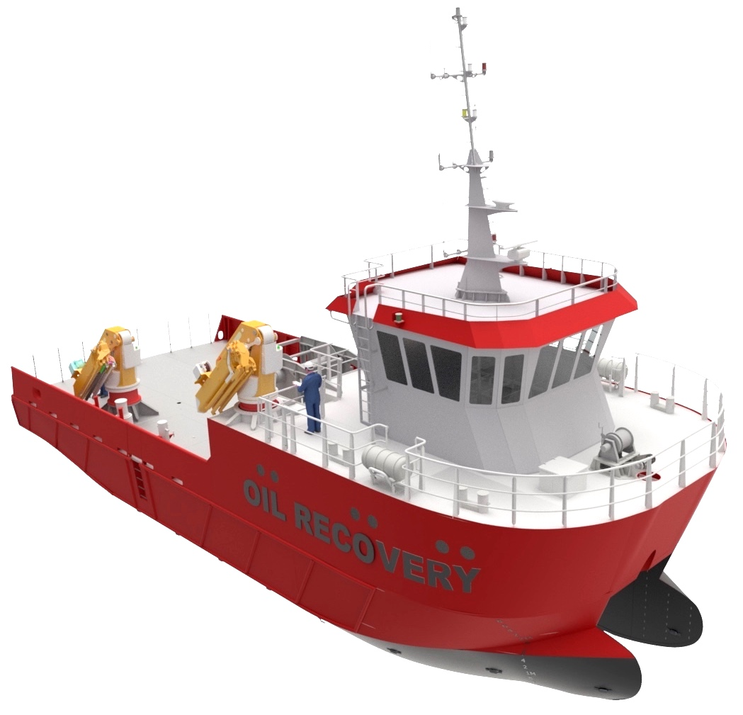


SIDC group of partners
www.sidc.eu

Slide 2
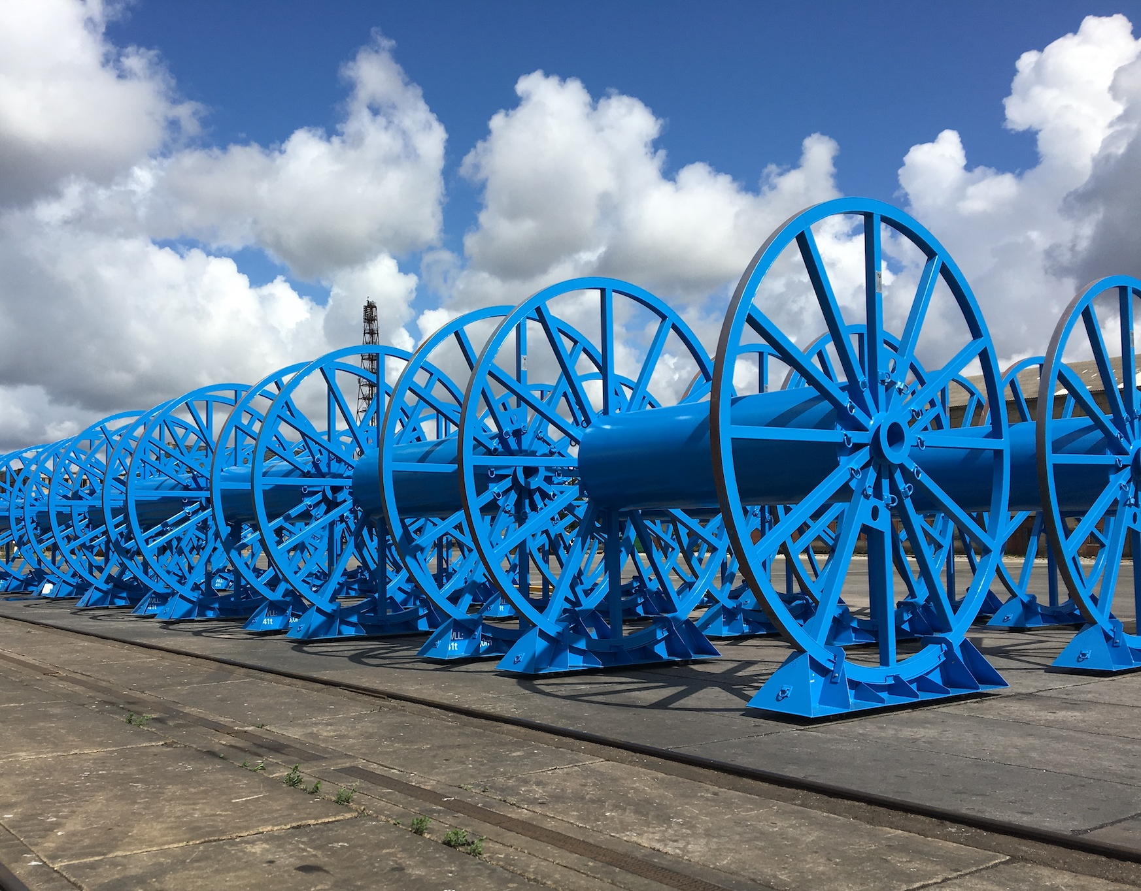
ABOUT US
Founded in 2010, SIDC LT started as a professional staff leasing agency. To keep up with market demands, we eventually expanded the range of our activities by adding project implementation (contracting and subcontracting) to our temporary employment services.
SIDC LT key areas of specialization: construction, shipbuilding and modernization, manufacture of offshore metal structures, project management and more.
SIDC LT manufacturing sites are currently located at Klaipeda Seaport. The construction of a new manufacturing plant has begun. This new area will allow us to meet growing customers‘ needs.

Slide 3
ABOUT US
Founded in 2010, SIDC LT started as a professional staff leasing agency. To keep up with market demands, we eventually expanded the range of our activities by adding project implementation (contracting and subcontracting) to our temporary employment services.
SIDC LT key areas of specialization: construction, shipbuilding and modernization, manufacture of offshore metal structures, project management and more.
SIDC LT manufacturing sites are currently located at Klaipeda Seaport. The construction of a new manufacturing plant has begun. This new area will allow us to meet growing customers‘ needs.

Slide 4

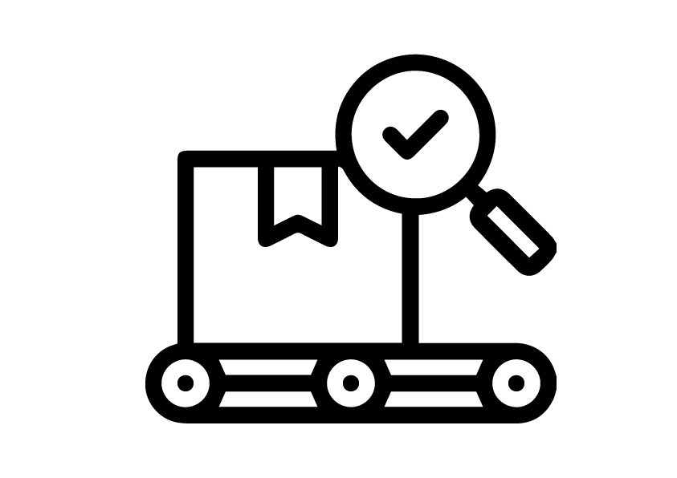

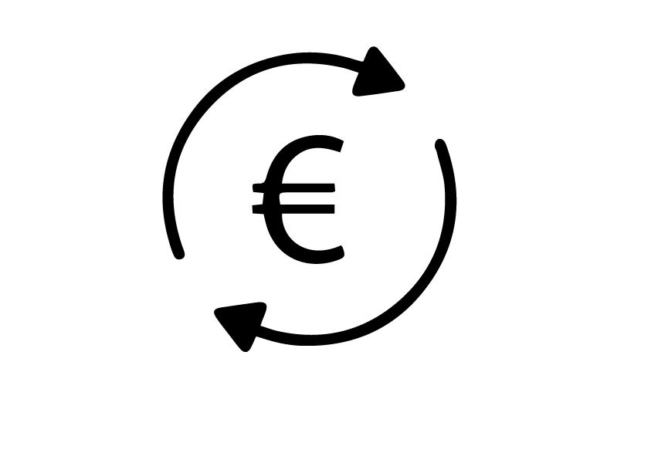
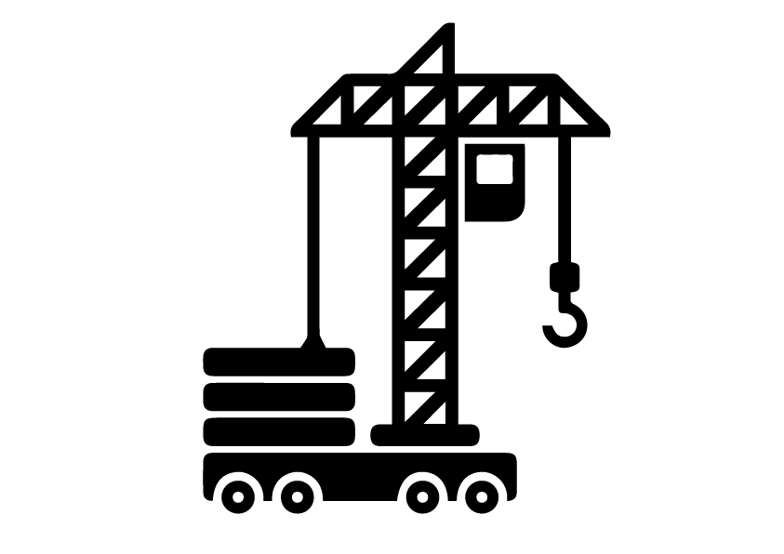
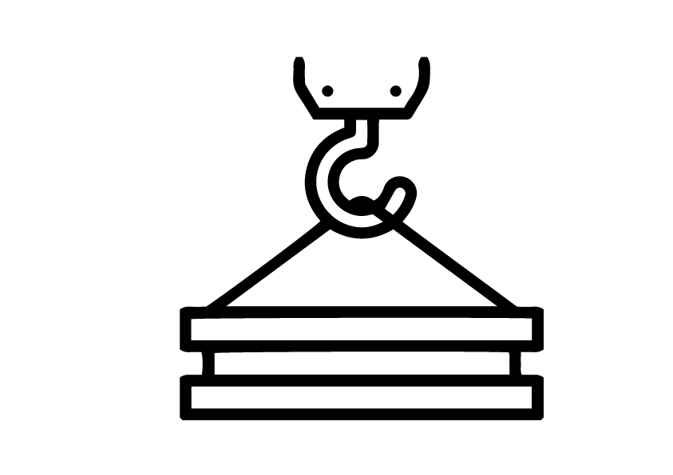
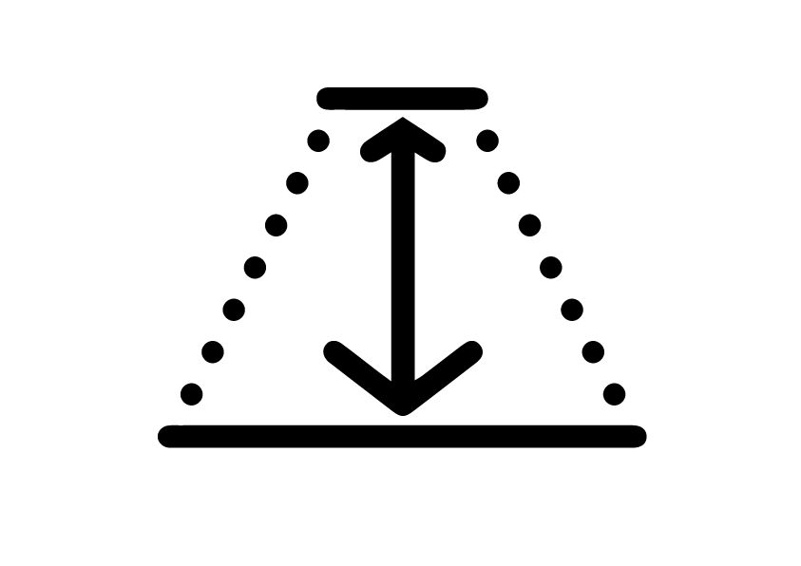

KEY FACTS
6500 sq. m.
Production
area
300-500 t
Production per
month
3
Manufacturing
sites
15 M
Annual
Turnover 2018
100 t
Loading capacity
of the outside crane
10-30 t
Loading capacity
of the inside cranes
16 m
Depth of the
embankment
600
Number of
employees

Slide 5
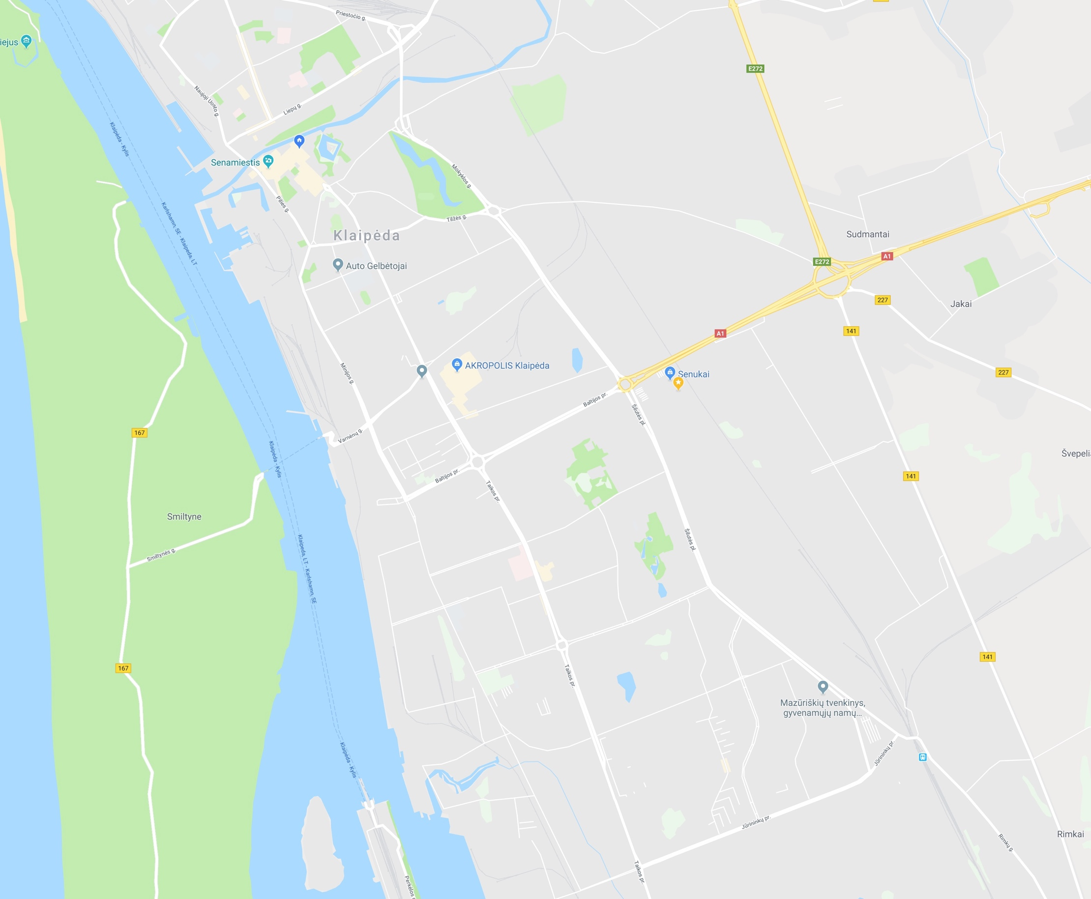

WORKSHOPS
FIRST AND SECOND WORKSHOPS, 2000 m²
NEW WORKSHOP, 3500 m²
THIRD WORKSHOP, 1000 m²
PLUS TWO PAINTING CHAMBERS
12 x 12 x 10 meters

Slide 6
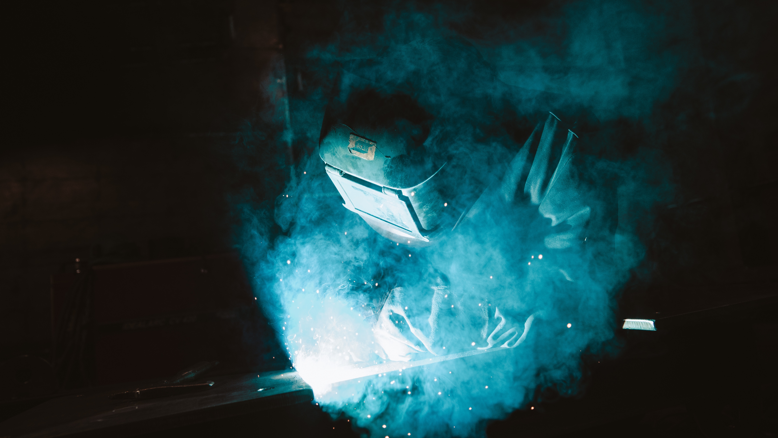
SECTORS
SHIPBUILDING & MODERNIZATION
OFFSHORE
INDUSTRY
STEEL
STRUCTURES

Slide 7
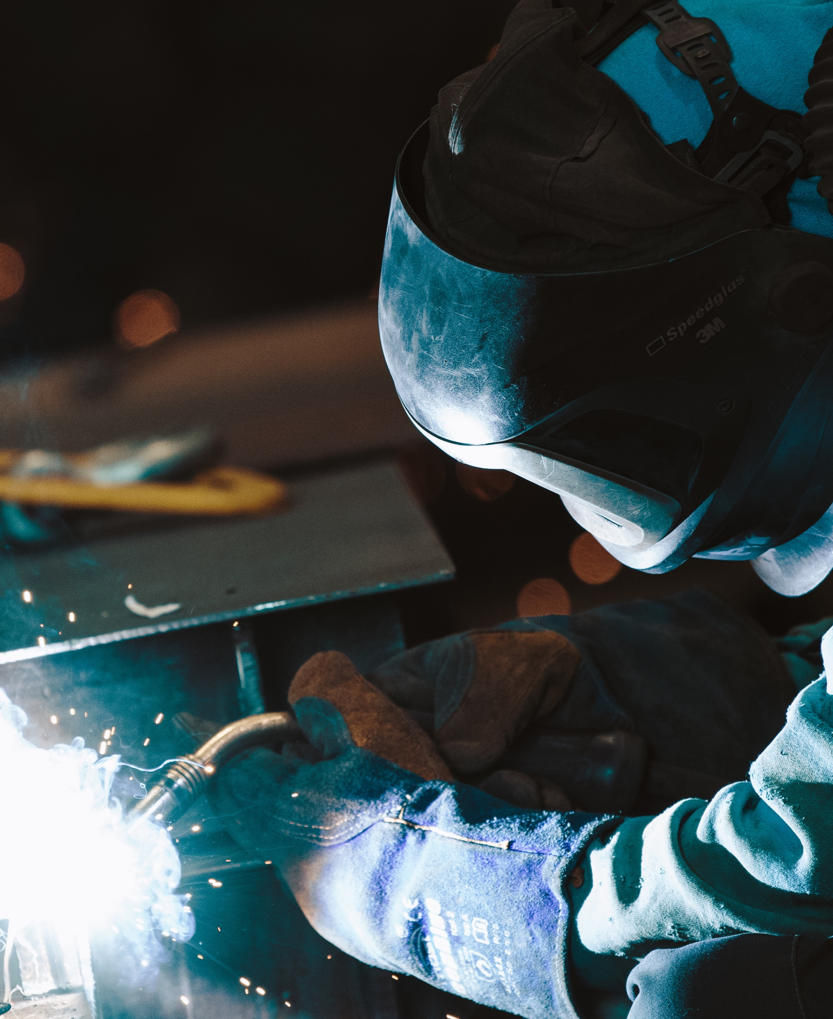
SHIPBUILDING & MODERNIZATION
We work with local and international clients, which trust us and give challenging projects: from shipbuilding to different modernization works. Needless to say, that one of the best feelings for us is to see our constructed ships floating in water.
Assembly of sections.
Outfitting works.
Electricity installation.
Production and installation of pipelines.
Painting work.
Engineering.

Slide 8
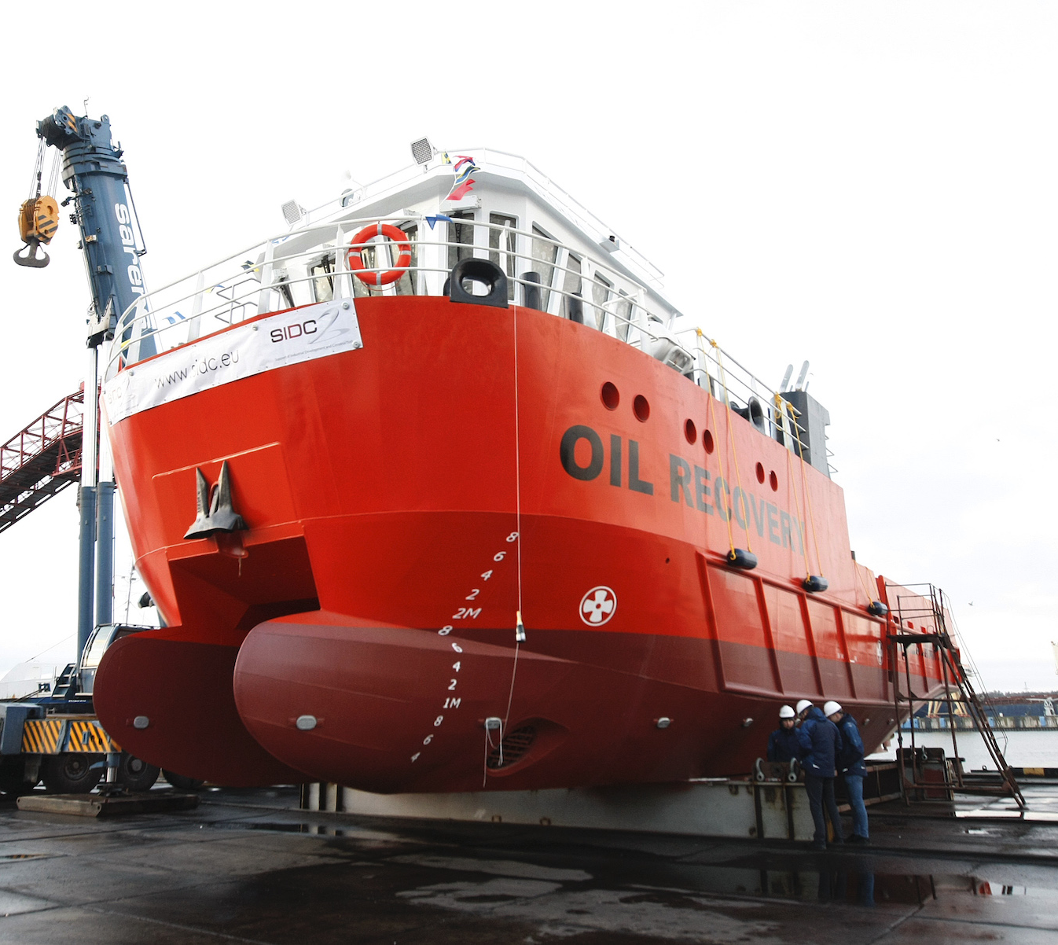
VESSEL “RUNA”
A stable 2-hull catamaran for cleaning small oil spills at sea. It was ordered by a Norwegian company. Runa was built by 60 members of our team. This vessel is the pride of the company and the starting point for our further development.
Duration: 10 months
Input: 160 t of metal
Dimensions:
length – 25 m, width – 10 m, height – 8 m.
Other:
2 diesel engines, 2 diesel generators for
generating electricity, 2 cranes.

Slide 9
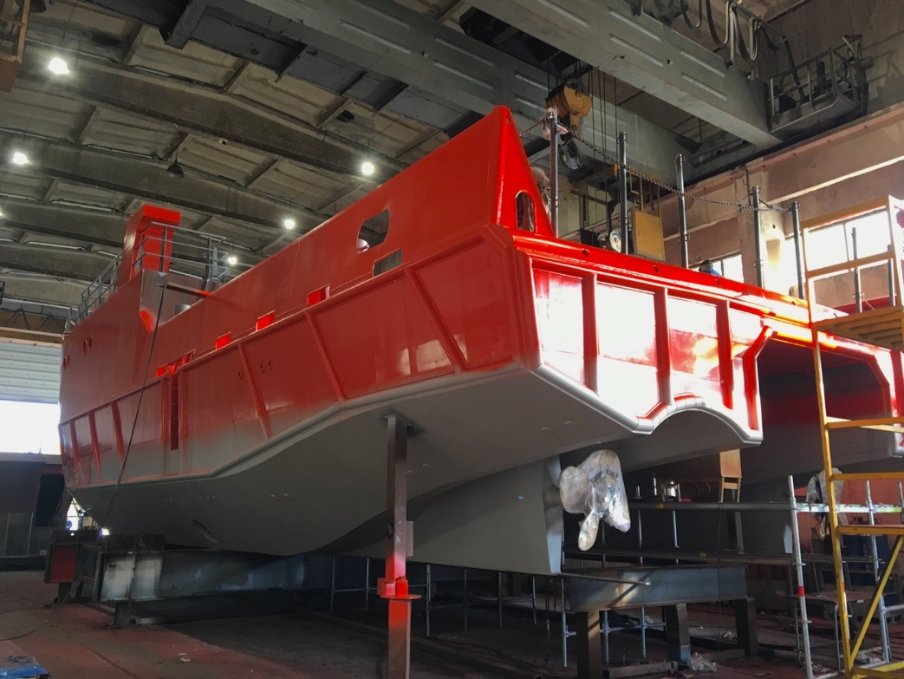
VESSEL “RUNA”

Slide 10
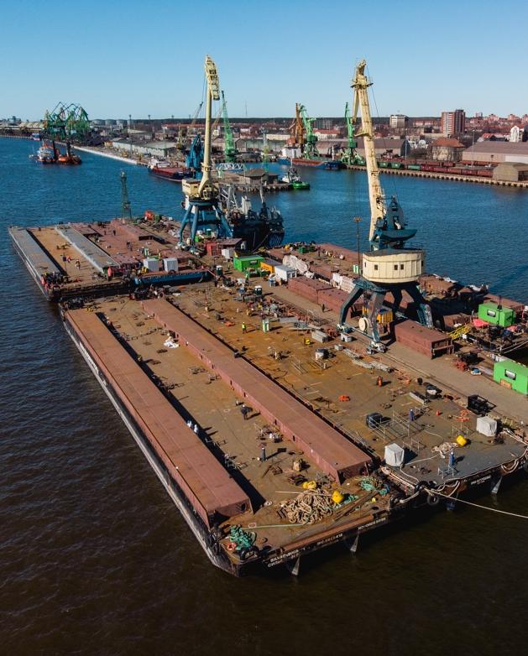
MODERNISATION OF SEVEN BARGES
Modernisation and installation of casings. By listening to the customer’s needs and through our many years’ of experience, we were able to renew these barges flawlessly – from structural changes to cosmetic painting. The work was done in a very short period of time, with a team of 300 people working on the project.
Duration: 4 months
Input: 2000 t of metal
Total output: 84 casings
Length of the one barge: 89 m

Slide 11
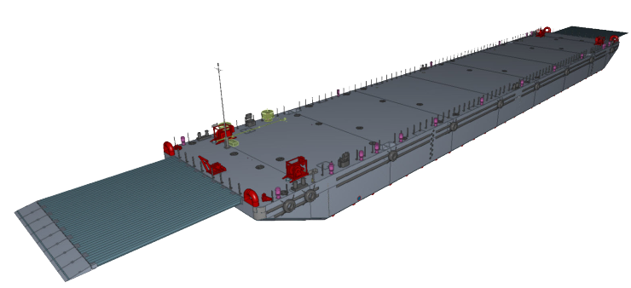
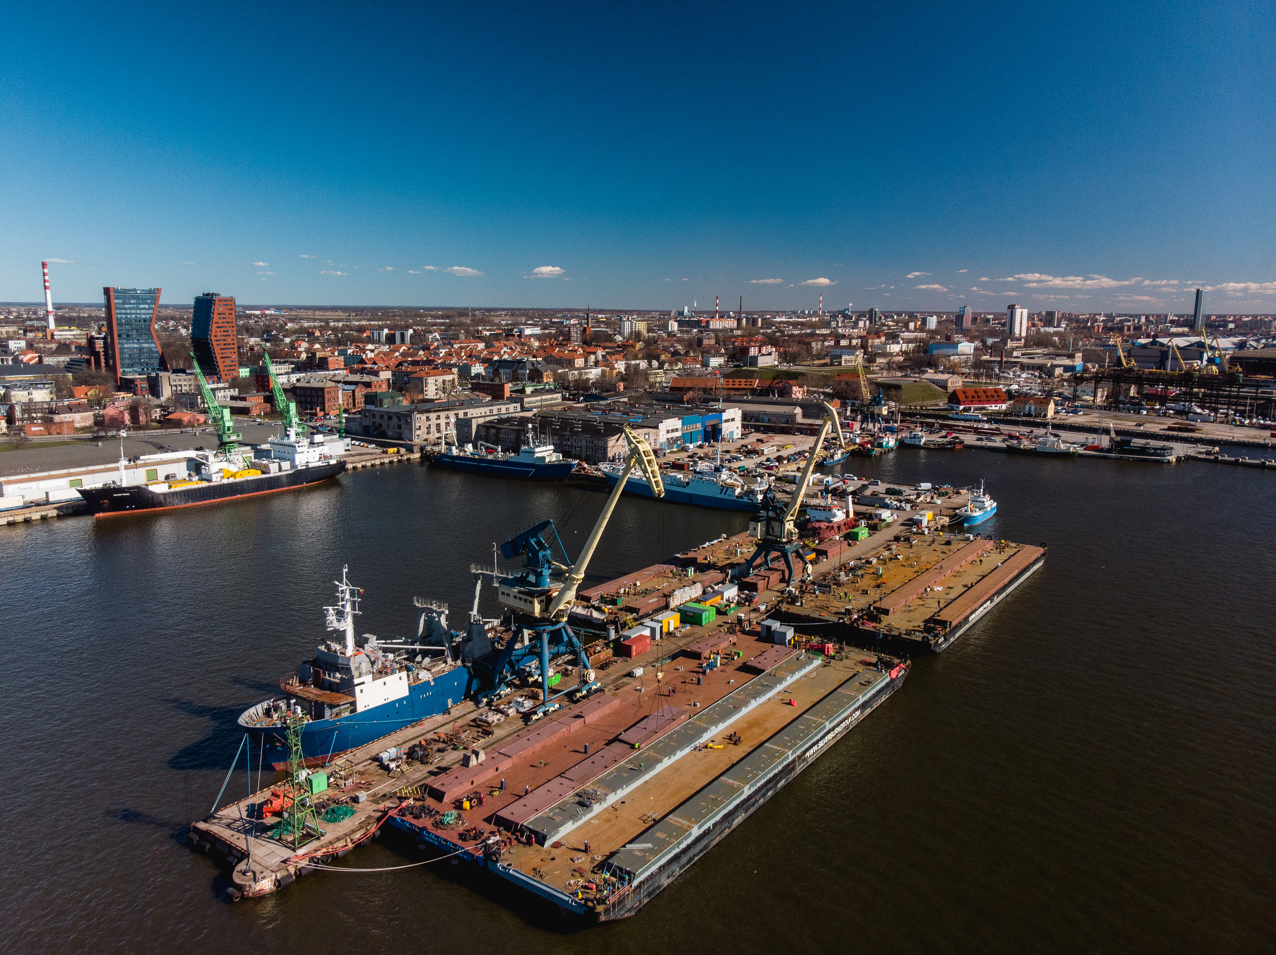
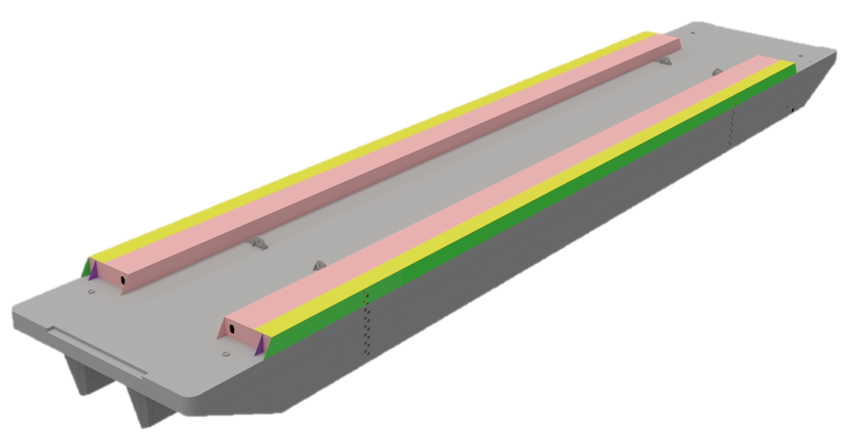
MODERNISATION OF SEVEN BARGES

Slide 12
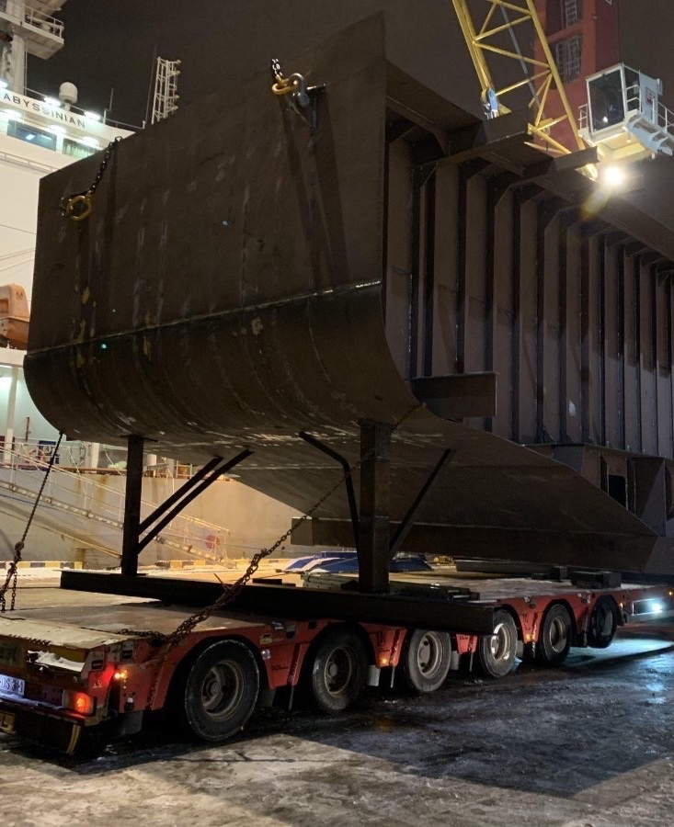
VESSEL INSERT
This was a challenge that our experienced team handled without any hassle. The vessel was extended by 7 meters, with an insert fitted in the middle, while matching all the details of the existing ship hull. Such projects are only possible thanks to the precision and attention to detail provided by our engineers.
Duration: 1 month
Input: 50 t of metal
Dimensions: width – 7 m, length– 10 m, height – 7m.

Slide 13
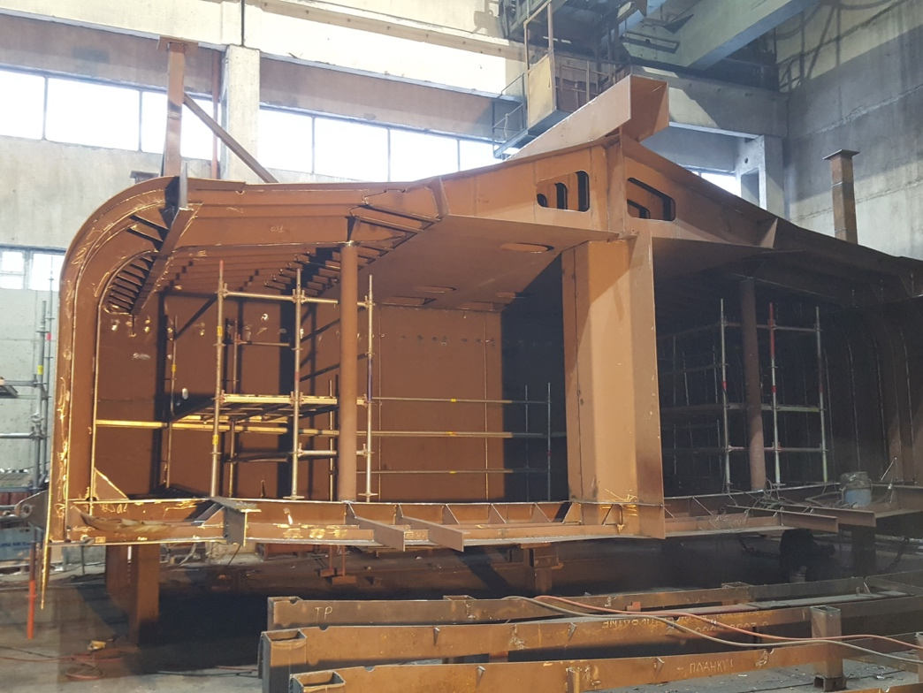
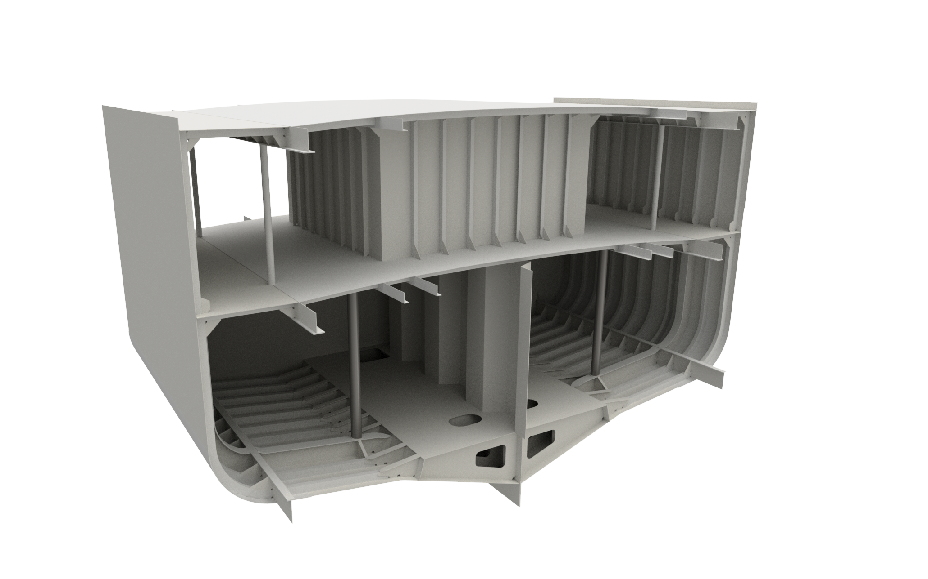
VESSEL INSERT

Slide 14
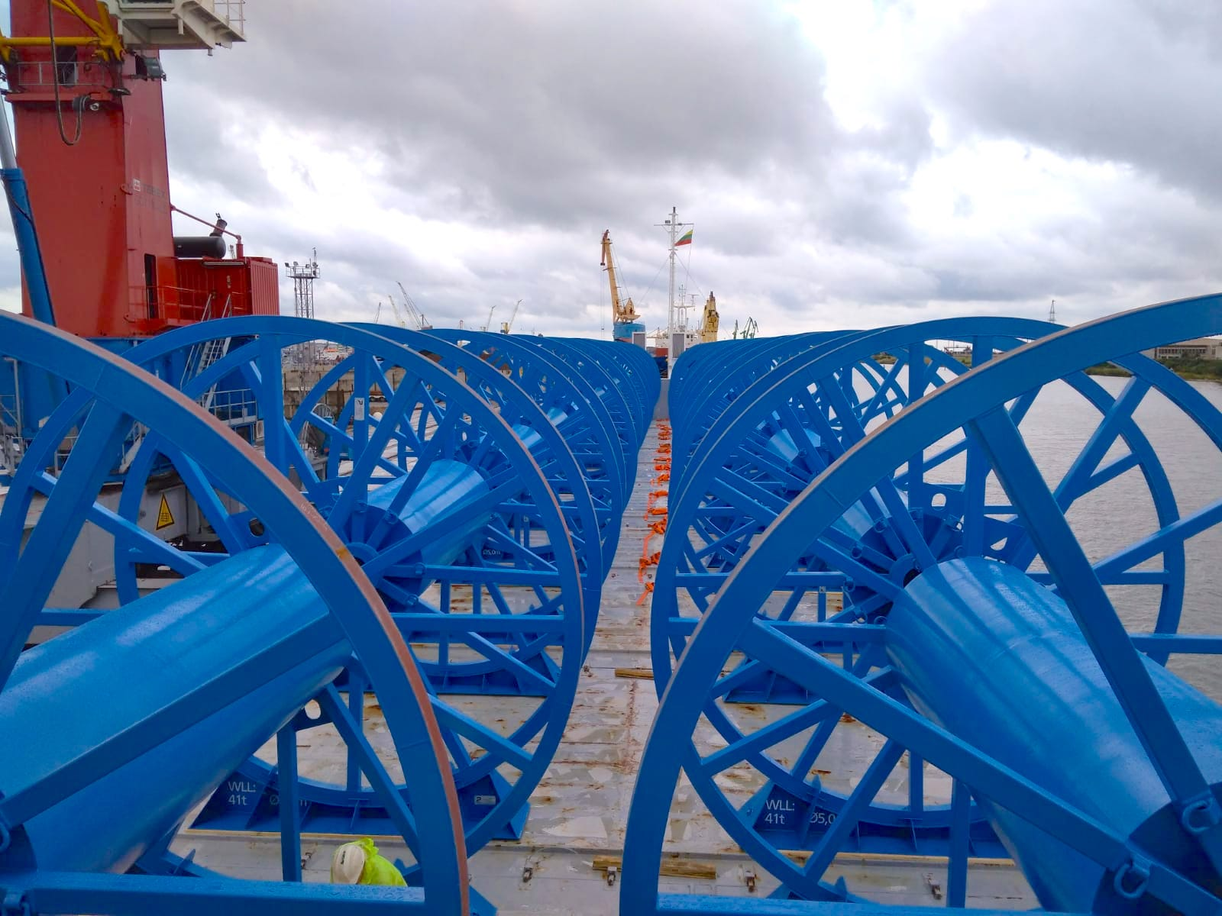
OFFSHORE
Give your idea – our team will design and create it in the right metal shape for. We have the personnel and experience to get the job done right.
Reels.
Cable storage baskets.
Turn tables.
Lifting beams.
Platforms.
Platform assemblies.
Etc.

Slide 15
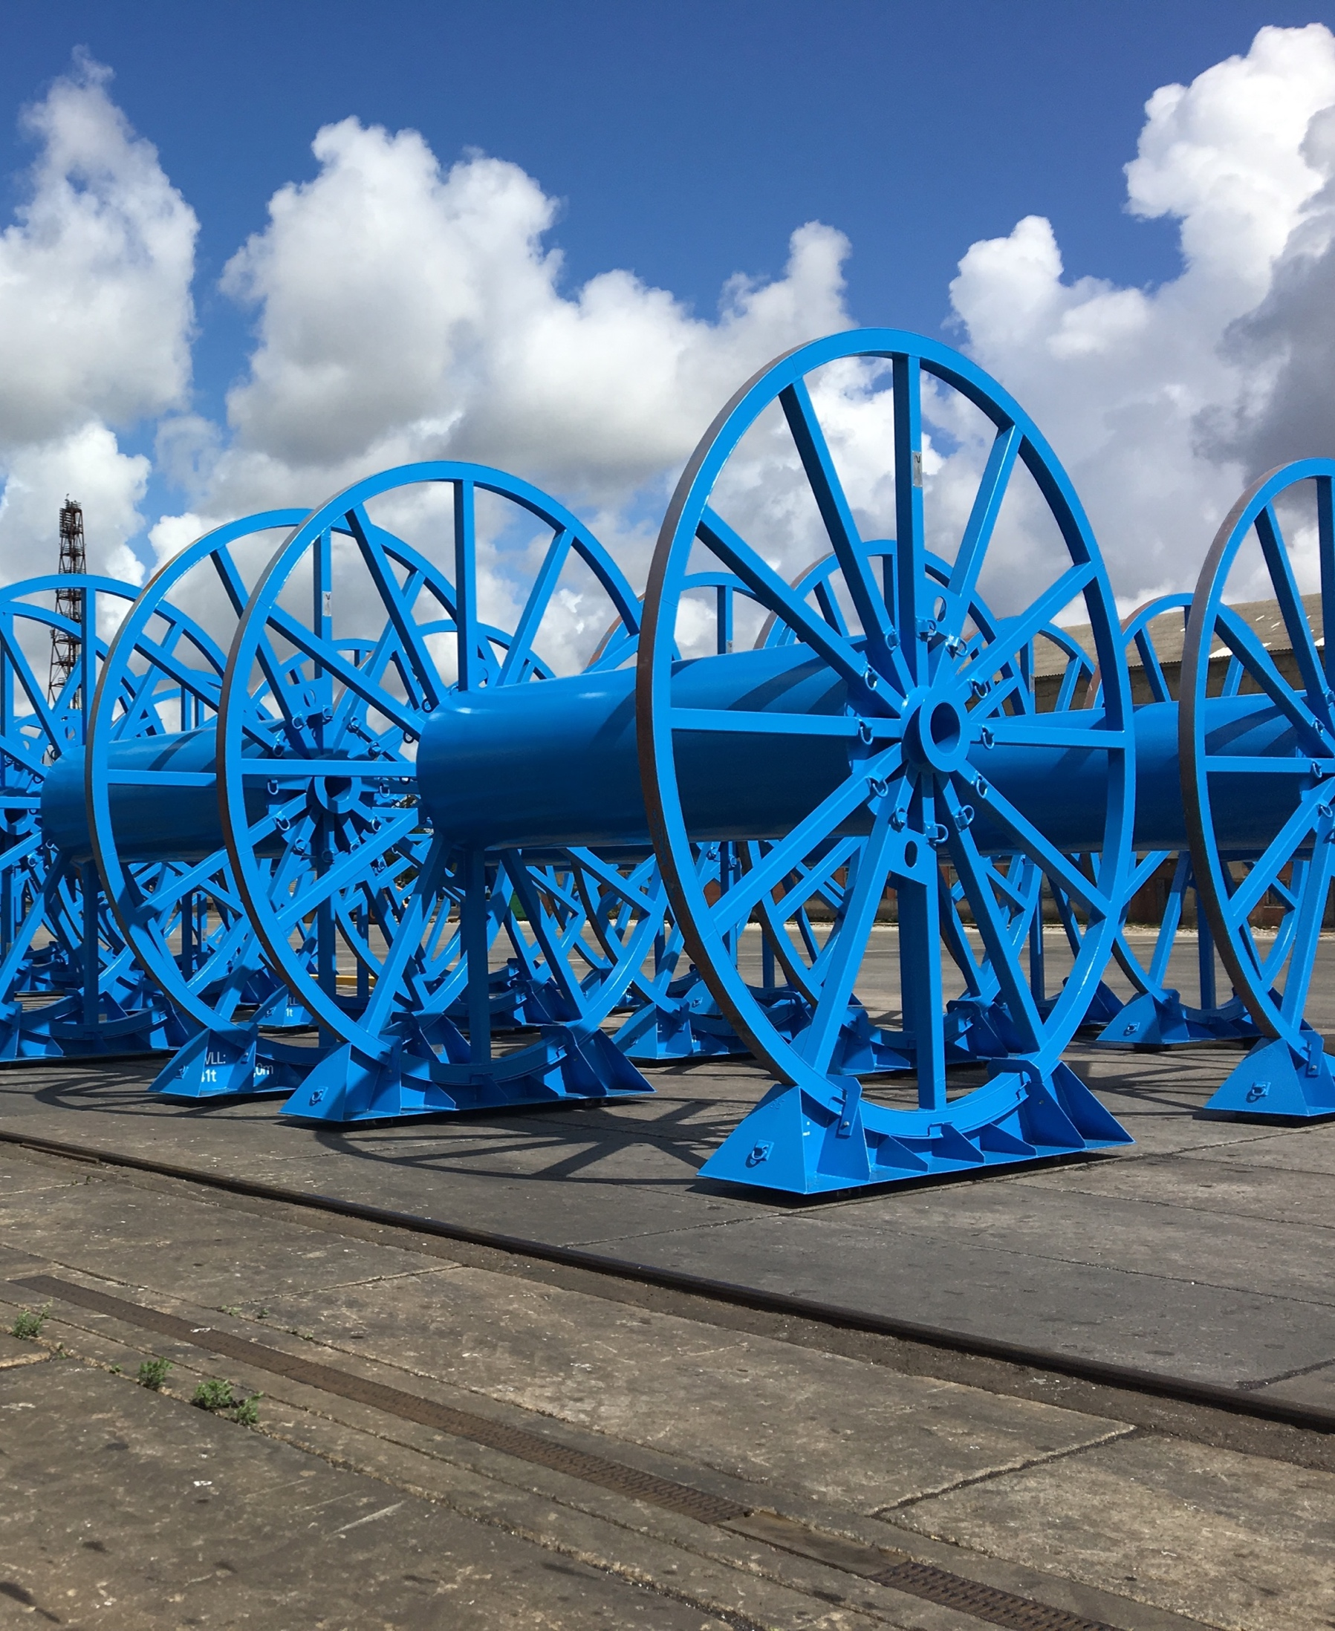
REELS
We design, manufacture and assemble reels of different sizes, and of both standard and complex structures. Our customised design solutions reduce time and transport costs.
Diameter: from 4 m to 11 m
Weight: from 3 t to 60 t

Slide 16
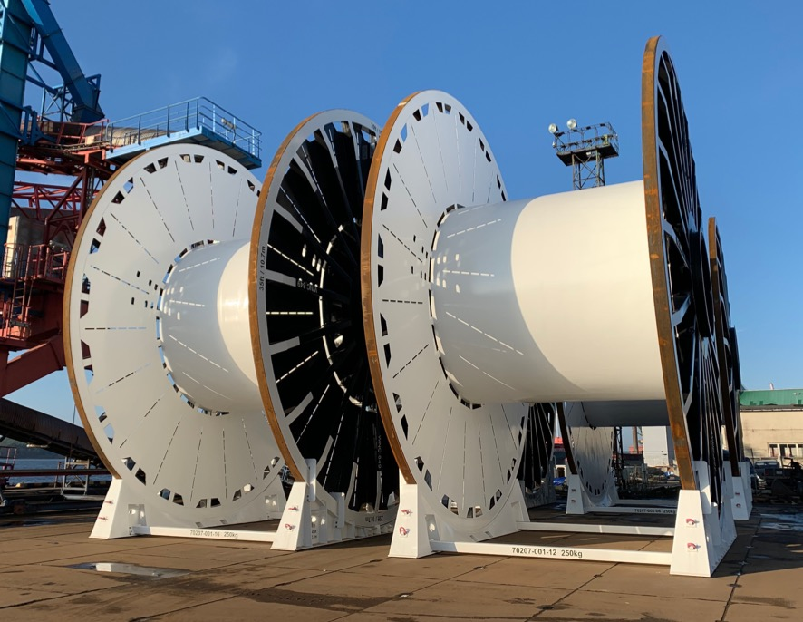
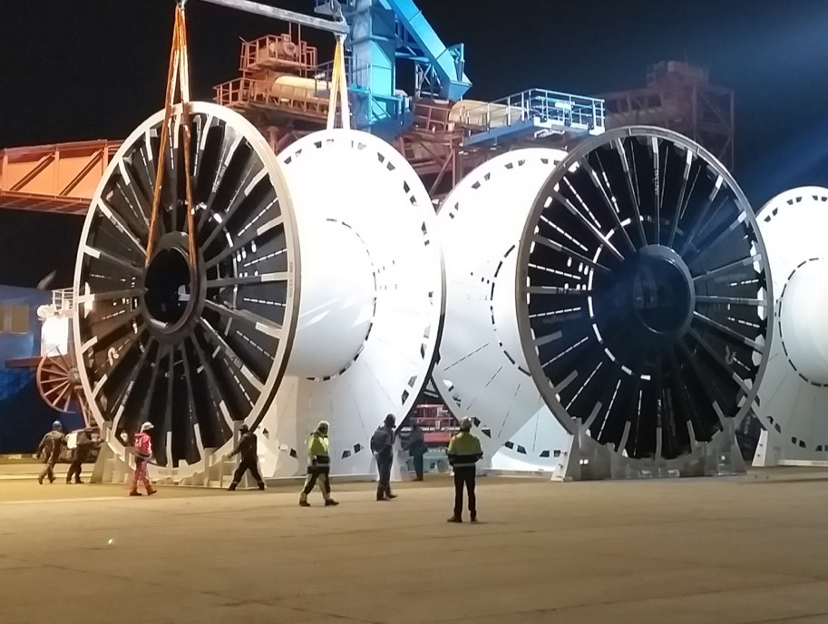
REELS

Slide 17
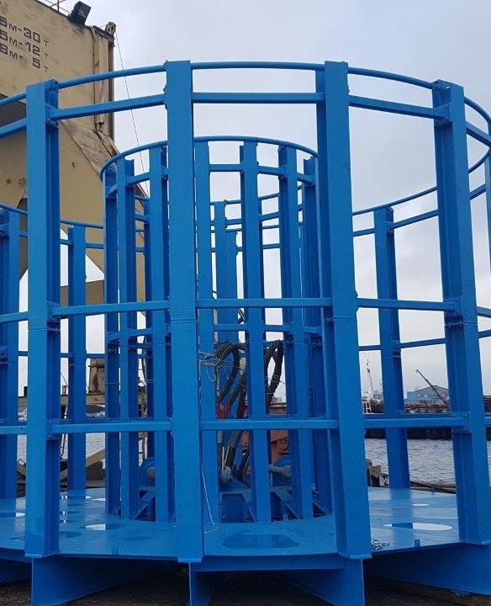
BASKETS
Using innovative technologies, we design and manufacture safe, reliable baskets of various diameters. The baskets can be adapted to individual needs, for the winding and storage of various wires and other flexible products.
Diameter: to 20 m

Slide 18
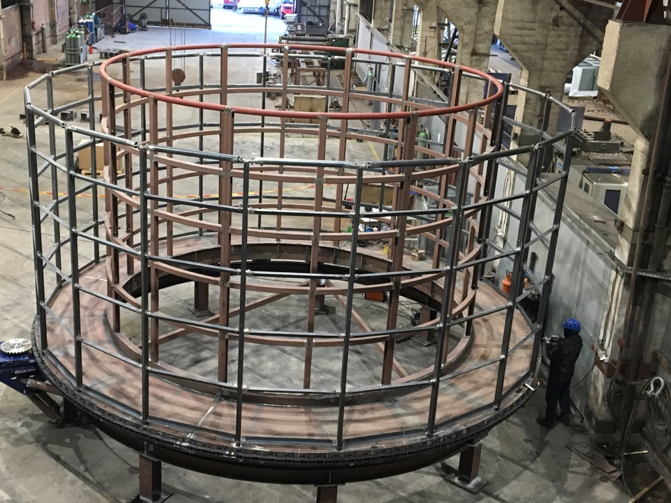
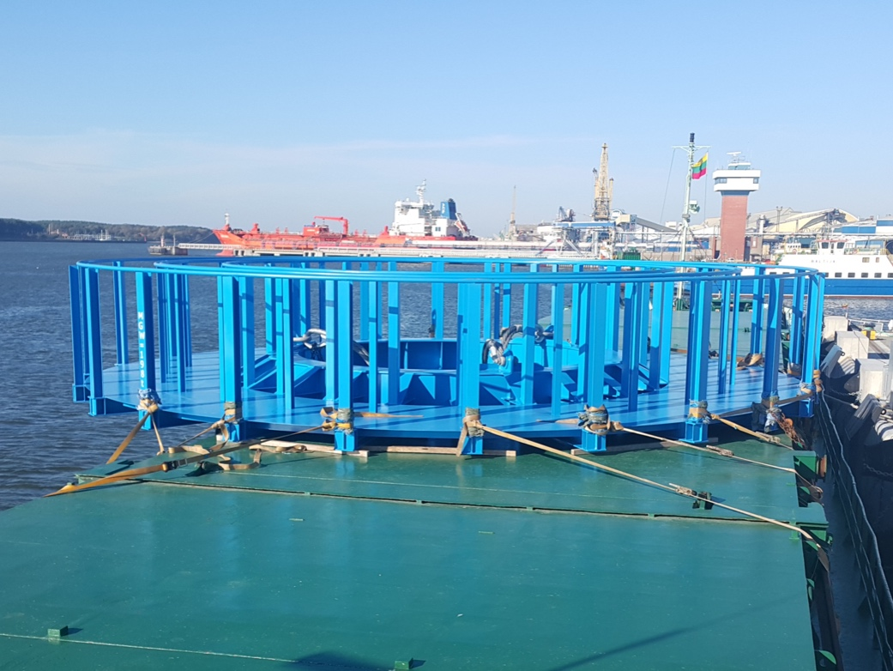
BASKETS

Slide 19
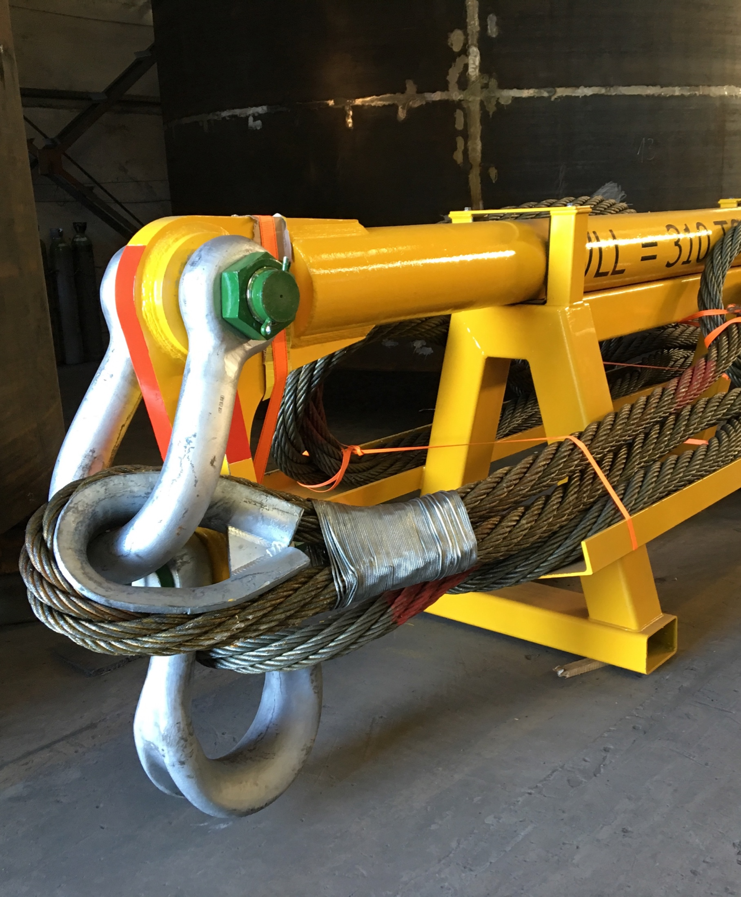
MANUFACTURING AND TESTING
OF LIFTING BEAM EQUIPMENT
We design and manufacture lifting beams using state-of-the-art engineering solutions. We pay a great deal of attention to safety – we test equipment according standards and client needs .

Slide 20
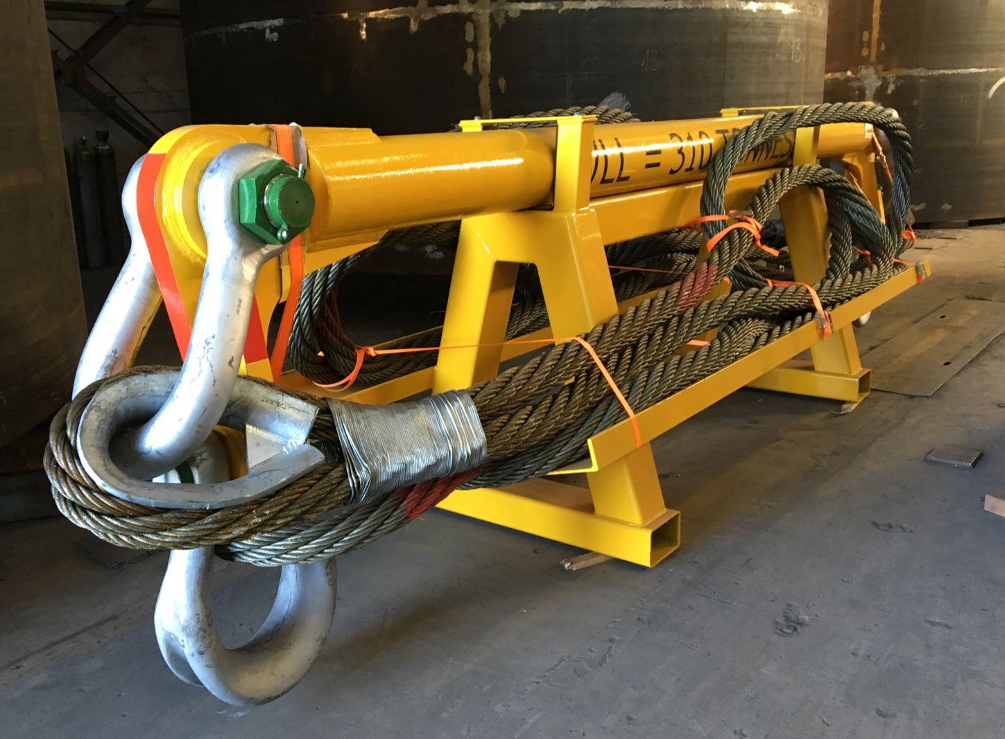
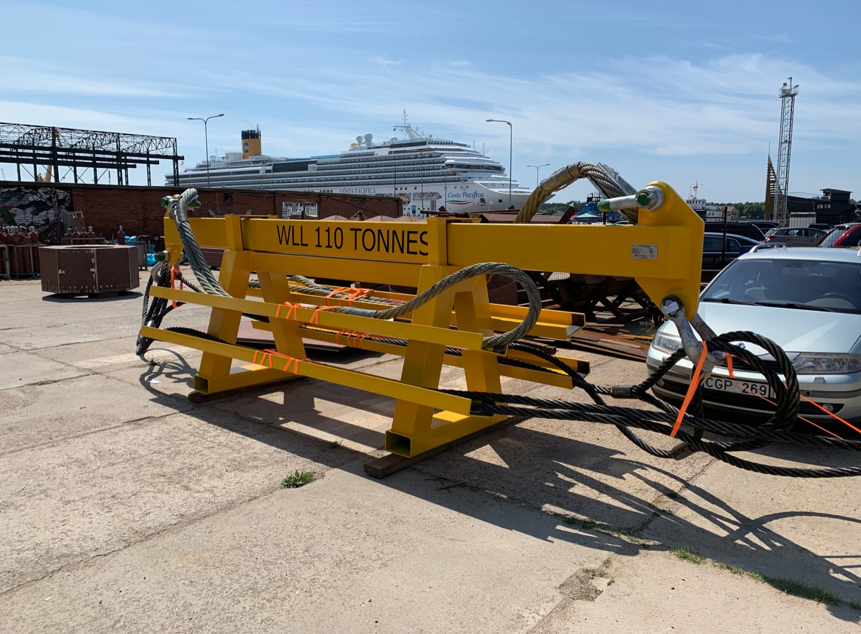
MANUFACTURING AND TESTING
OF LIFTING BEAM EQUIPMENT

Slide 21
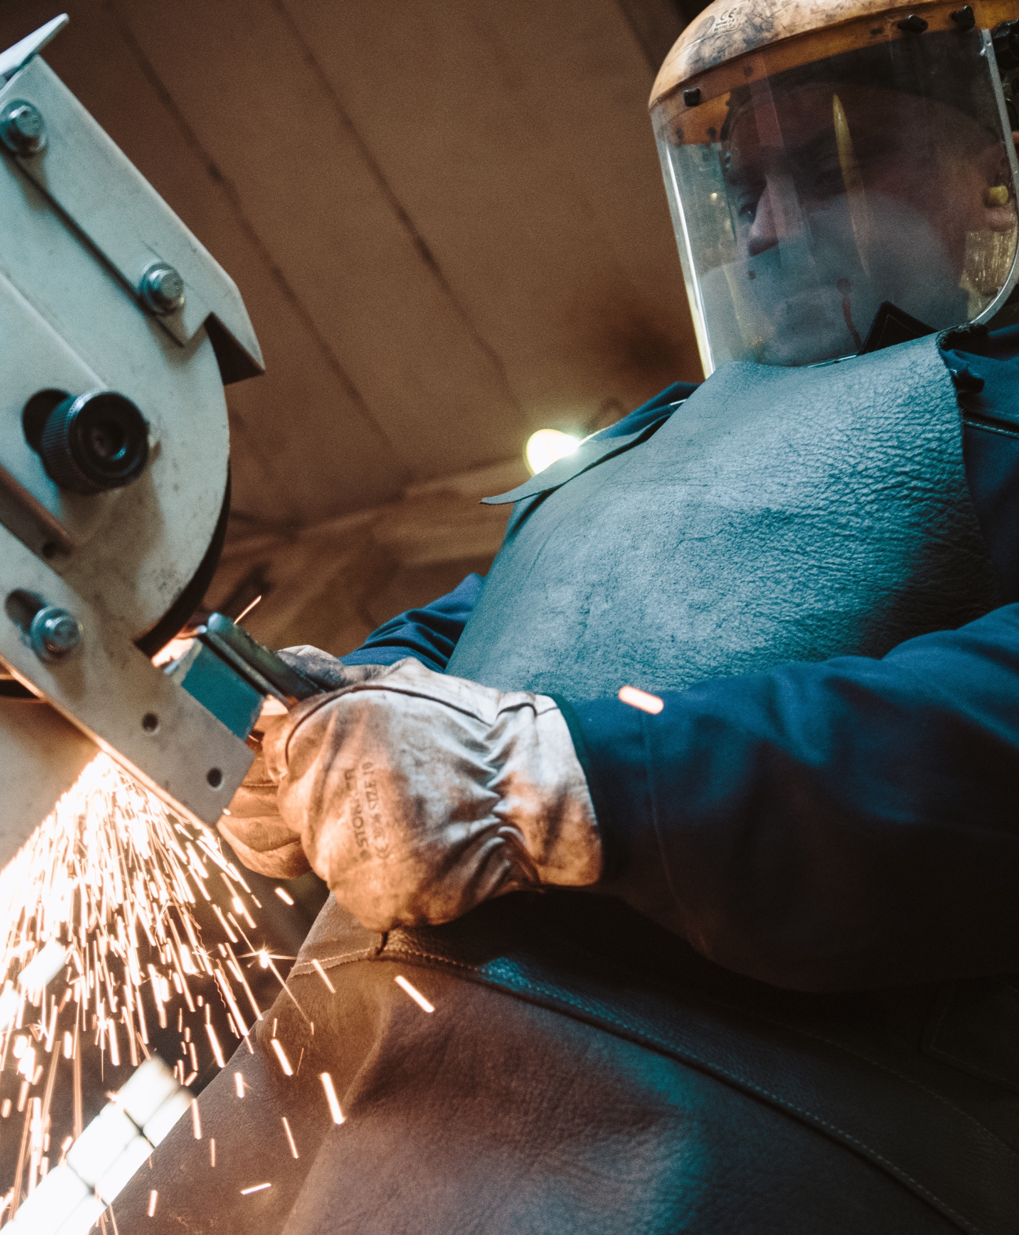
INDUSTRY
Our team has a long-term experience in constructing heavy industrial facilities across a broad range of specialized market segments. This experience made it possible to offer integrated construction solutions for several of the world’s leading industries, oil & gas, or energy production companies.
Storage/processing tanks.
Silo storage tanks.
Twist-lock handling systems.
Industrial filters.
Etc.

Slide 22
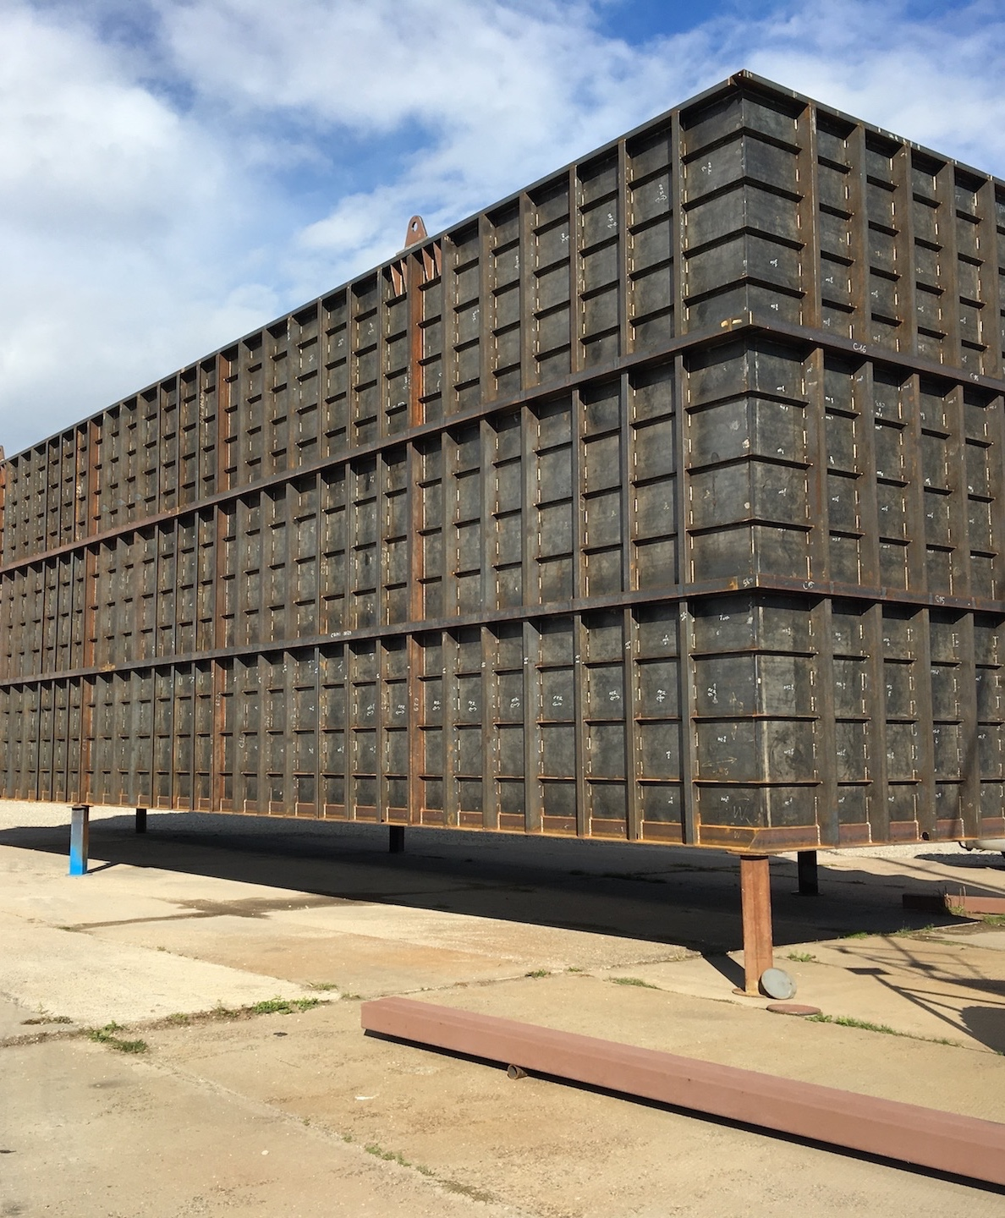
FILTERS FOR BIOFUEL POWER PLANT
The 4 largest filters in Europe for removing polluted air or gas from particulate matter have been built here. The customer was a new biomass-fired heat and bio power plant in Denmark.
Weight of a filter: 93 t
Length of a filter: 25 m
Input: 400 t of metal

Slide 23
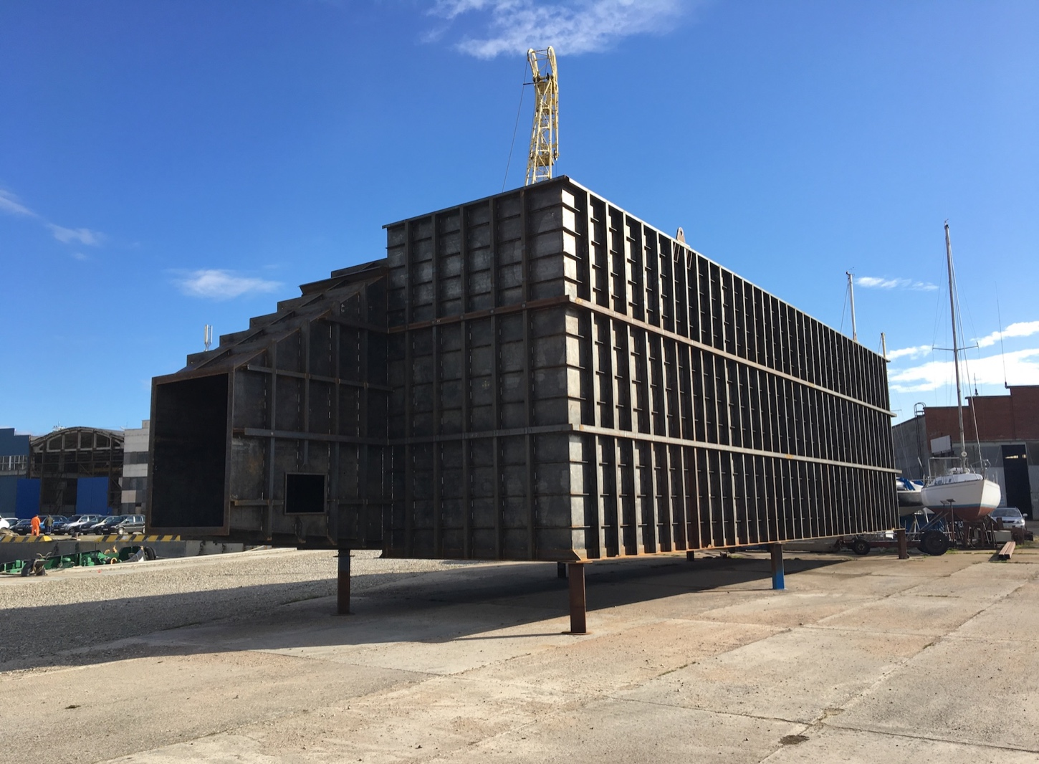
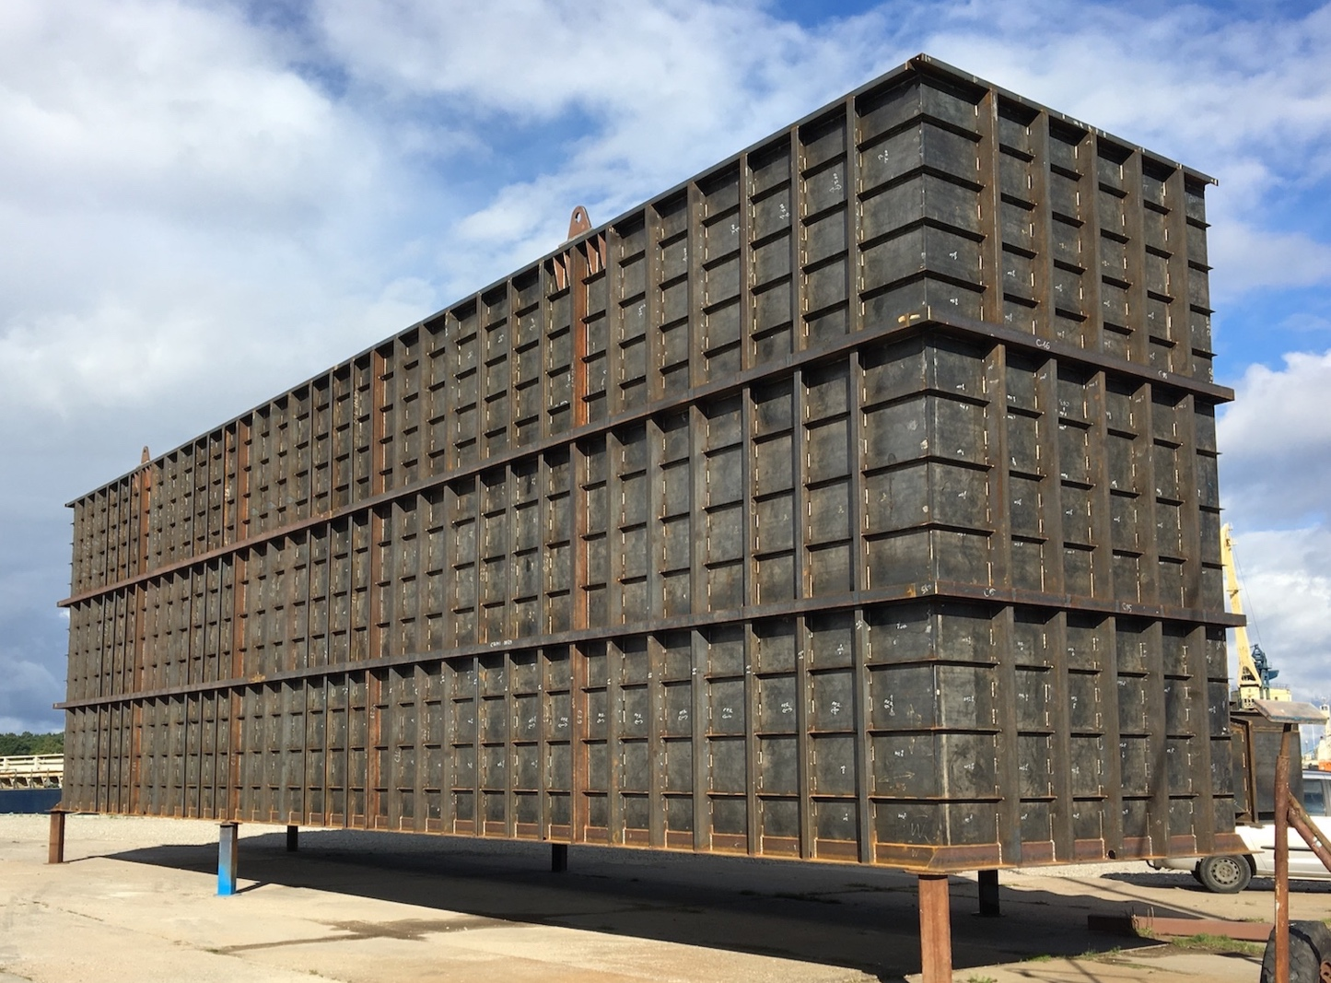
FILTERS FOR BIOFUEL POWER PLANT

Slide 24
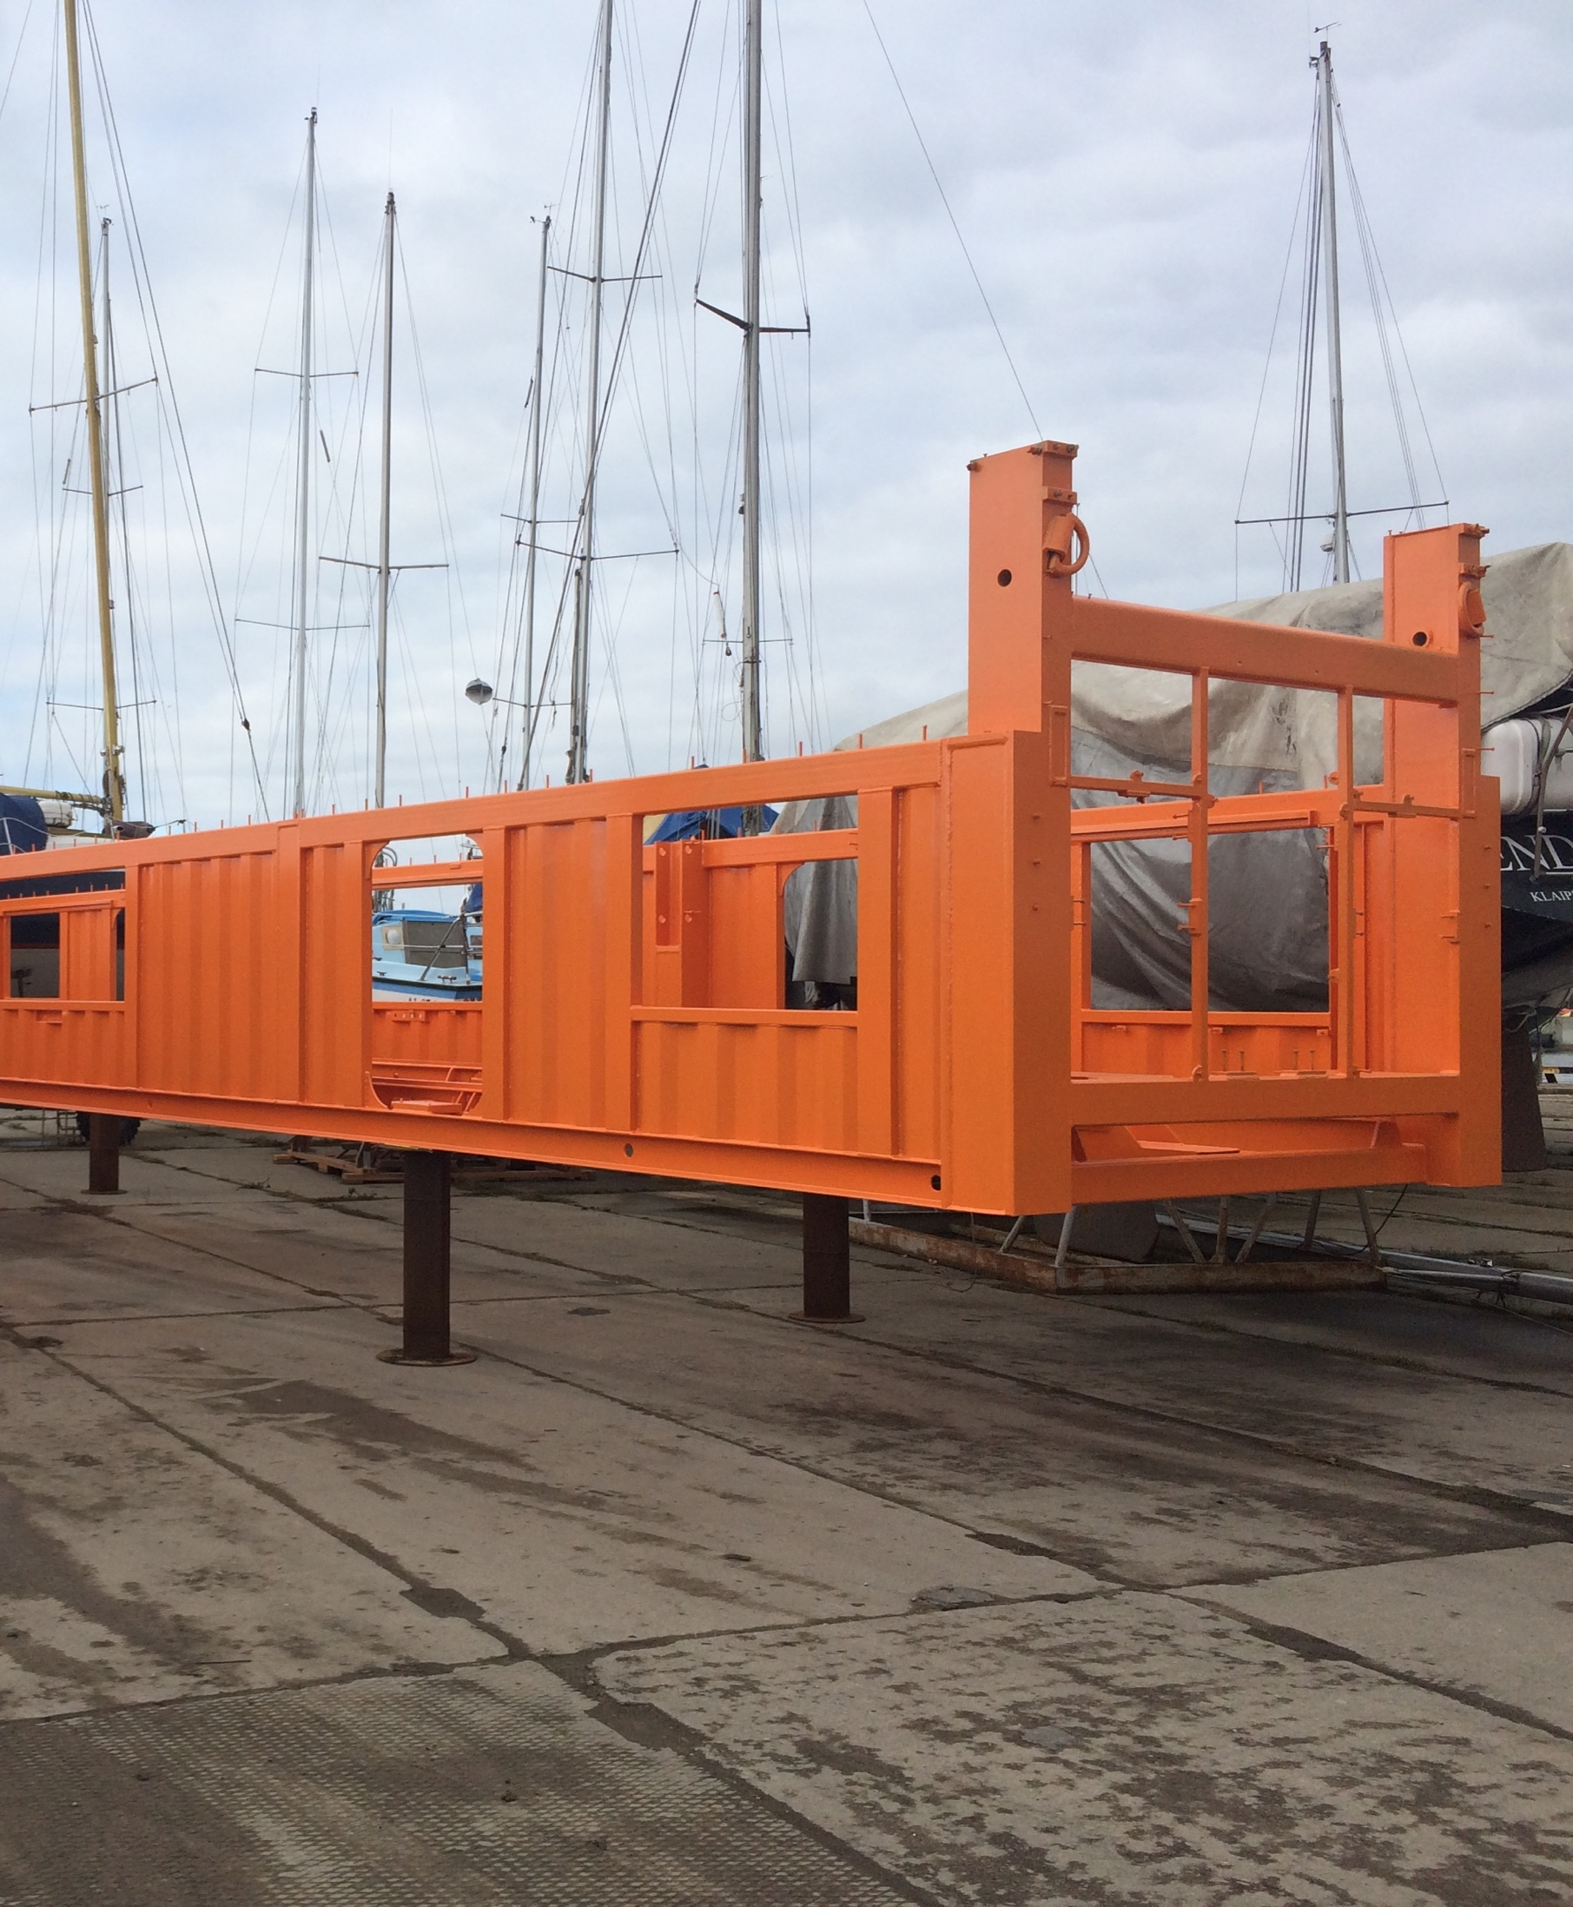
TWIST-LOCK HANDLING SYSTEM
With the help of our specific knowledge and competent team, a fully automated 7-prototype system has been designed to ensure the optimal performance in container handling. It is equipped with a sustainable mounting tube and a high quality hydraulic system.
Duration: 5 months
Input: 120 t of metal

Slide 25
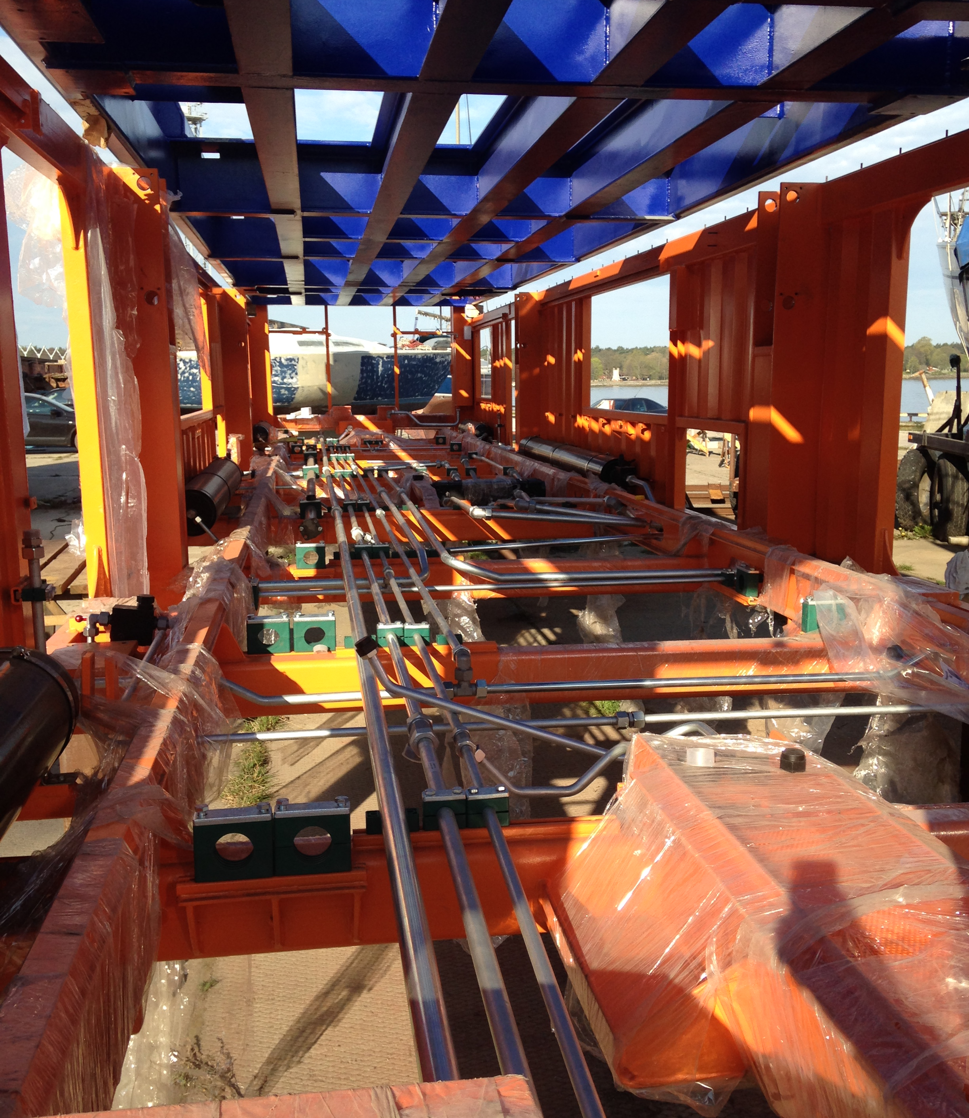
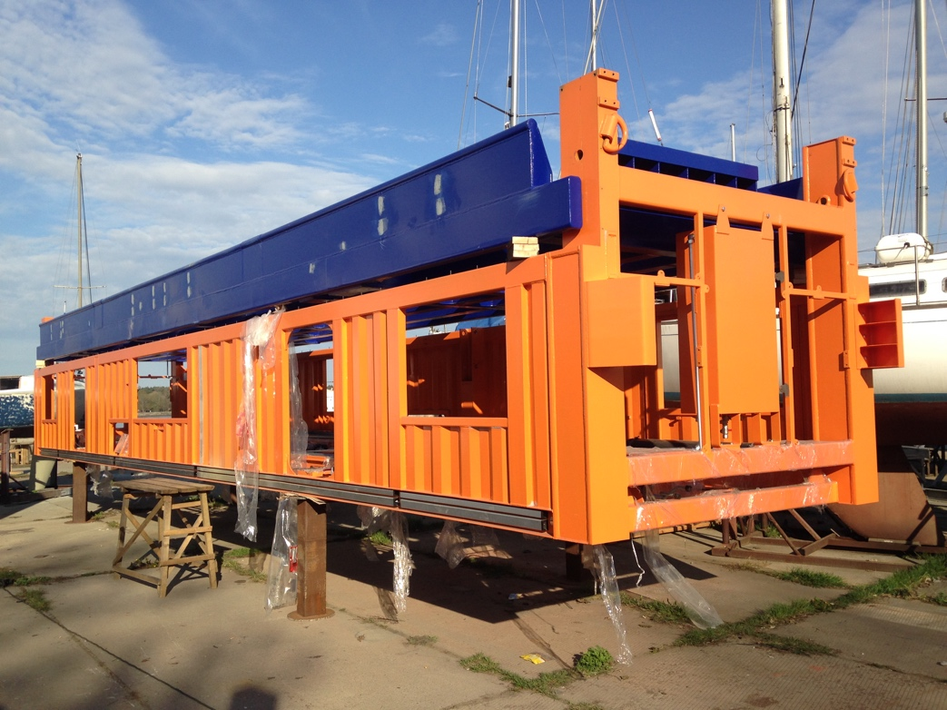
TWIST-LOCK HANDLING SYSTEM

Slide 26
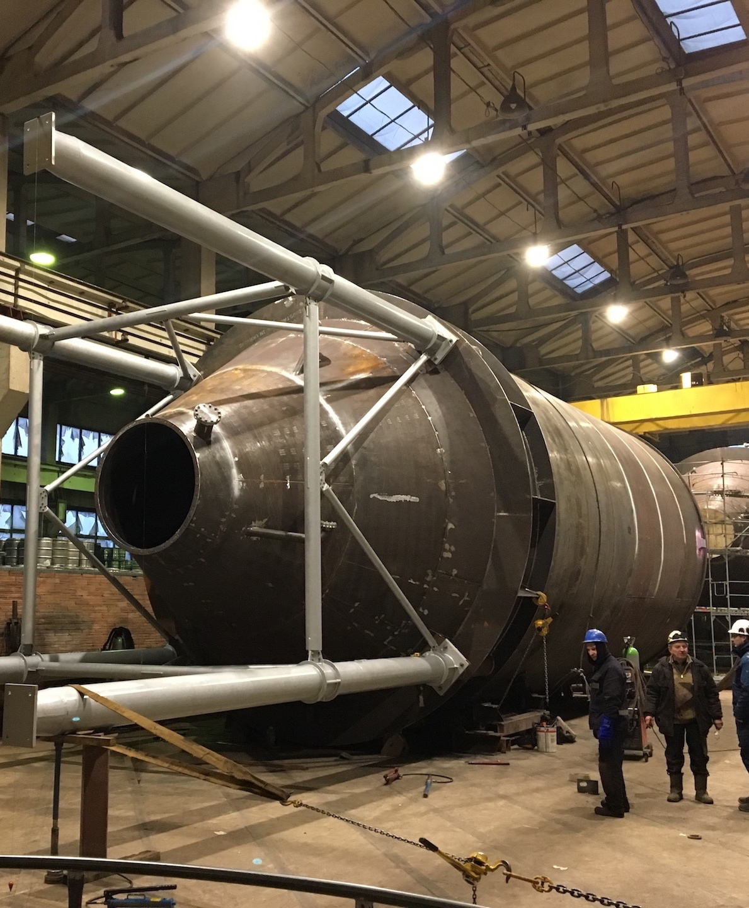
SILO STORAGE TANKS
The company made 2 silo storage tanks. A reliable production design and solutions were created by qualified employees, to ensure the materials are protected from moisture and different weather conditions.
Duration: 2 months
Dimensions: diameter– 7 m, height – 23 m
Total weight of 2 silo storage tanks: 70 t

Slide 27
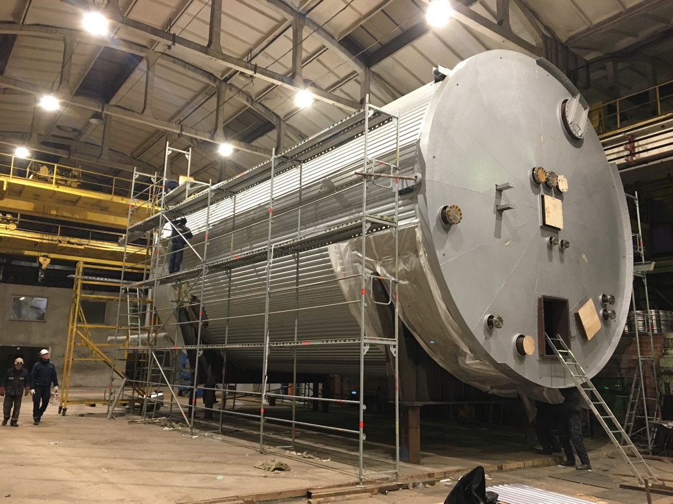
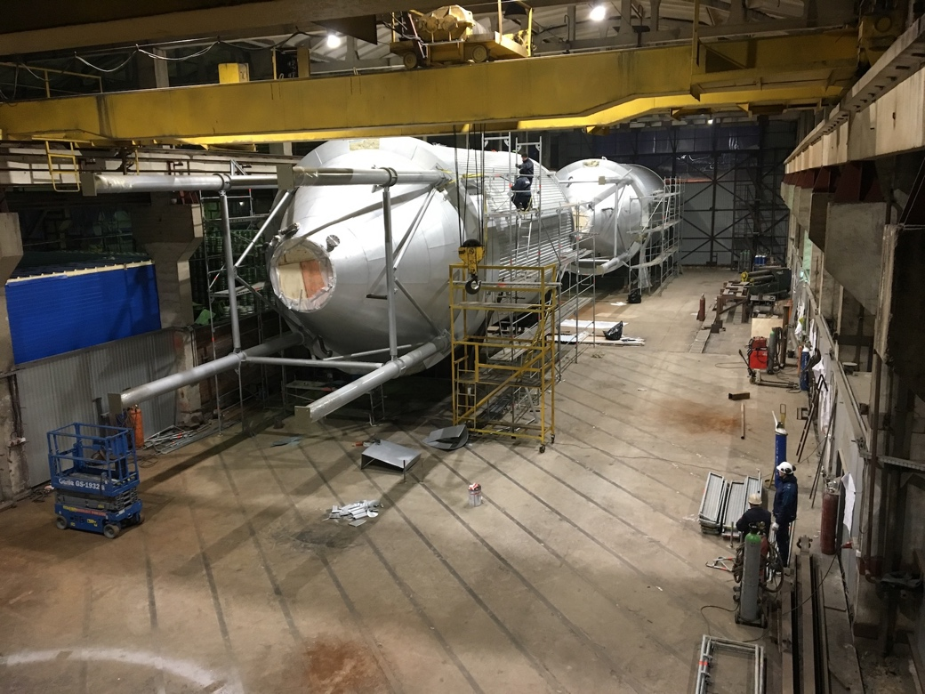
SILO STORAGE TANKS
Notes:
-

Slide 28
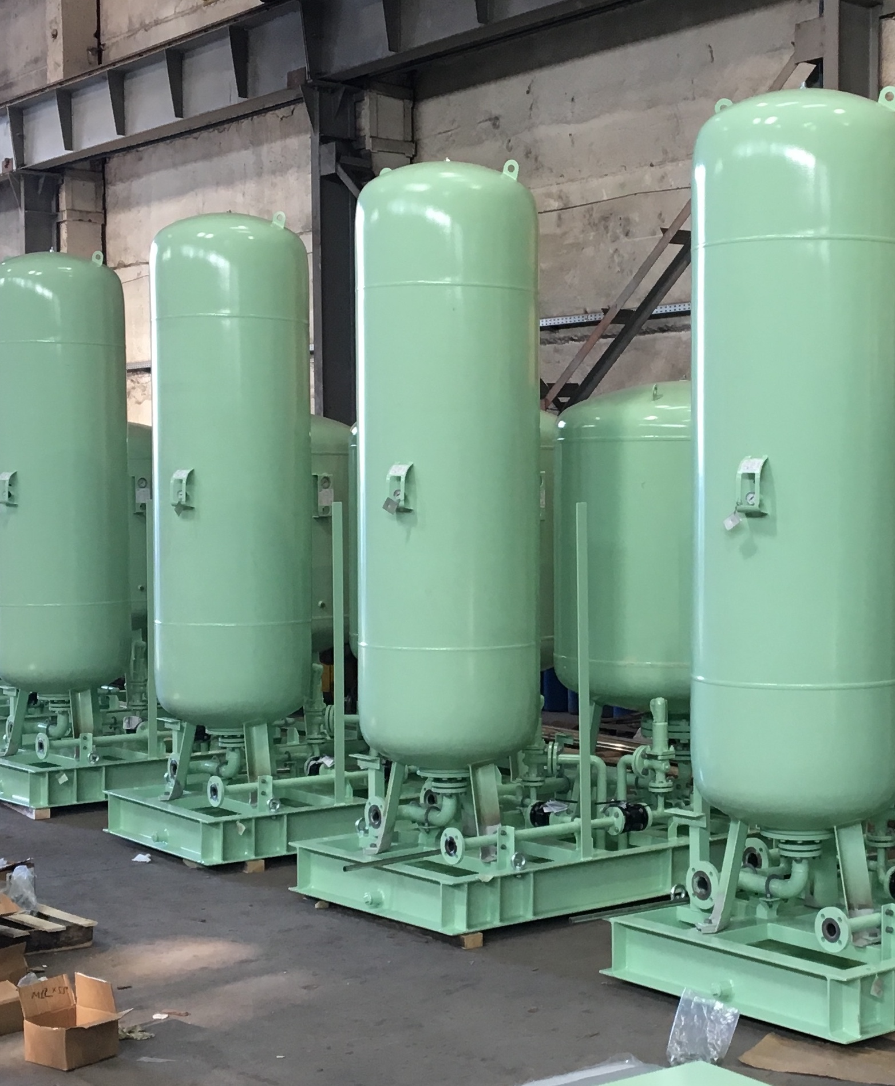
EXPANSION UNITS
7 units were produced and services were provided from A-to-Z. Exceptional attention was given to the design, modern decision -making and full production cycle.
Duration: 2 months

Slide 29
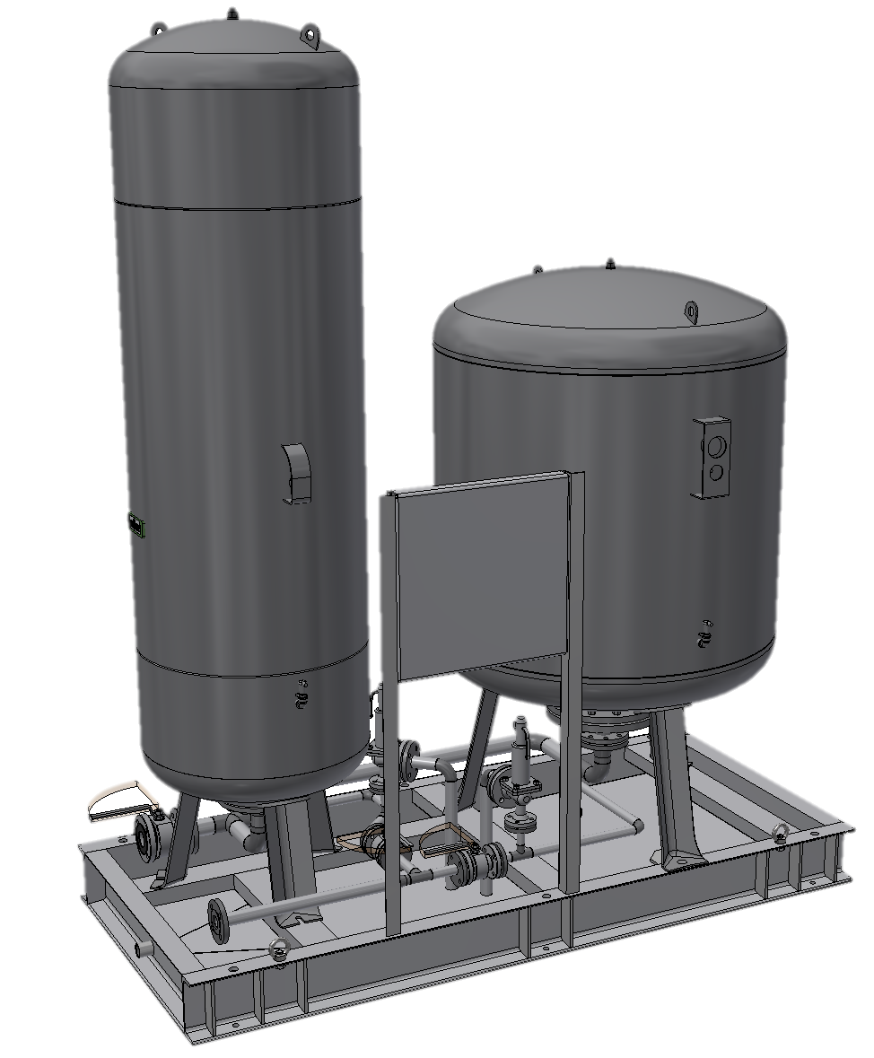
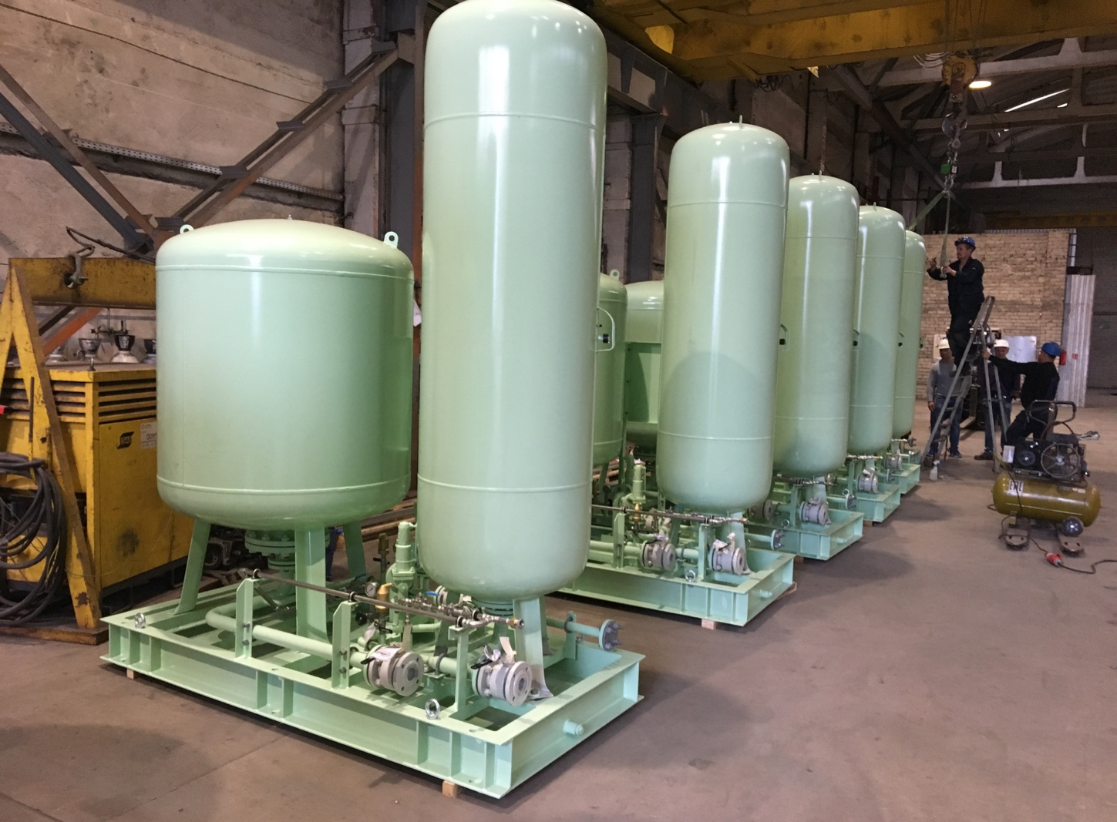
EXPANSION UNITS

Slide 30
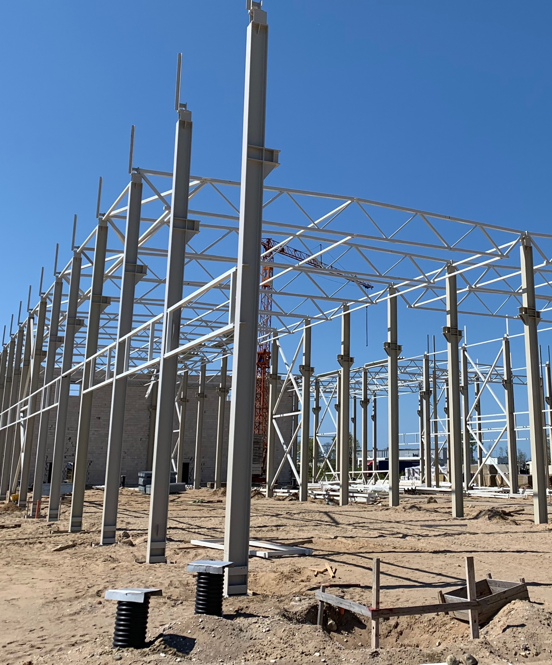
STEEL STRUCTURES
With over 5 years of experience, SIDC has demonstrated the competency and ability though the management and execution of a broad range of civil engineering projects works.
Our world class engineering team has experience designing all type structures and construction of other prefabricated reinforced concrete structures.
We offer a full range of project management capabilities as well as having the ability to perform cost estimation and provide resource management for various civil projects.

Slide 31
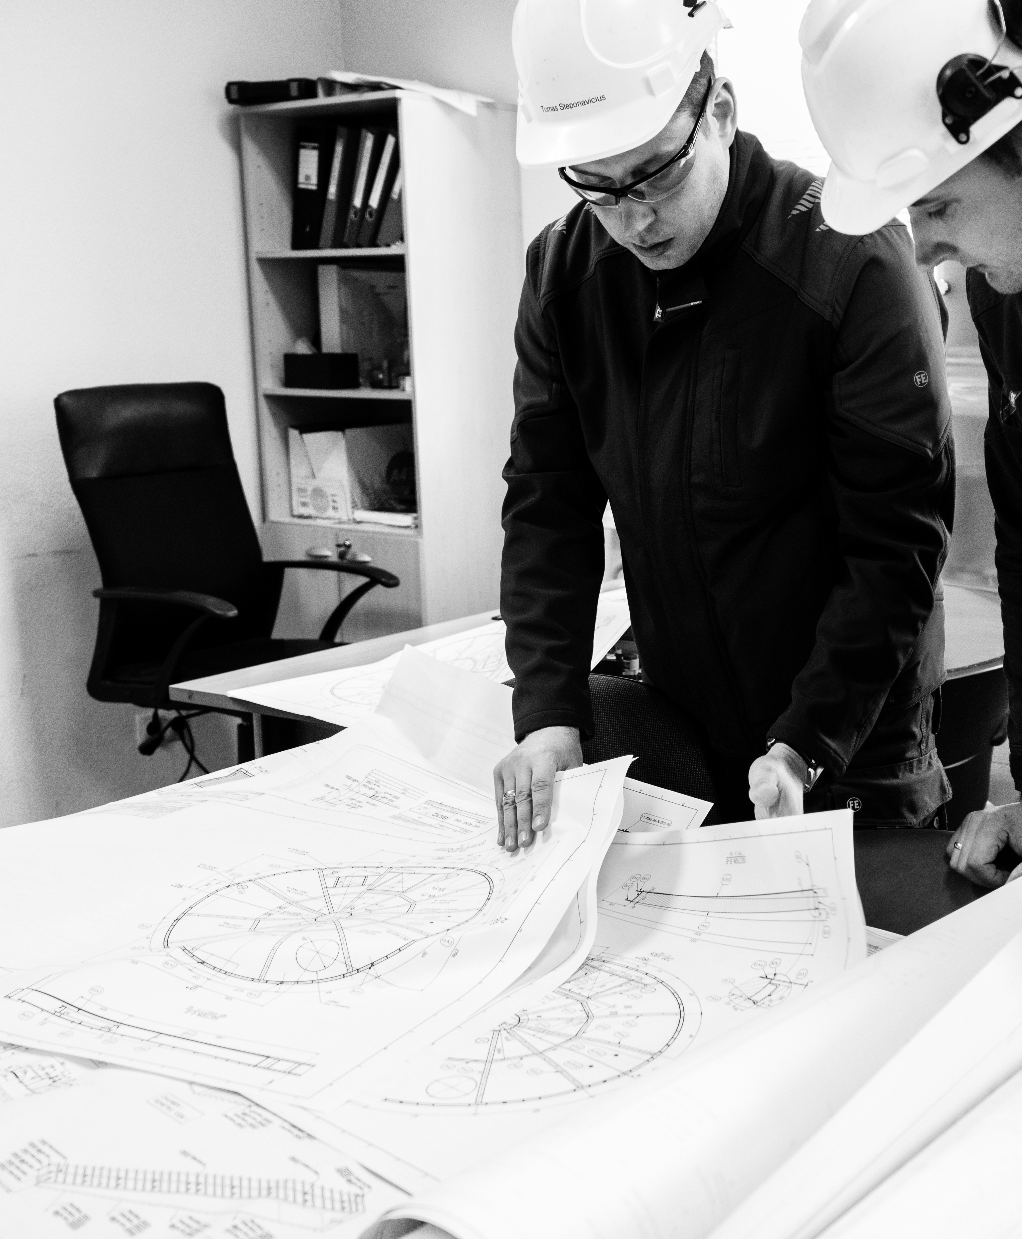
ENGINEERING
We host the highly qualified and certified engineering team, with industry leading international experience. We help clients achieve real world management solutions to the countless challenges that plague most projects.
Engineering.
Design of complex structures.
Strength calculations.
Workshop drawings.
Industrial equipment design.

Slide 32
TECHNICAL STAFFING
Our company invest more value in to the personnel and prepare them according client needs. Each candidate is carefully investigated and necessary training are provided.
Technical personnel available for temporary, project or long-term consulting.
Drafters (Autodesk AutoCAD);
Design Engineers (Autodesk Inventor, Solidworks);
Mechanical Engineers (Autodesk Inventor, Solidworks);
Project Engineers (Autodesk Inventor, Solidworks);
Package Engineers (With key knowledge in production and safety);
Piping Engineers (AutoCAD Plant 3D);
Naval Engineers (Ship constructor, AutoCAD).

Slide 33
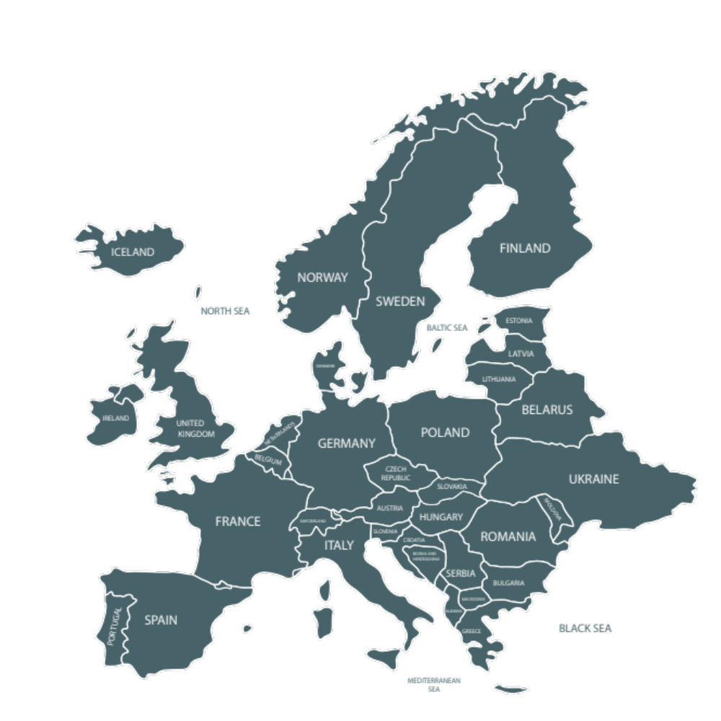
PARTNER WORTH TRUSTING
We work all over the Europe and are planning to expand to other regions. The countries where our projects are currently standing include:
SWEDEN
NORWAY
UNITED KINGDOM
LITHUANIA
GERMANY
BELGIUM
NETHERLANDS
FRANCE
CROATIA
FINLAND
BRASIL

Slide 34
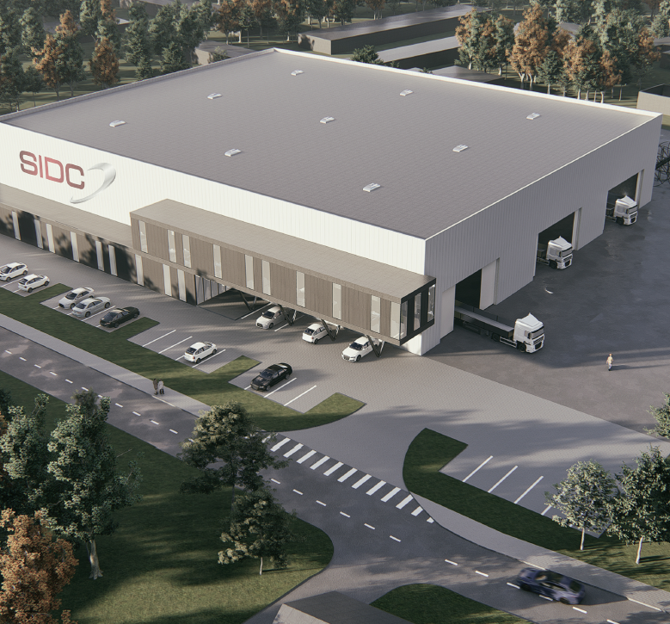
FUTURE PLANS
NEW WORKSHOP
1st part:
Length -100 m, width – 12 m, height - 8,5 m;
Gate width - 12 m, height – 6 m;
Cranes 2x10 t.
2nd part:
Length - 100 m, width – 12 m, height - 8,5 m;
Gate width - 12 m, height – 6 m;
Cranes 2x20 t.
3rd part (painting workshop):
Length – 100 m, width – 12 m, height - 8,5 m;
Gateway width - 12 m, height – 6 m;
Cranes 1x30 t.

Slide 35
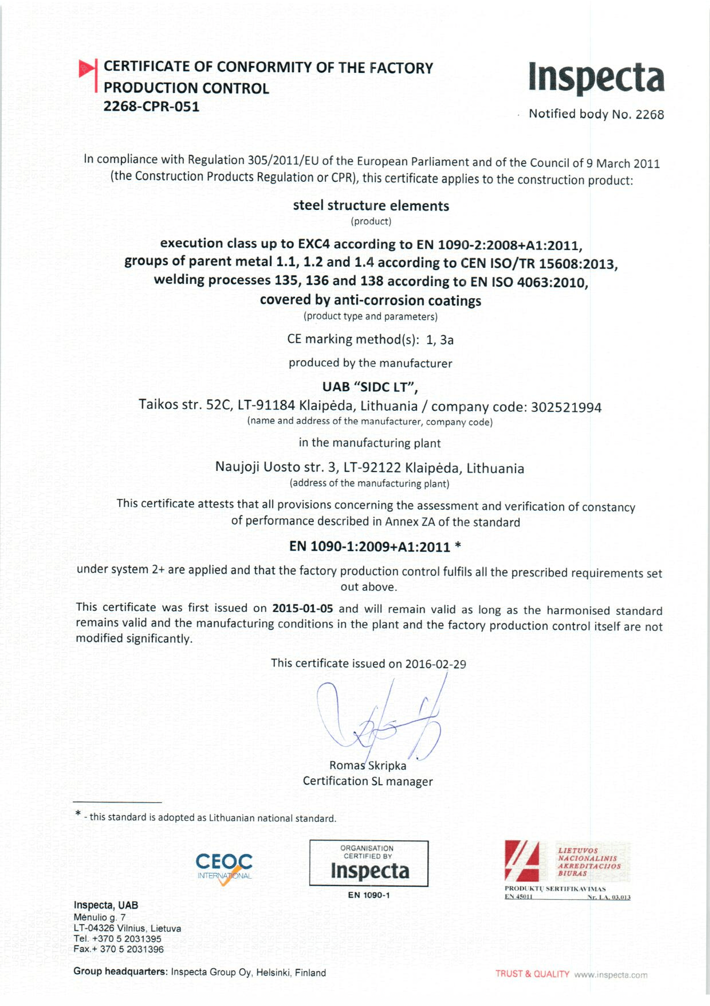
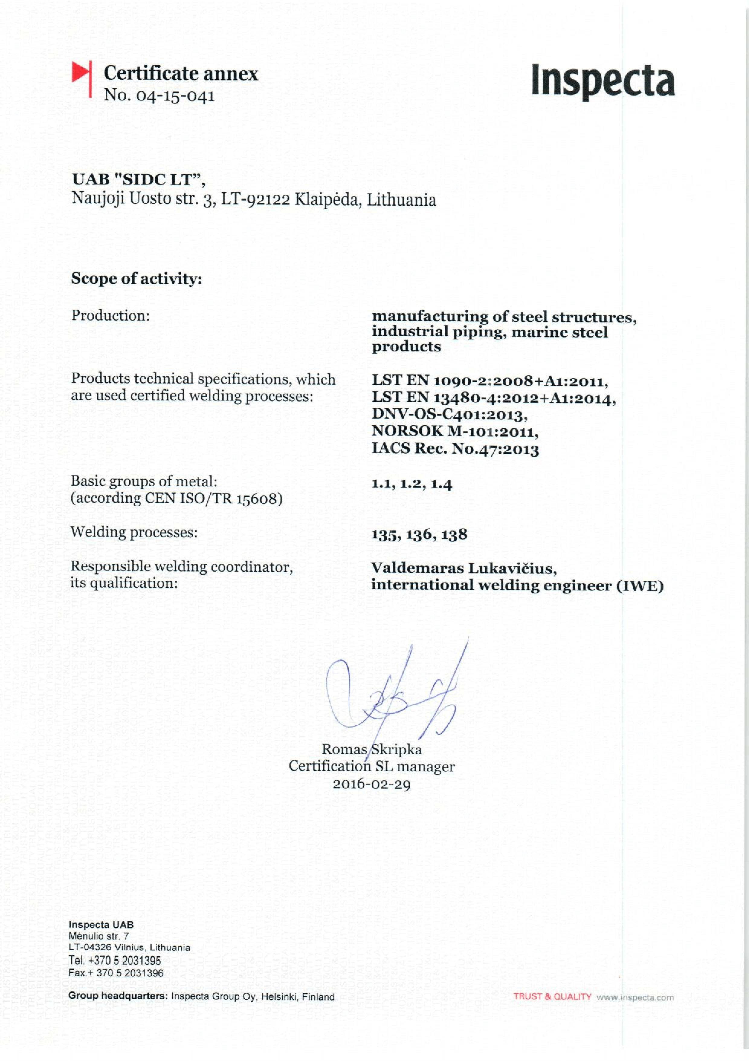
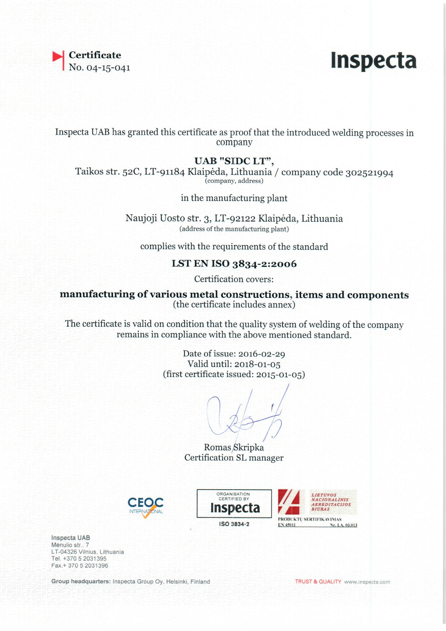
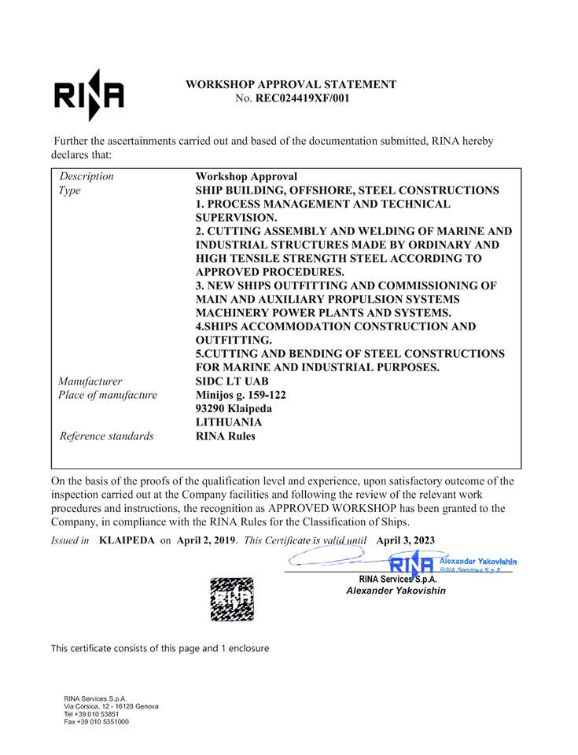
EN 1090-1 EXC-4 and EN ISO 3834-2 management system certificates

Slide 36



ISO 9001, 14001, and 18001 (OHSAS) management system certificates and VCA certificates

Slide 37





















We are pleased to work with:

Slide 38


Thank you!
Aivaras Kamas
SIDC LT Director and CEO of SIDC group

Slide 39

SIDC LT, JSC
Company code: 302521994
Vat code: LT100006517214
Address: Minijos str. 159-122,
93290 Klaipeda, Lithuania
Tel. +370 652 51754
Email: info@sidc.eu
www.sidc.eu

