Slide 1



SIDC group of partners

Slide 2


Slide 3

About Us
Founded in 2010, SIDC LT started as a professional employee leasing agency. To keep up with market demands, we eventually expanded the range of our activities by adding project implementation (contracting and subcontracting) to our temporary employment services.
SIDC LT key areas of specialization are the following: project management; manufacture of metal structures in non-standard sizes; high-rise works; pipework installation and welding; ship repairs and shipbuilding; off-shore structure installation.
SIDC LT manufacturing unit is currently located at Klaipėda Seaport. We will start construction of a new manufacturing plant in the immediate future, which will allow us to better serve ever growing needs of our customers.
Large scale projects implemented by our professionals are not limited to shipbuilding and ship repair: they also include oil and gas, wind power station, and civil engineering sectors.

Slide 4
Our production workshop
SIDC GROUP has already two manufacturing units at Klaipeda city port and in near future planning to build another manufacturing plant.
First Workshop - length - 60m, width - 18m height - 6m; Gate width - 9,7m height - 7m; Cranes 1x10t, 2x5t.
Second Workshop - length - 60m, width -16m, height - 7m; Gate width - 10 m, height - 7m; Cranes 2x10t.
New workshop:
1 - part length -100m -17m width, height - 8,5m; Gate width - 8 m, height - 8m; cranes 2x10t
2 - part, length - 100 meters width -17m, height - 8,5m; Gate width - 12 m, height - 9m; cranes 2x20t
3 - part (painting workshop) length - 42m -14m width, height - 8,5m / Gateway width - 12 m, height - 9m; cranes 1x10t

Slide 5
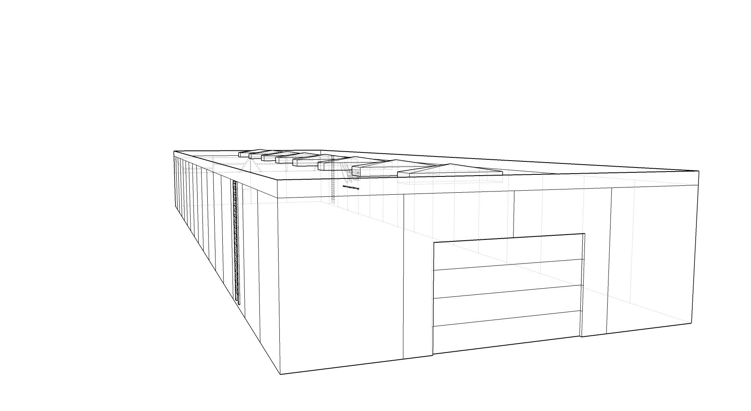
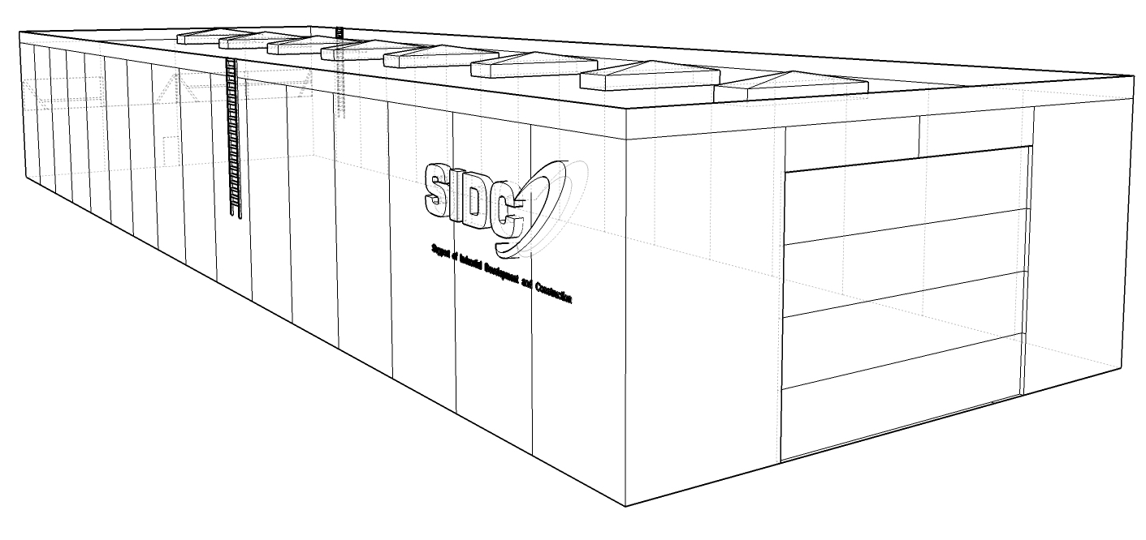
First Workshop and Second Workshop
First Workshop - length - 60m, width - 18m height - 6m; Gate width - 9,7m height - 7m; Cranes 1x10t, 2x5t.
Second Workshop - length - 60m, width -16m, height - 7m; Gate width - 10 m, height - 7m; Cranes 2x10t.

Slide 6
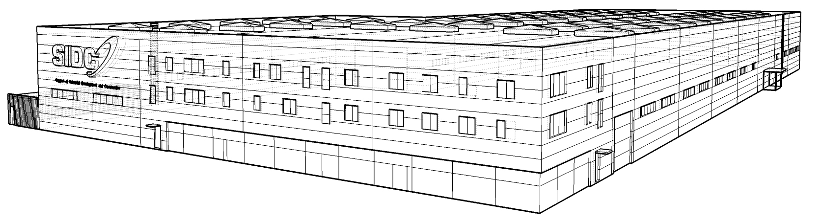
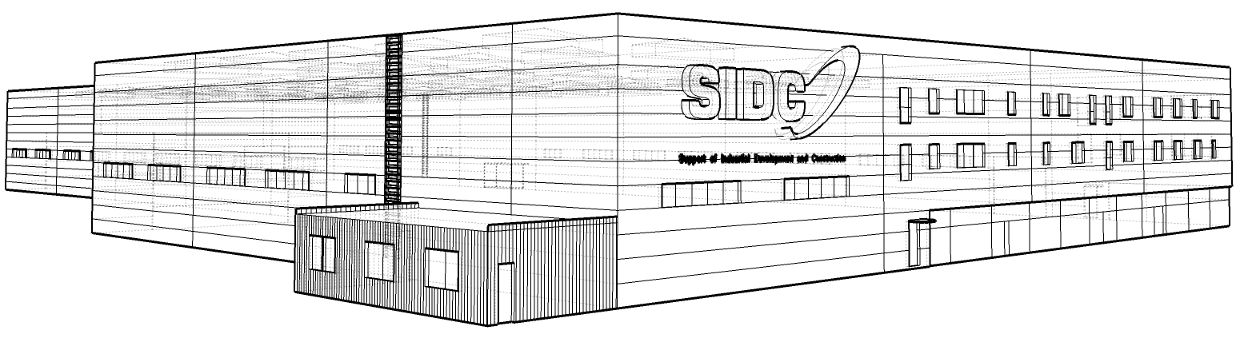
New workshop
1 - part length -100m -17m width, height - 8,5m; Gate width - 8 m, height - 8m; cranes 2x10t
2 - part, length - 100 meters width -17m, height - 8,5m; Gate width - 12 m, height - 9m; cranes 2x20t
3 - part (painting workshop) length - 42m -14m width, height - 8,5m / Gateway width - 12 m, height - 9m; cranes 1x10t

Slide 7
Our services
We are working in sectors:
CIVIL CONSTRUCTION
INDUSTRIAL CONSTRUCTION
SHIP BUILDING AND REPAIRS
MANUFACTURE OF METAL CONSTRUCTIONS
ENGINEERING AND CONSTRUCTION MANAGING

Slide 8
Our services
We are proud to have a variety of professional specialists:
Ship builders
Welders
Fitters
Pipe fitters
Electritions E&I cable pullers
Builders (variuos profiles)

Slide 9
CIVIL CONSTRUCTION
With over 5 years of Civil related industry experience, SIDC provides a wide range of multifaceted engineering and construction personnel solutions created with the client in mind.
Our world class engineering team has experience with designing all type structures and construction of other prefabricated reinforced concrete structures.

Slide 10
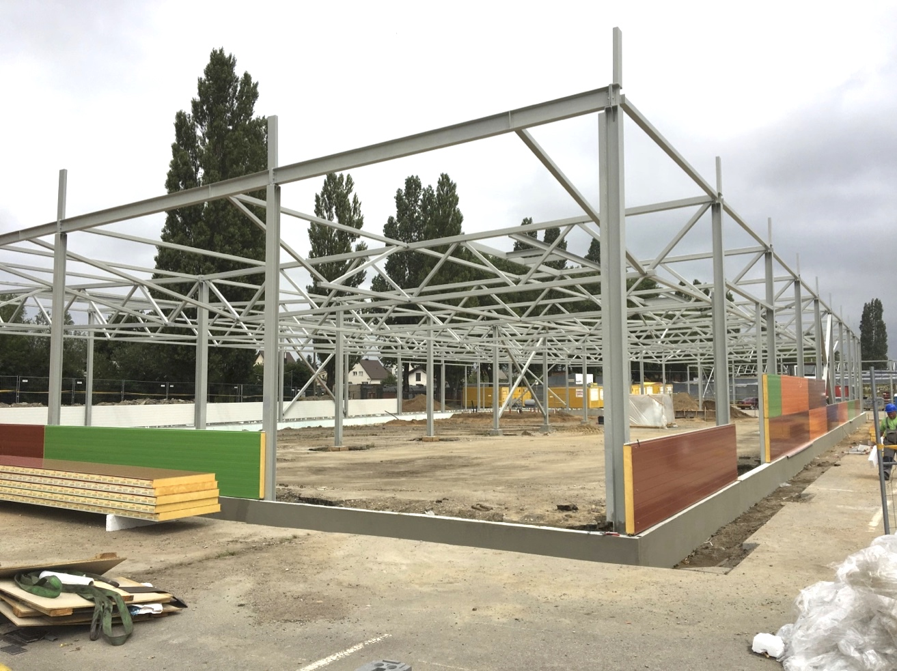
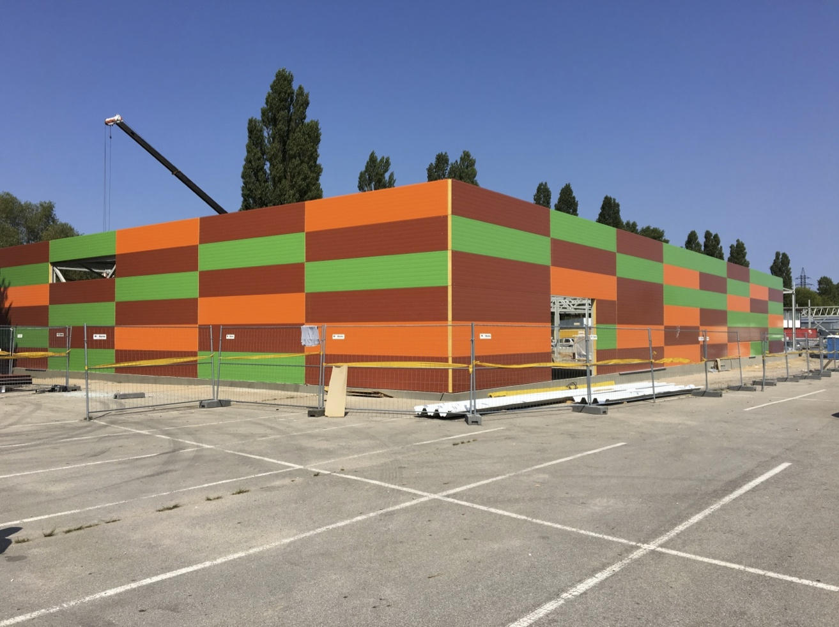
CIVIL CONSTRUCTION
With over 5 years of Civil related industry experience, SIDC provides a wide range of multifaceted engineering and construction personnel solutions created with the client in mind.
Our world class engineering team has experience with designing all type structures and construction of other prefabricated reinforced concrete structures.
We offer a full range of project management capabilities as well as having the ability to perform cost estimation and provide resource management for various civil projects.
Klaipėda market construction.
General construction works for three Buildings x 1200m2.

Slide 11
INDUSTRIAL CONSTRUCTION
SIDC has several years of experience constructing heavy industrial facilities across a broad range of specialized market segments.
We provide integrated construction solutions for several of the world’s leading industrial, mineral processing, and oil & gas production companies. We provide personnel and solutions to facilitate industrial installations, maintenance, and construction.

Slide 12
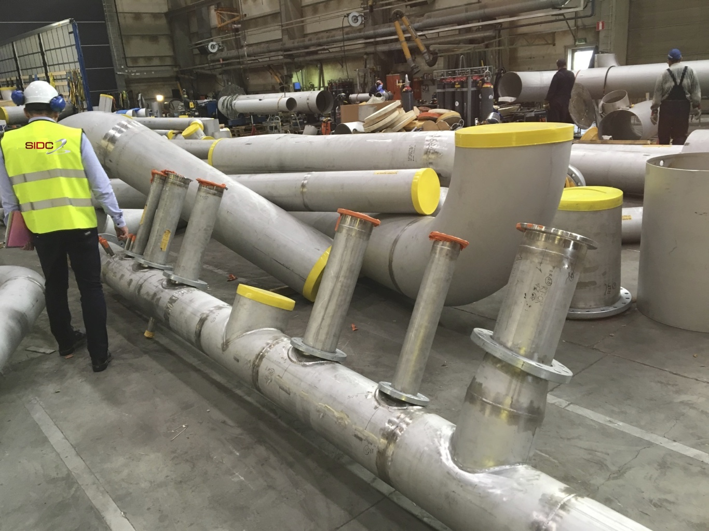
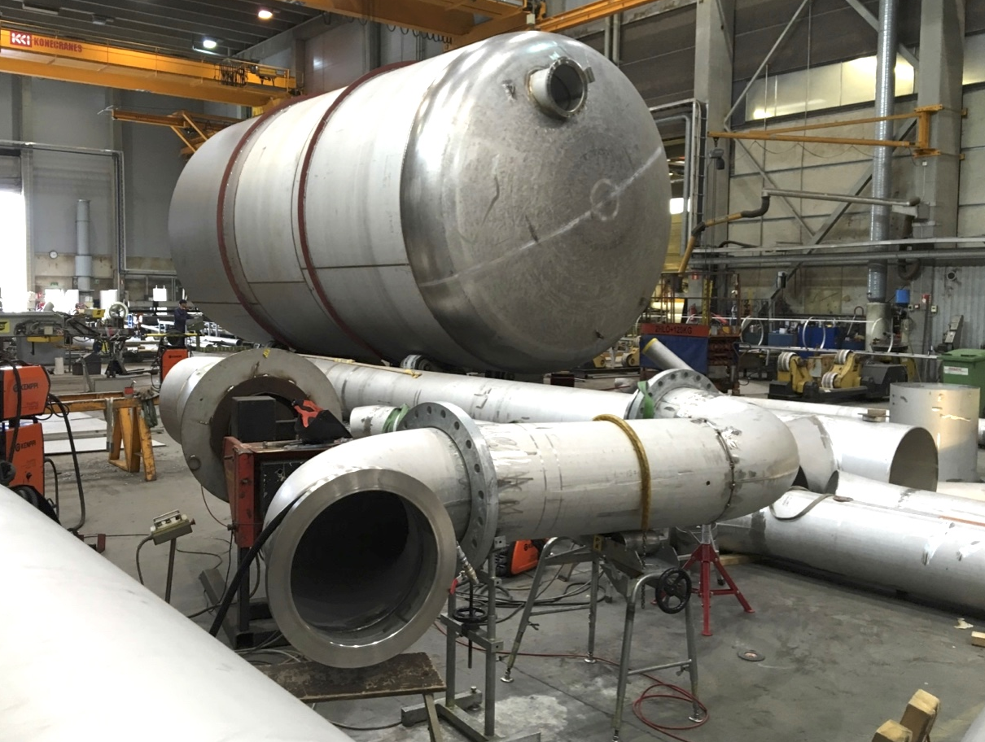
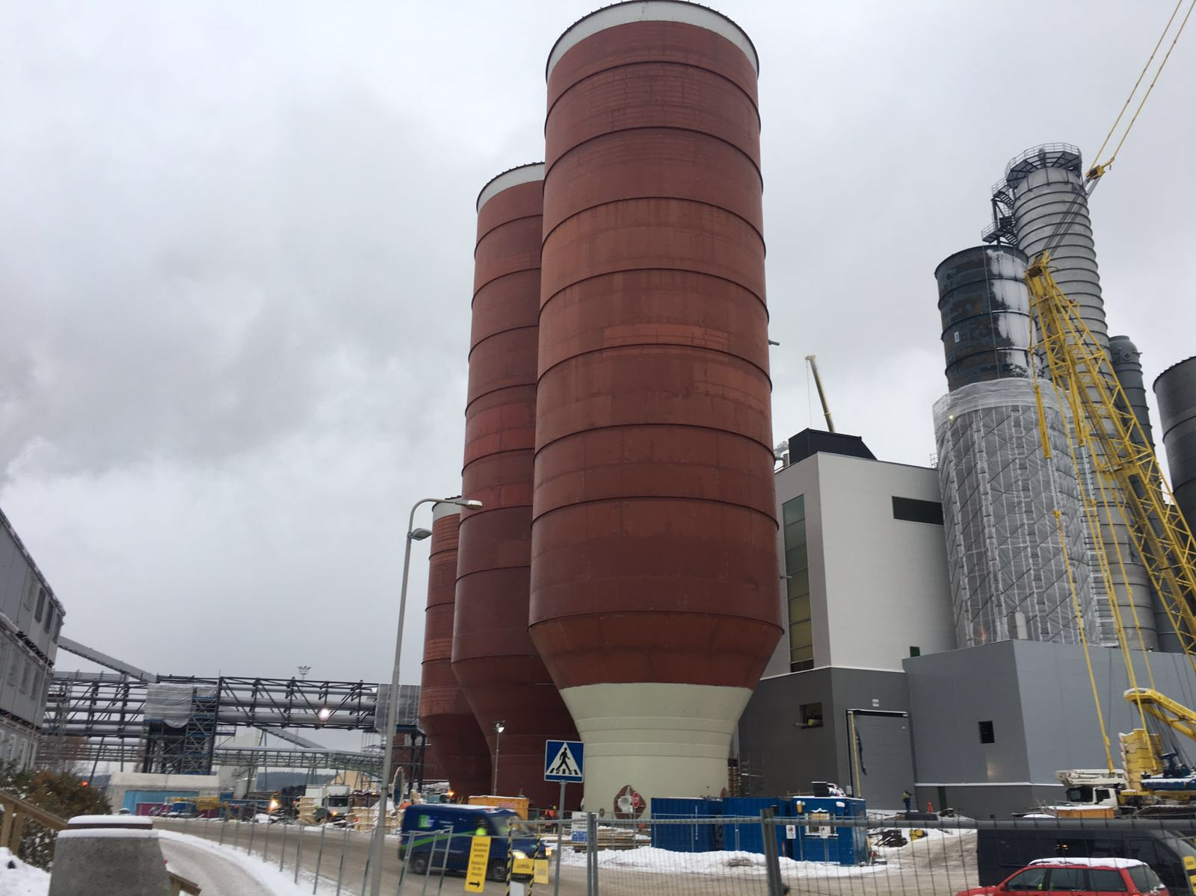
INDUSTRIAL CONSTRUCTION
The prefabrication, welding and installation of industrial tanks is one our many specialties at SIDC.
We have installed several tanks for a multitude of projects in various industries.
SIDC has several years of experience constructing heavy industrial facilities across a broad range of specialized market segments.
We provide integrated construction solutions for several of the world’s leading industrial, mineral processing, and oil & gas production companies. We provide personnel and solutions to facilitate industrial installations, maintenance, and construction.
Our team includes over 10 years of industrial experience needed to provide turnkey services to our clients. We also design, fabricate, and provide load testing on several types of structural supports.

Slide 13
SHIP BUILDING AND REPAIRS
SIDC has been providing maritime services for over 7 years. We have the ability to perform, shop repair, steel design fabrication, pipe fabrication and machining, and blasting/ coating.
Whatever your needs feel confident and secure that SIDC will over deliver and exceed all expectations.

Slide 14
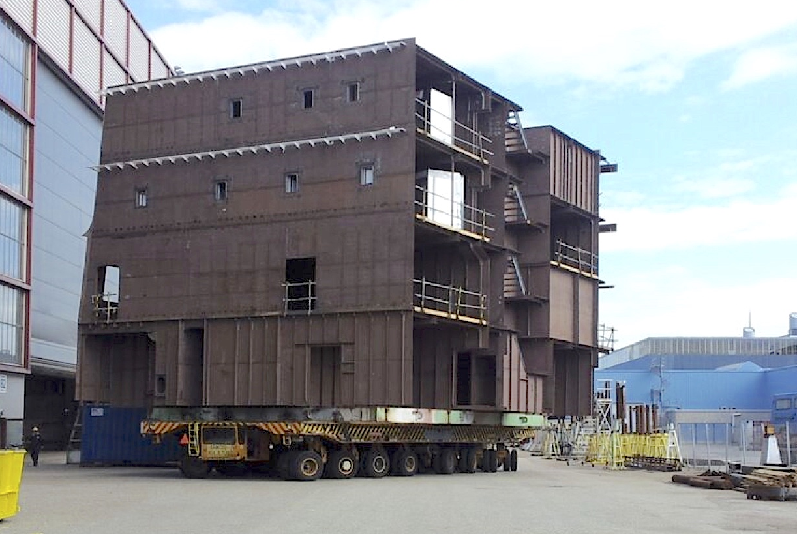
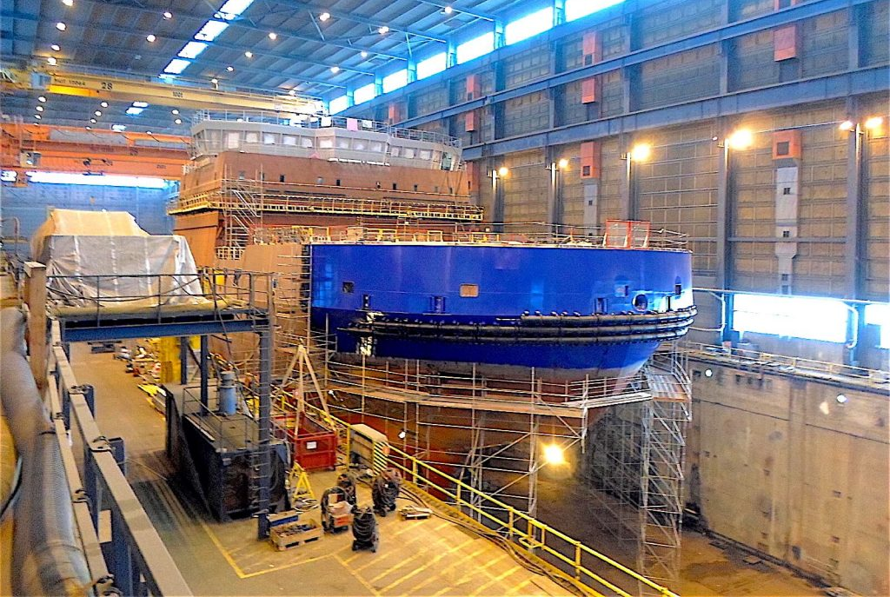
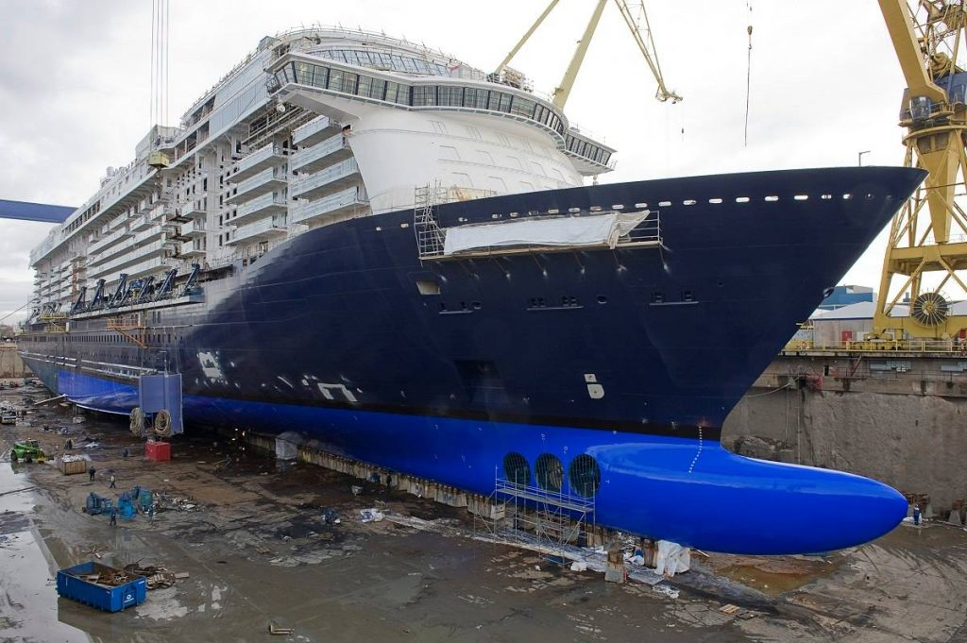
SHIP BUILDING AND REPAIRS
SIDC has been providing maritime services for over 7 years. We have the ability to perform, shop repair, steel design fabrication, pipe fabrication and machining, and blasting/ coating.
Whatever your needs feel confident and secure that SIDC will over deliver and exceed all expectations.
SIDC provides a multitude of marine services including hull/facility construction.
We design and build sectional hulls, and grand blocks for carrier ships.

Slide 15
MANUFACTURE OF METAL CONSTRUCTIONS
Here at SIDC we have personalized experience in several types of metal manufacturing and construction.
Whether it be metal tanks, metal containers, cable storage baskets, platforms, or platform assemblies, we have the personnel and experience to get the job done right.

Slide 16
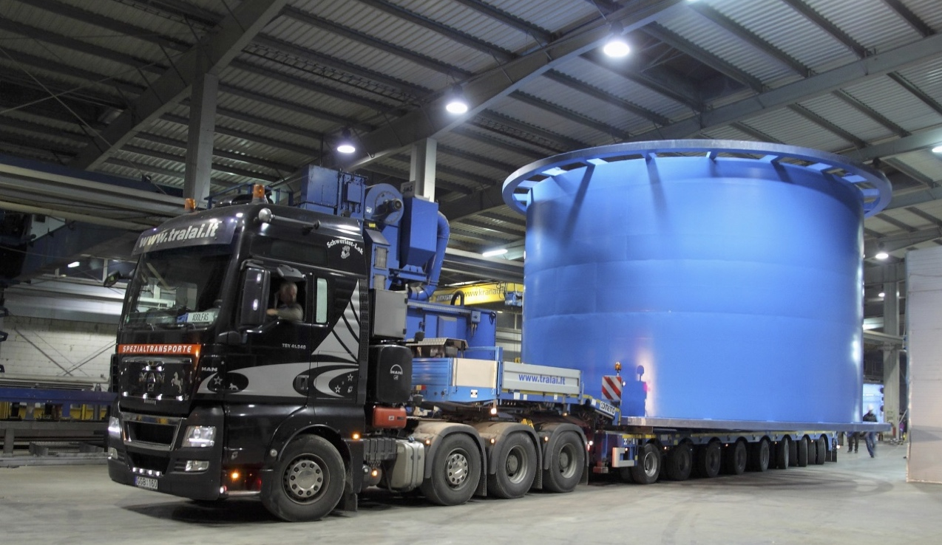
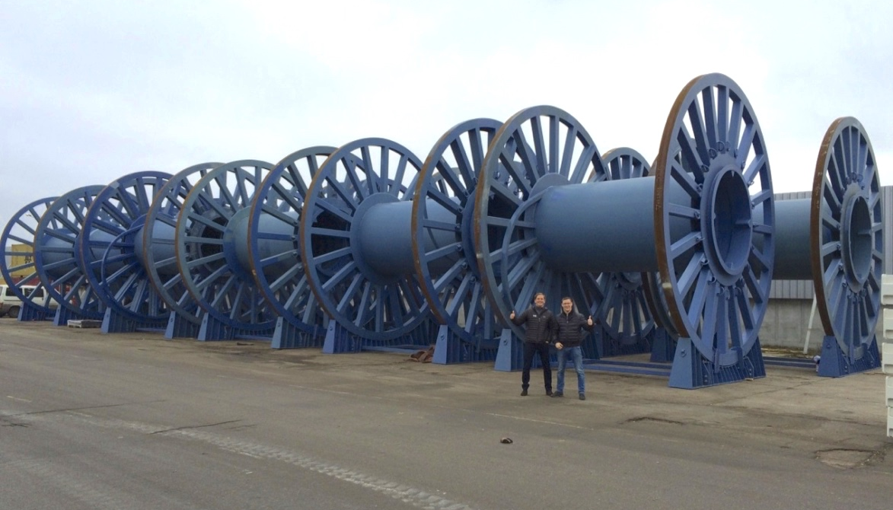
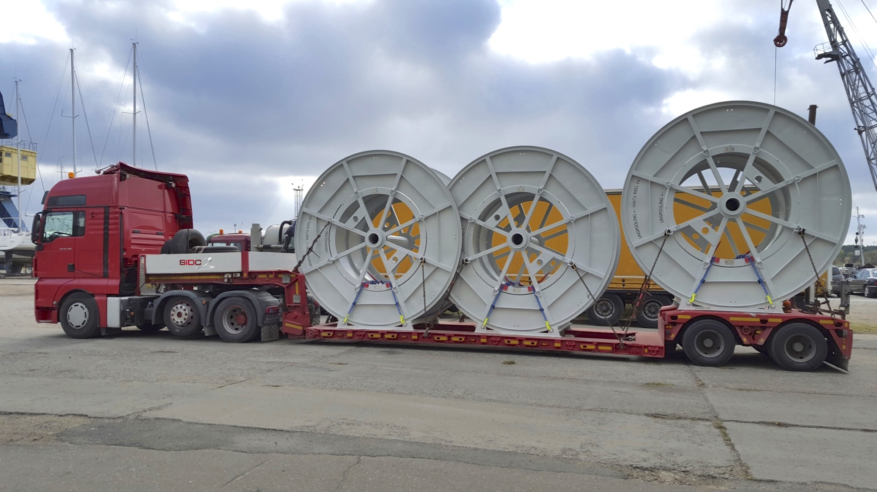
MANUFACTURE OF METAL CONSTRUCTIONS
Here at SIDC we have personalized experience in several types of metal manufacturing and construction.
Whether it be metal tanks, metal containers, cable storage baskets, platforms, or platform assemblies, we have the personnel and experience to get the job done right.
We also provide services dealing with metal structure maintenance, including but not limited to: painting, galvanized coatings, and metal shaping.
We have years of experience the manufacturing and procurement of reels and cradles.
We can handle larger orders for any industrial project.

Slide 17
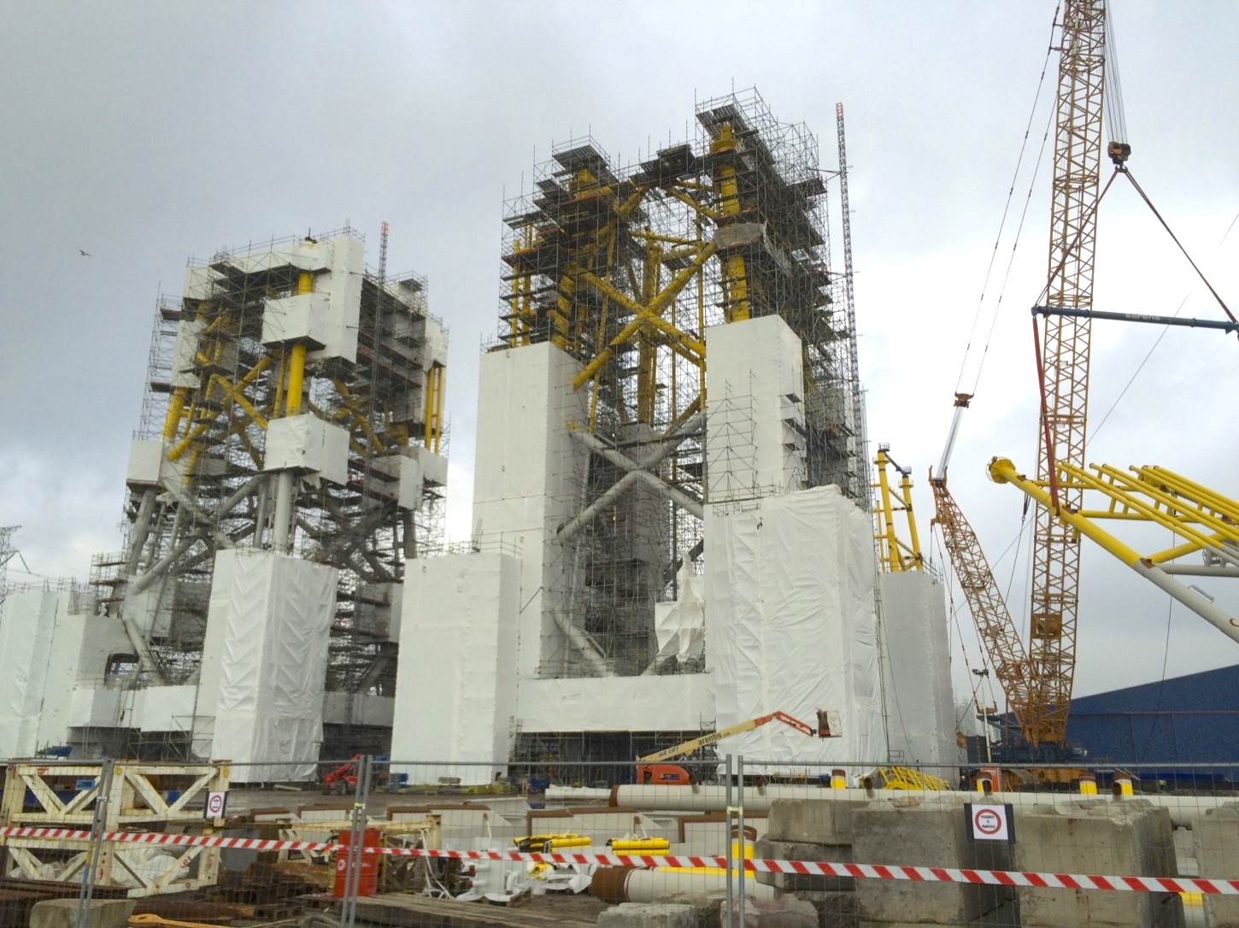
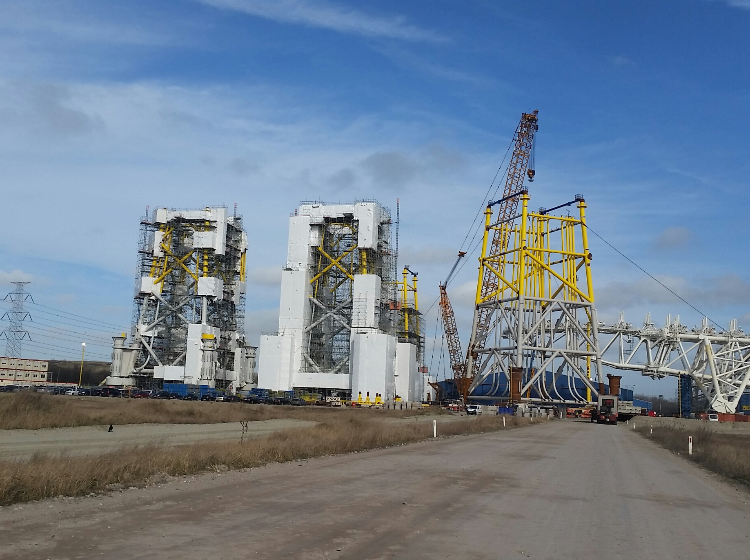
MANUFACTURE OF METAL CONSTRUCTIONS
SIDC employs a highly skilled team capable of performing a variety of welding services.
We have the man power and resources to tackle any sized job!

Slide 18
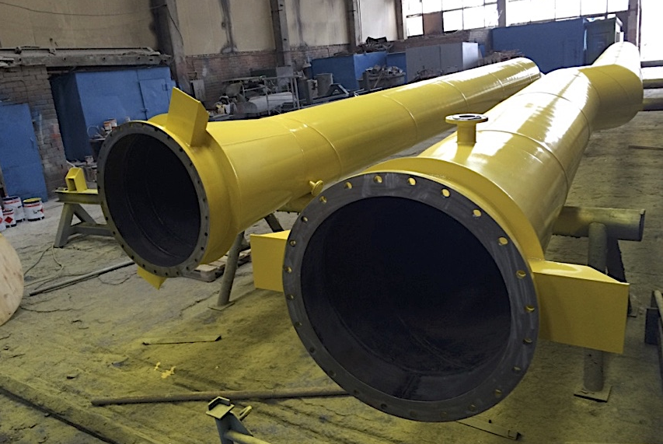
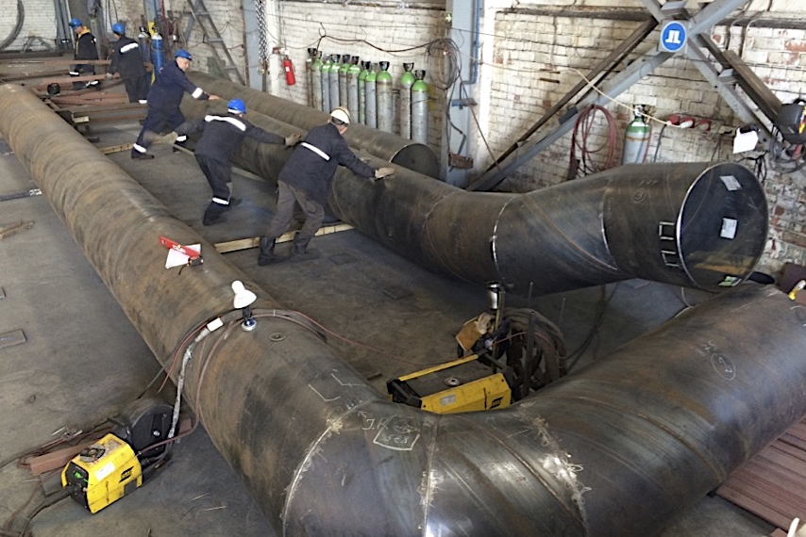
MANUFACTURE OF METAL CONSTRUCTIONS
We design and pre-fabricate several diameter nominal pipes for a multitude of industrial projects.
Whatever your specs, we can design them!

Slide 19
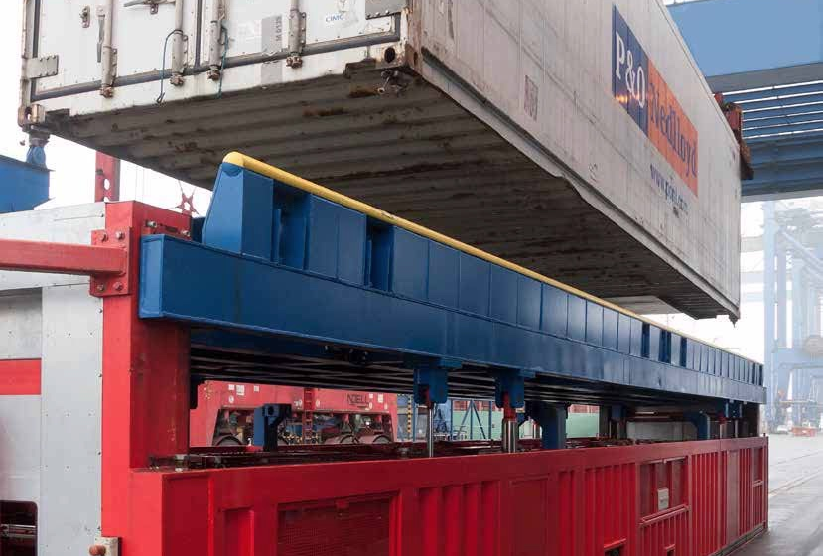
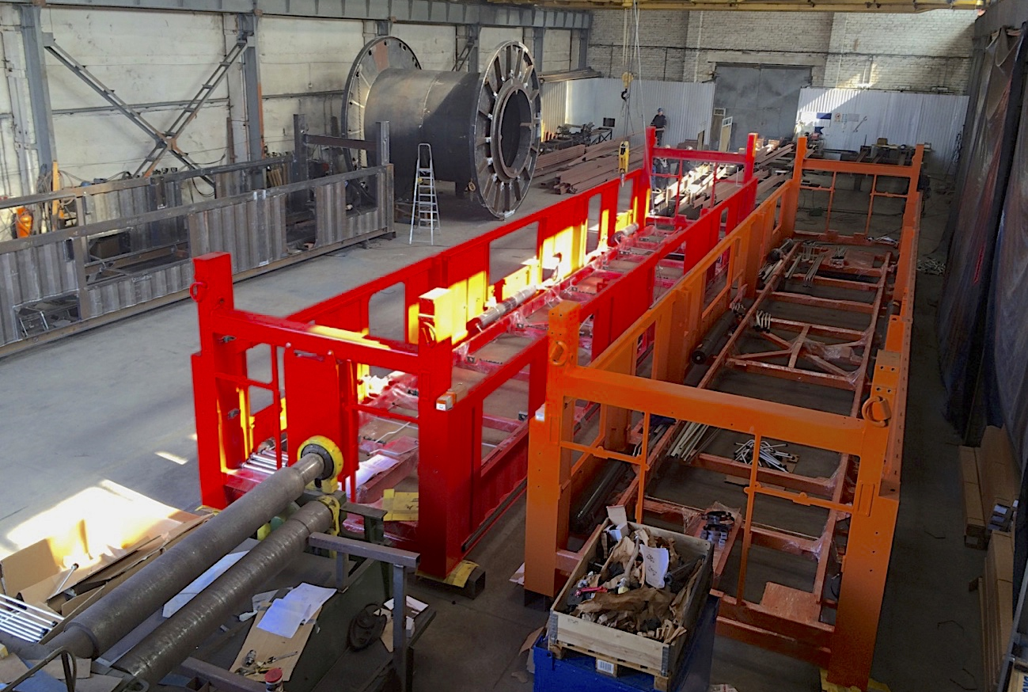
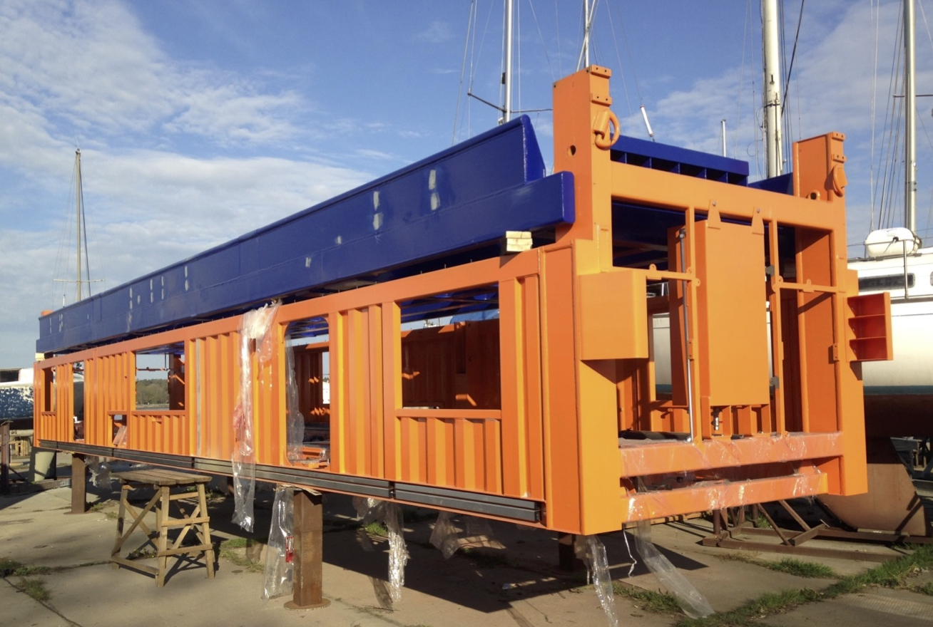
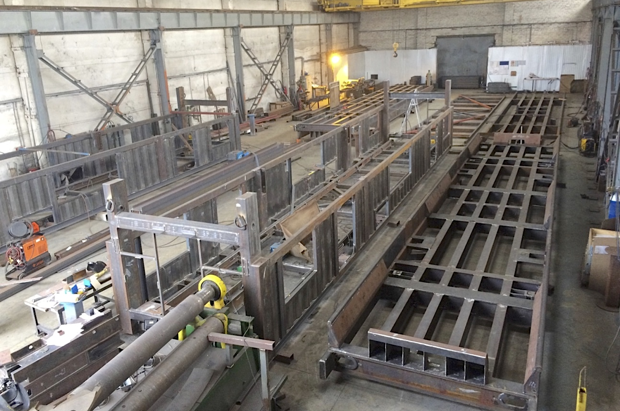
MANUFACTURE OF METAL CONSTRUCTIONS
SIDC has specific expertise in the design and construction of Automatic twistlock handling solution frames.

Slide 20
Engineering services
SIDC combines the capabilities of a full-service engineering firm with specialty construction and project management capabilities.
We host a team of highly qualified and certified project management professionals, with industry leading international experience.
We help clients achieve real world management solutions to the countless challenges that plague most projects.
Services we offer: engineering, design of complex structures, calculations, design of engineering networks. Work with professionals, who can create any project!

Slide 21
Engineering services
3D model preparations
Steel structure designs
Mechanical equipment designs
Transportation equipment designs
Production line designs
Structural analyses and calculations
Fabrications, shop drawings and plate cutting file preparations
Layout and arrangement drawings
Assembly instructions and presentations
Prototype modelling and visualisations
Piping designs and piping isometric drawings
Engineering consultations

Slide 22
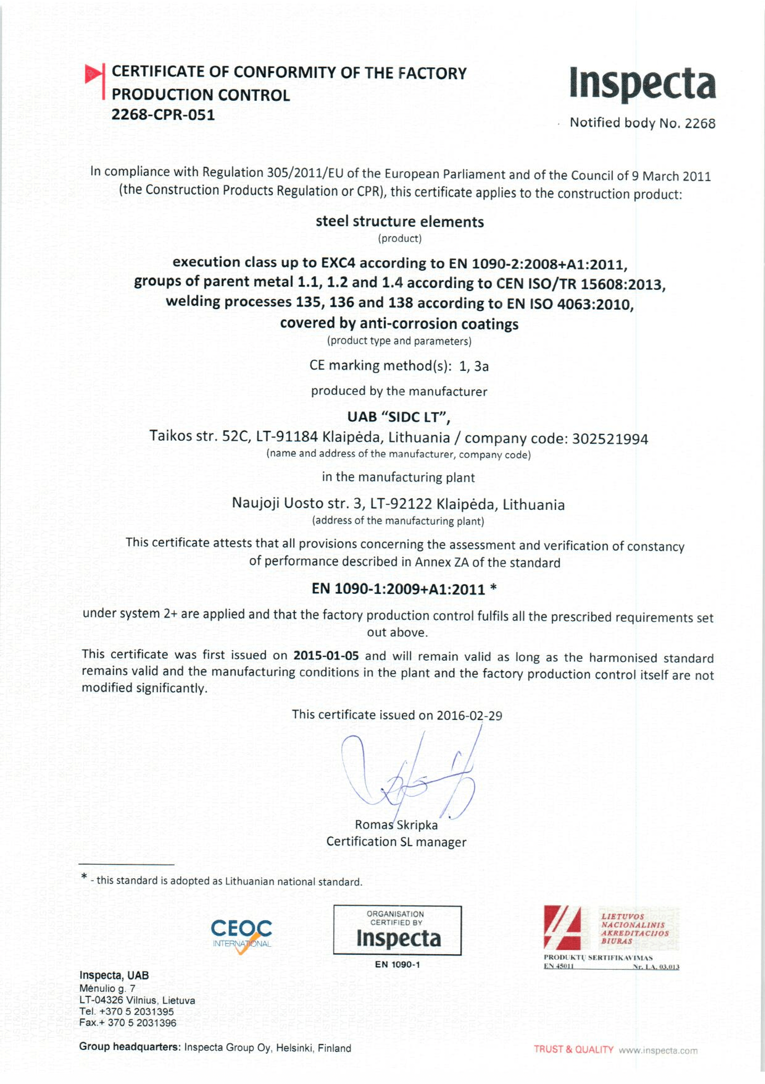
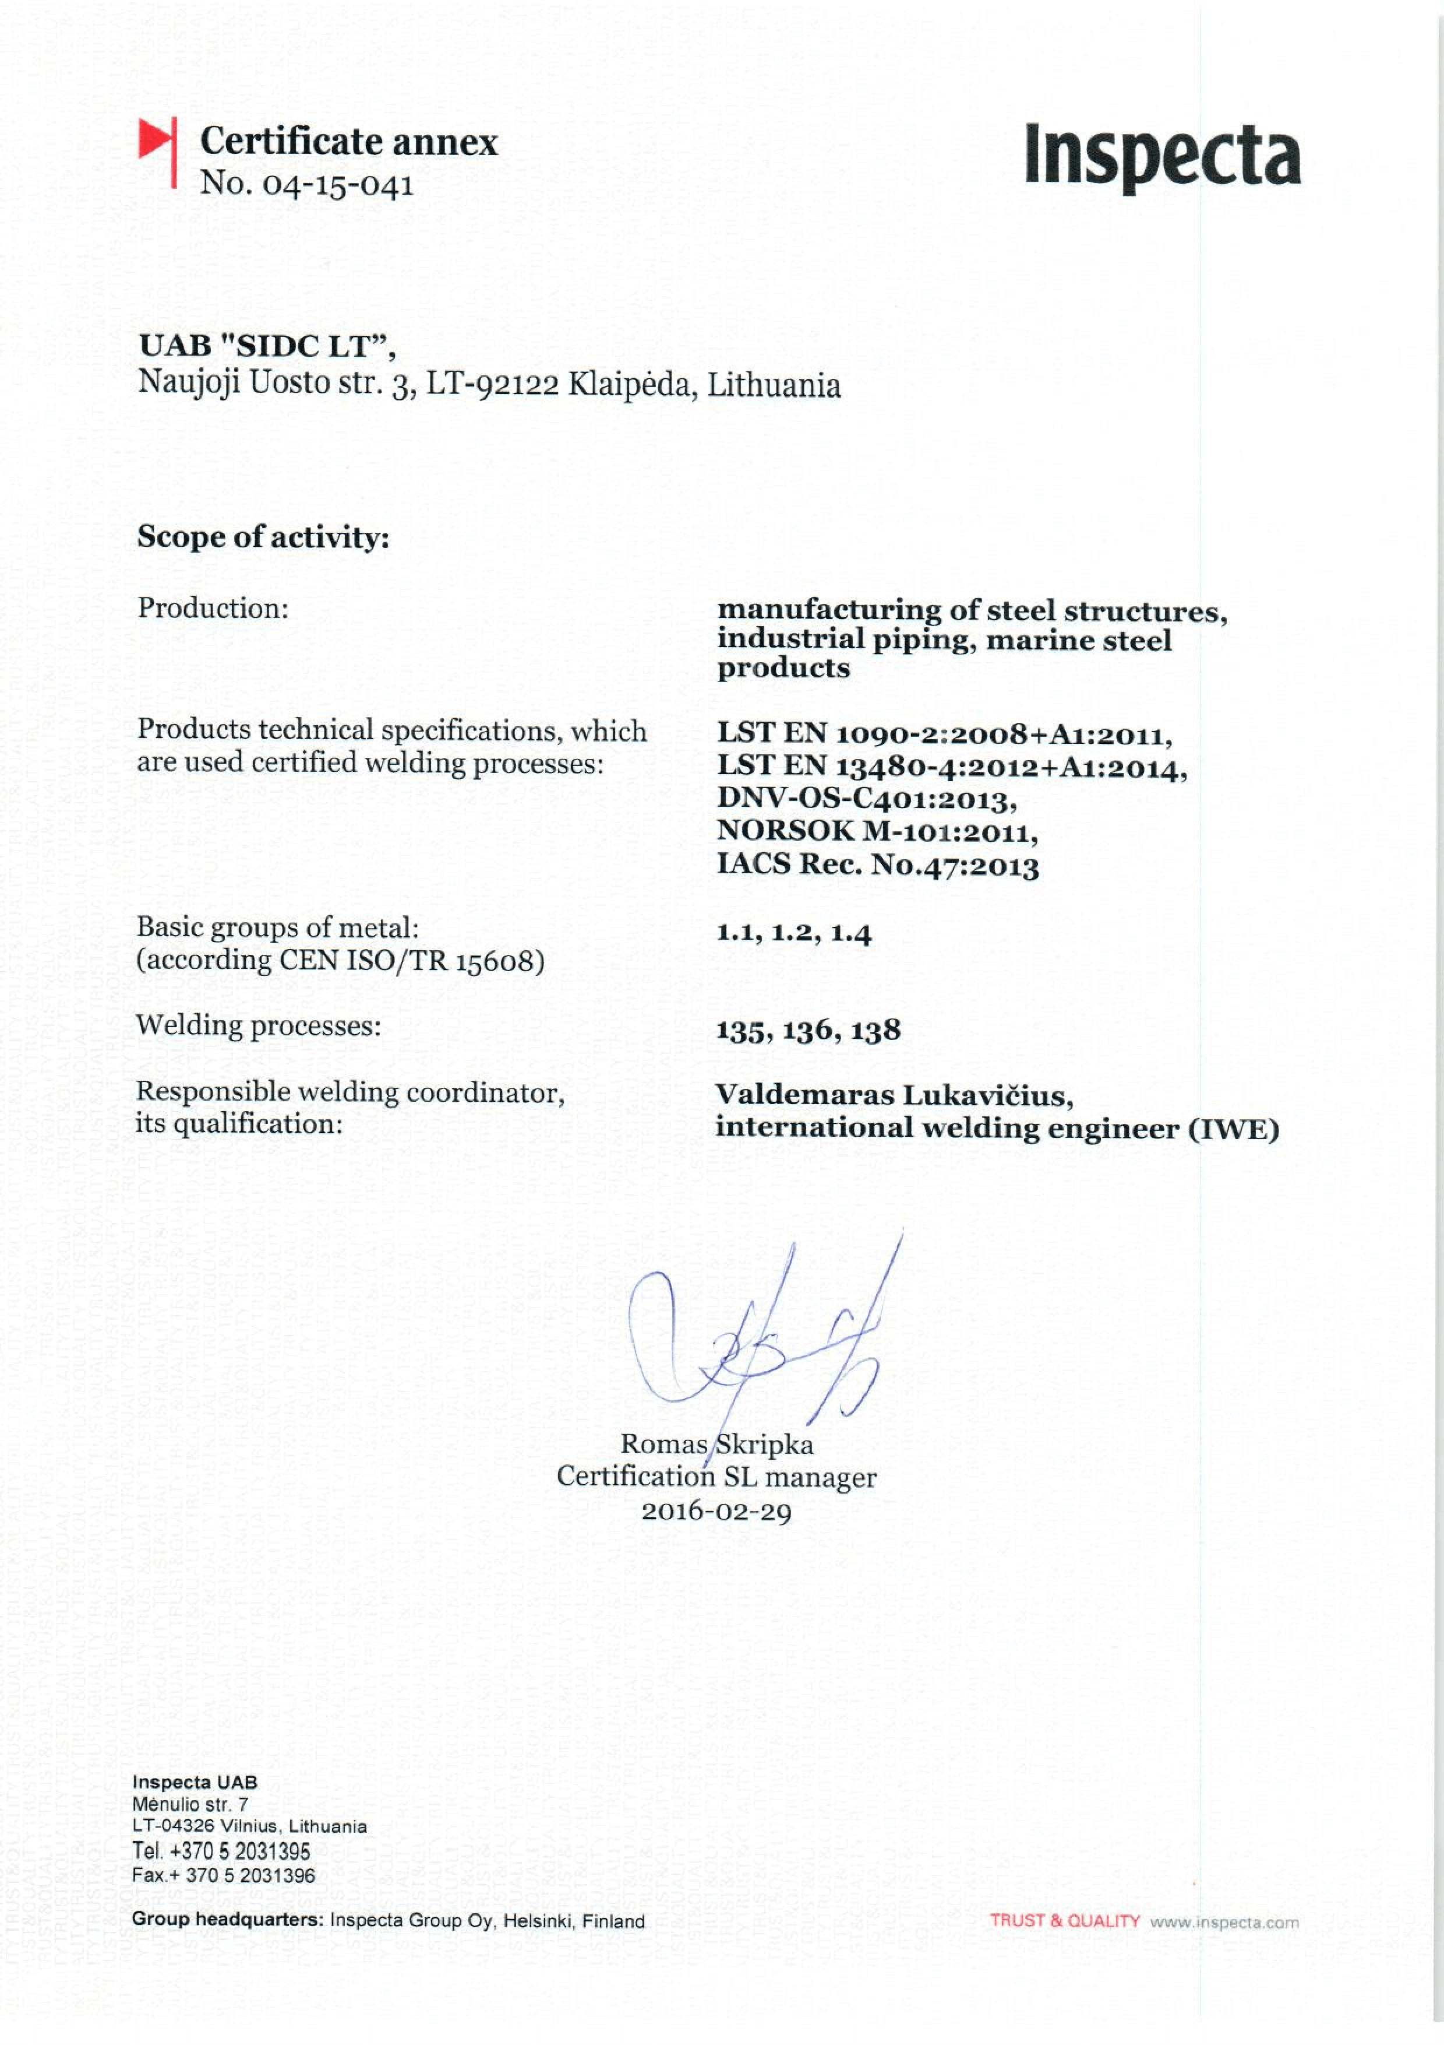
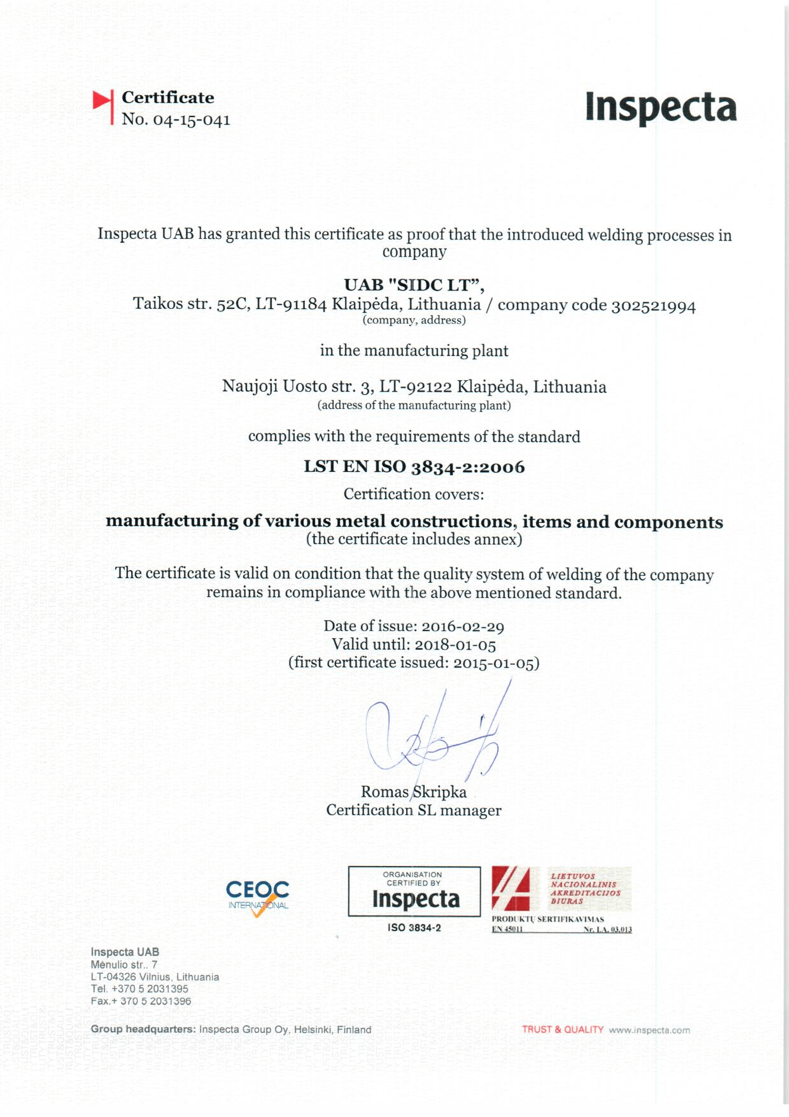
We have EN 1090-1 EXC-4 and EN ISO 3834-2 management system certificates

Slide 23
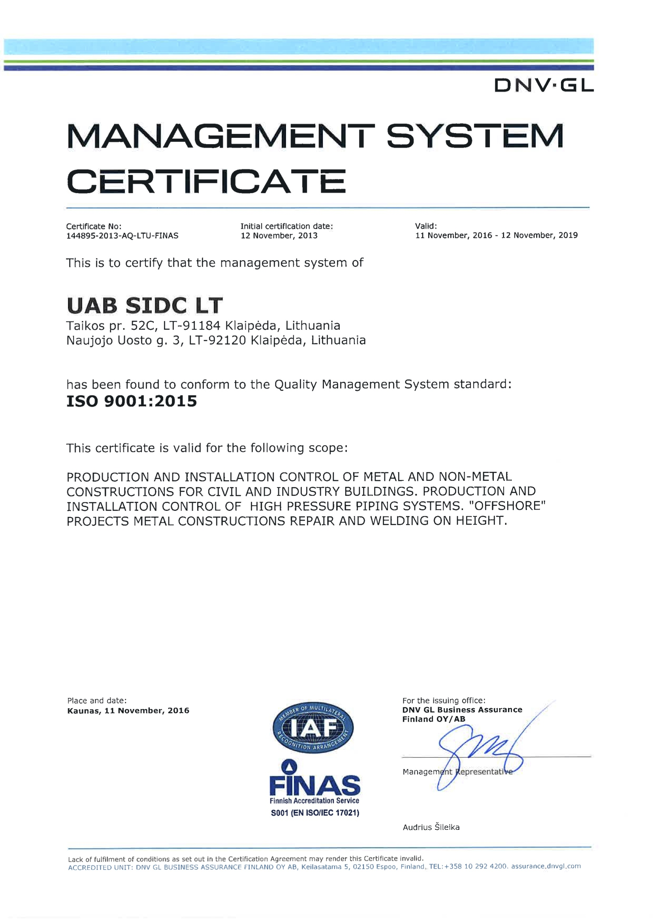
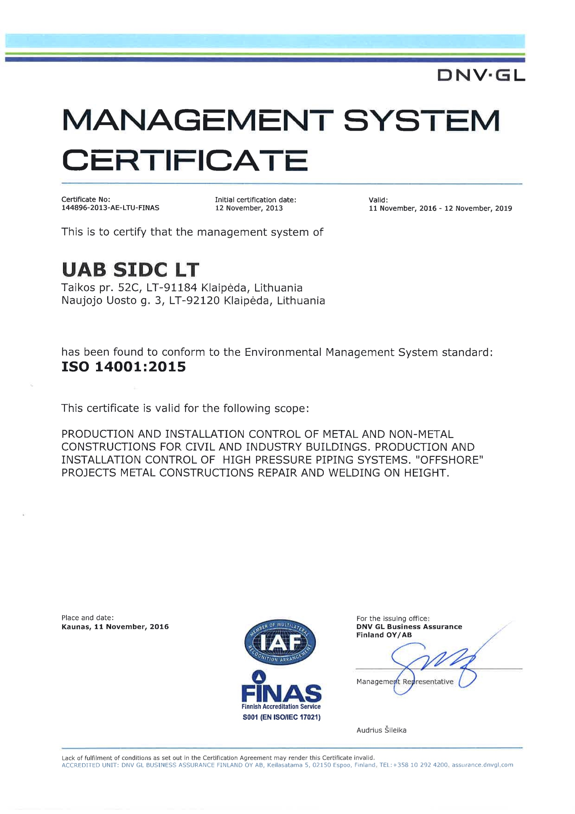
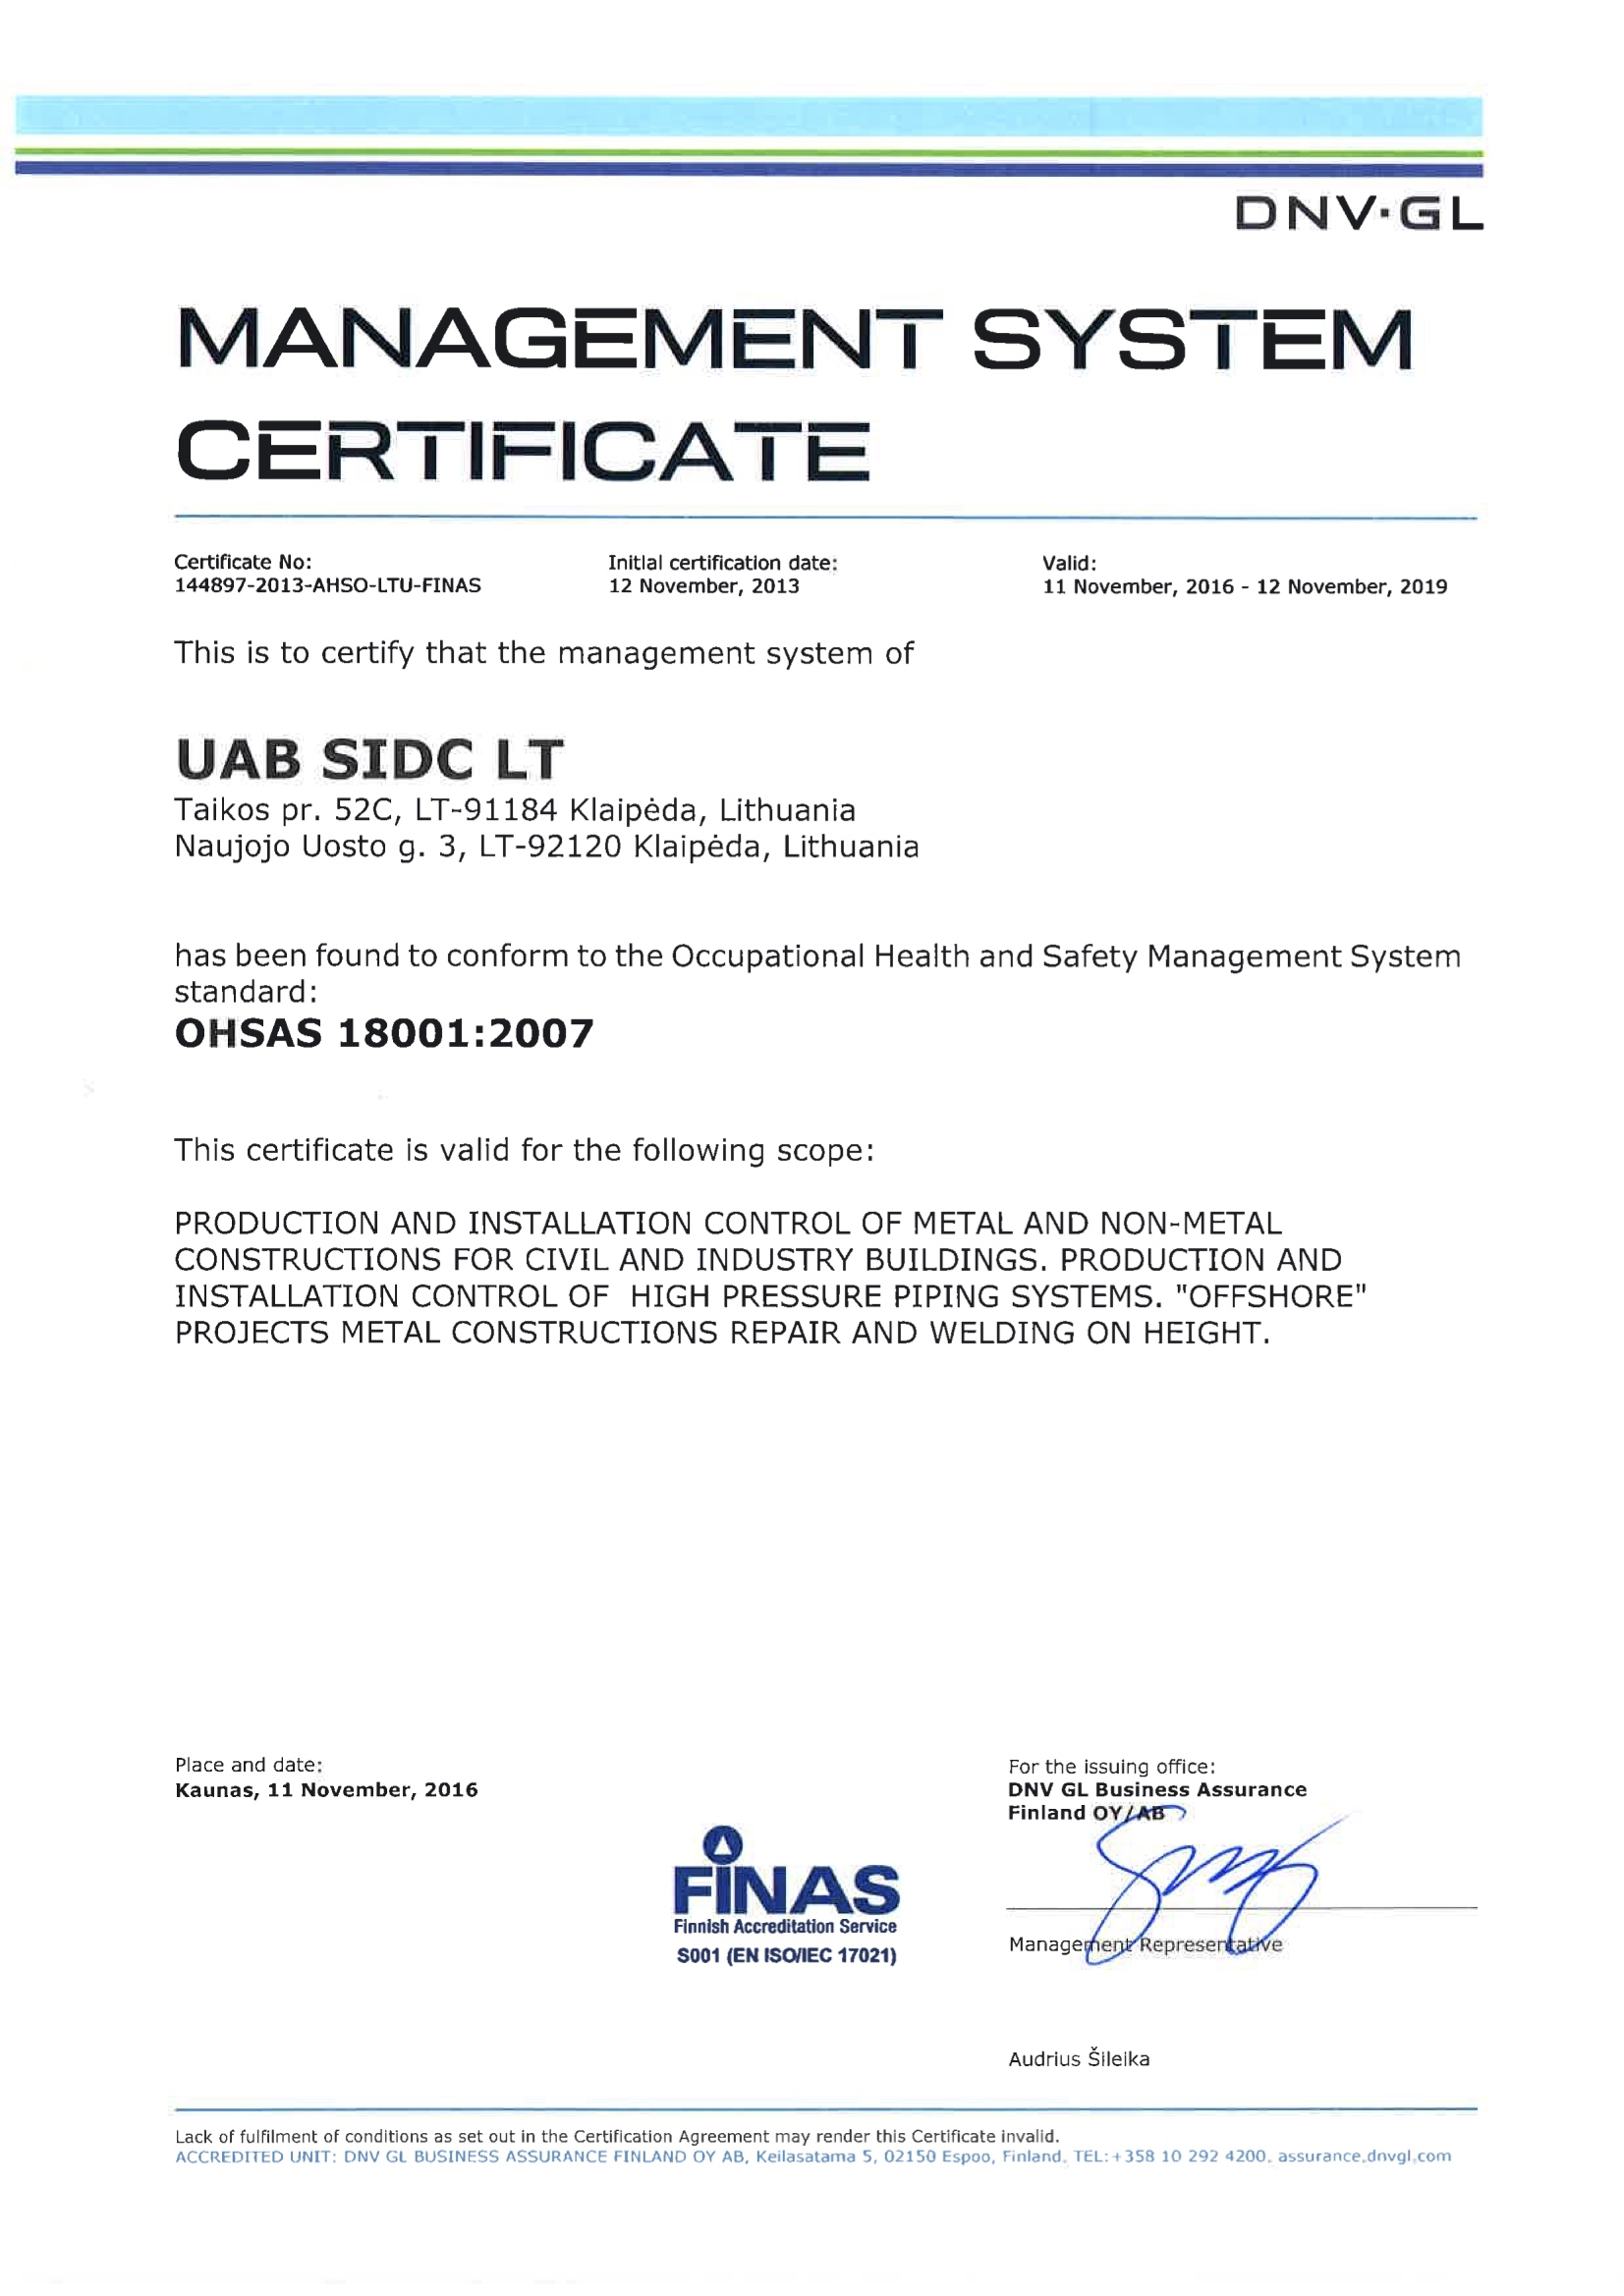
We have ISO 9001, 14001, and 18001 (OHSAS) management system certificates and VCA certificates

Slide 24






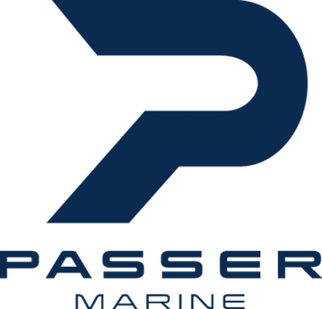

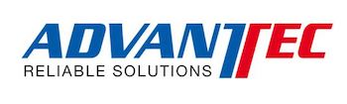



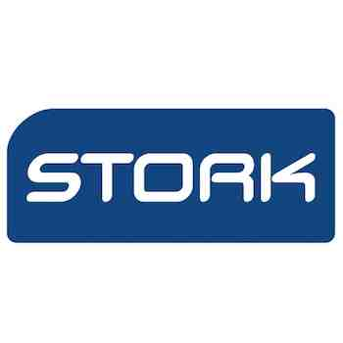










We are pleased to work in projects to

Slide 25

Thank you!
Aivaras Kamas
SIDC LT Director and CEO of SIDC group

Slide 26
SIDC LT, JSC
Company code: 302521994
Vat code: LT100006517214
Address: Taikos ave. 52C,
91184 Klaipeda, Lithuania
Tel. +370 652 51754
Email: info@sidc.eu

