Slide 1



SIDC group of partners
Engineering department

Slide 2

Engineering services
3D model preparations
Steel structure designs
Mechanical equipment designs
Transportation equipment designs
Production line designs
Structural analyses and calculations
Fabrications, shop drawings and plate cutting file preparations
Layout and arrangement drawings
Assembly instructions and presentations
Prototype modelling and visualisations
Piping designs and piping isometric drawings
Engineering consultations

Slide 3
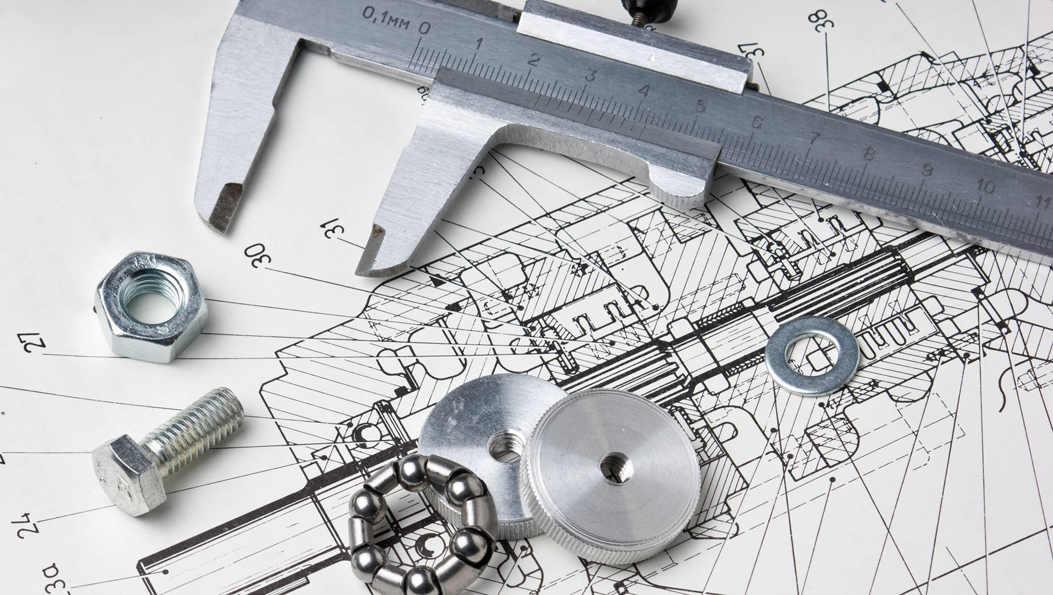
3D model preparations
According to the customer’s needs, any kind of object can be measured and transferred to a 3D environment.

Slide 4
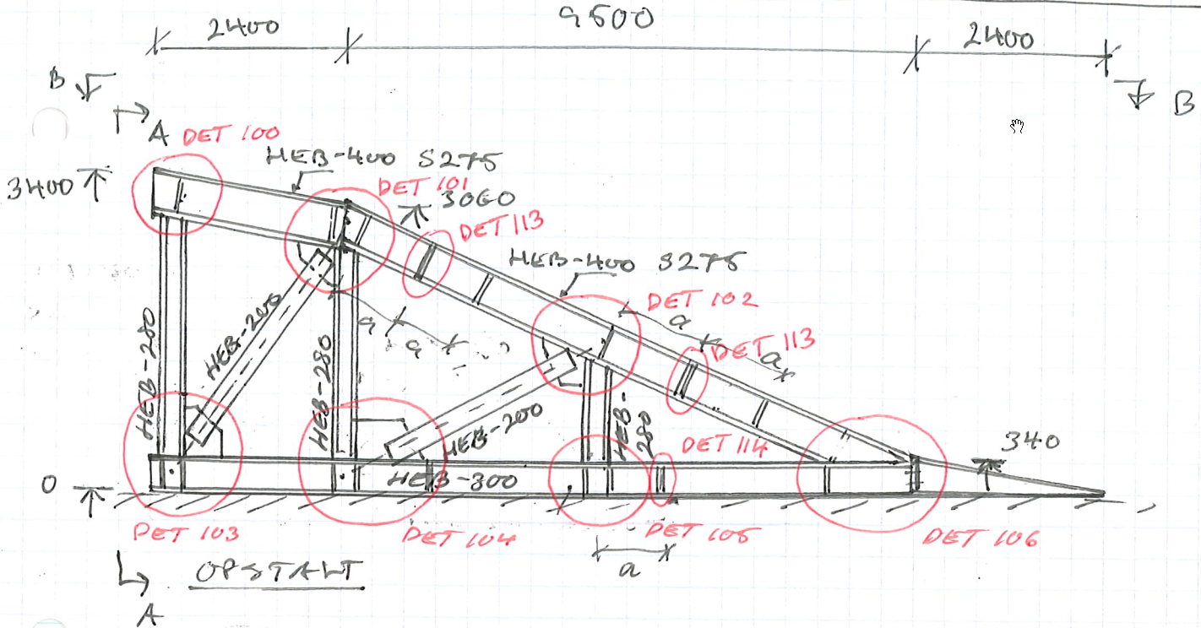
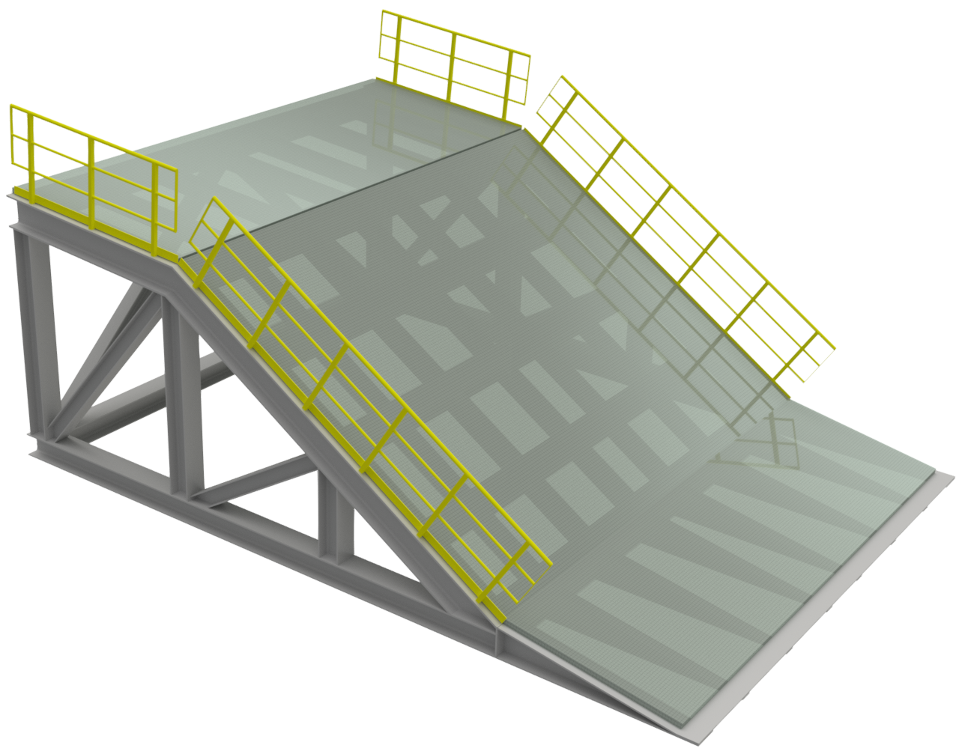
Steel structure designs
We can create steel constructions from a simple idea or sketch.

Slide 5
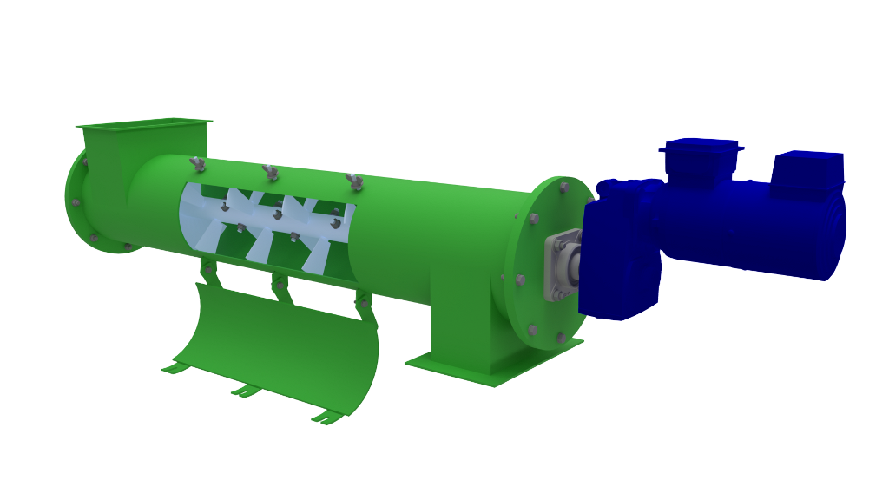
Mechanical equipment designs
We like to deal with any kind of motion in the machines.

Slide 6
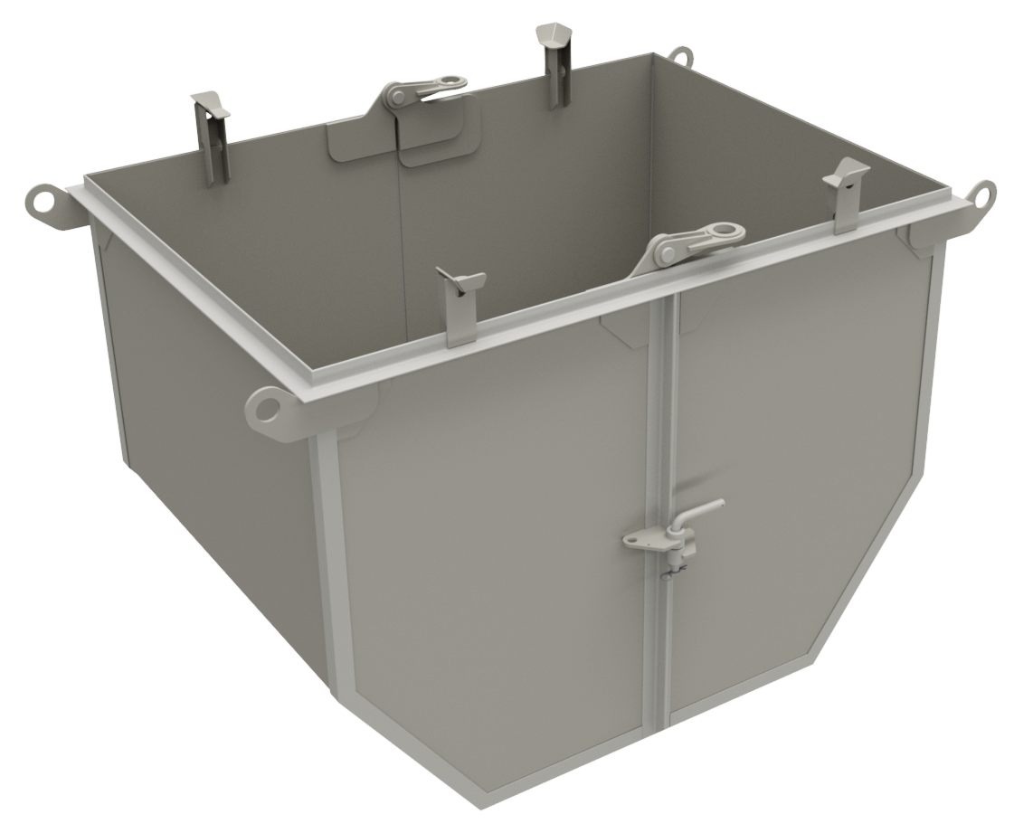
Transportation equipment designs
Full case studies are performed in order to find the best solution for the material transportation.

Slide 7
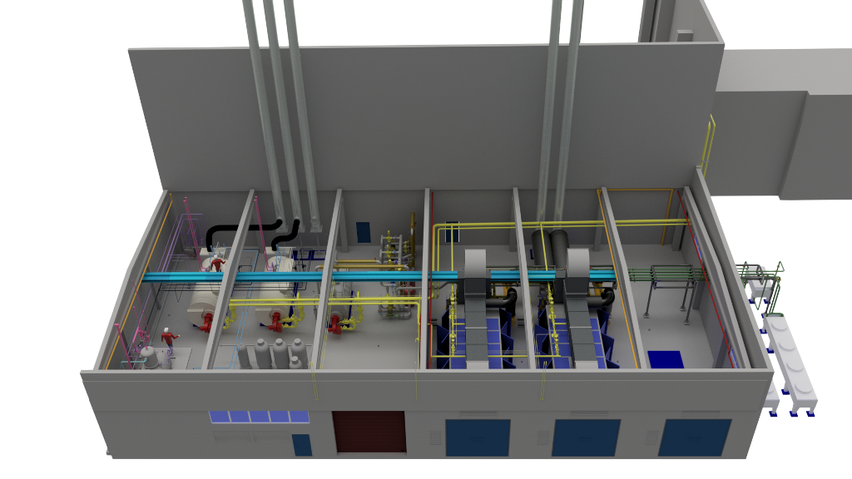
Production line designs
Creating fully detailed models in order to find the best possible layout for production lines or a whole factory.

Slide 8
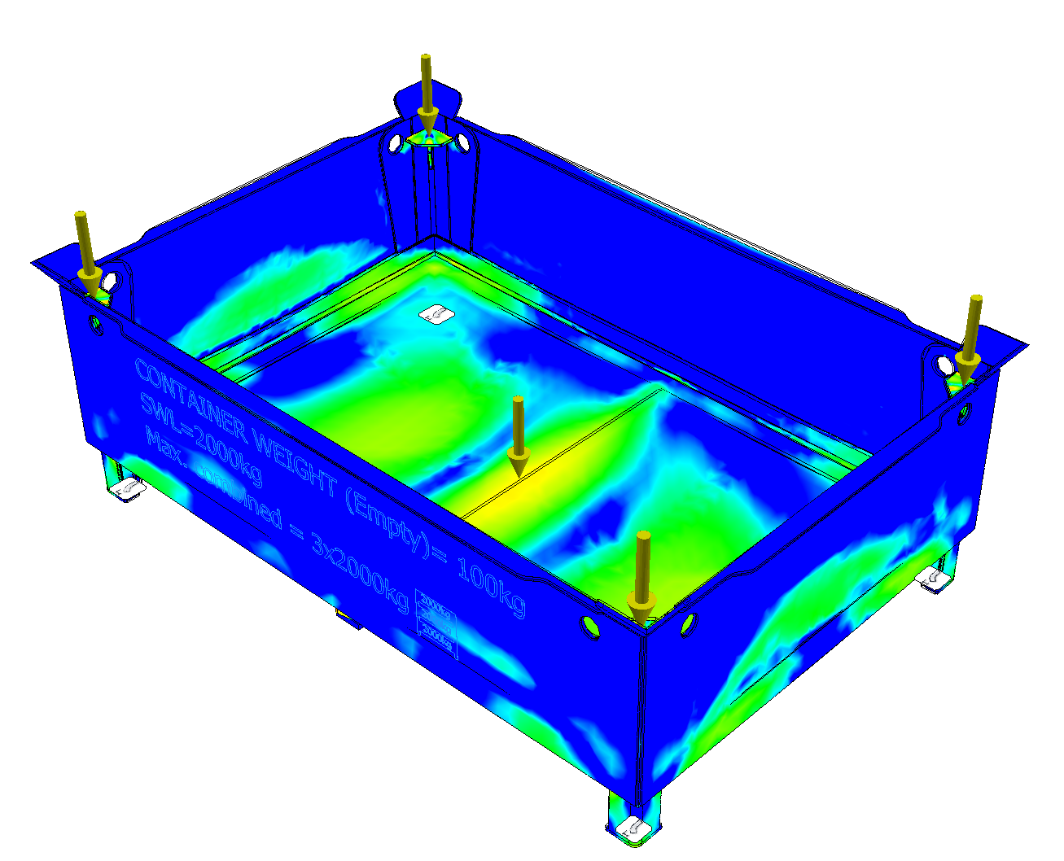
Structural analyses and calculations
With the engineering software we use, we are capable of calculating and analysing steel structures using the FEM – Finite Element Method.

Slide 9
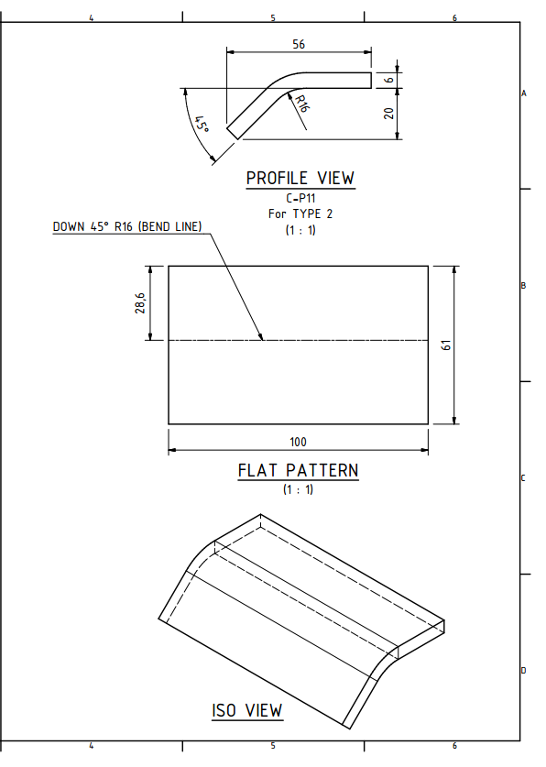
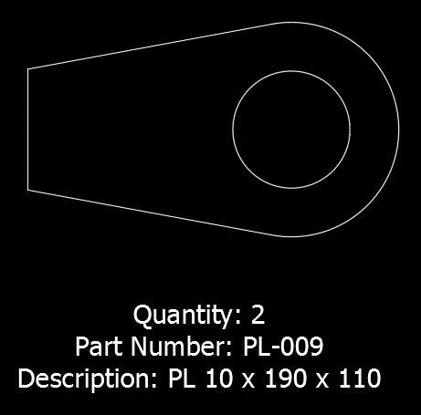
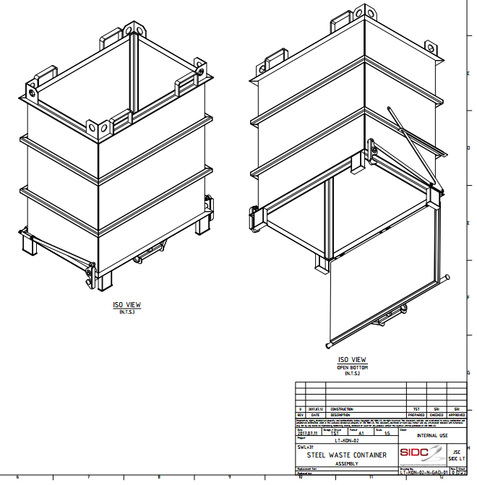
Fabrication, shop drawings and plate cutting file preparation
Very detailed shop drawings and full support for the fabrication.

Slide 10
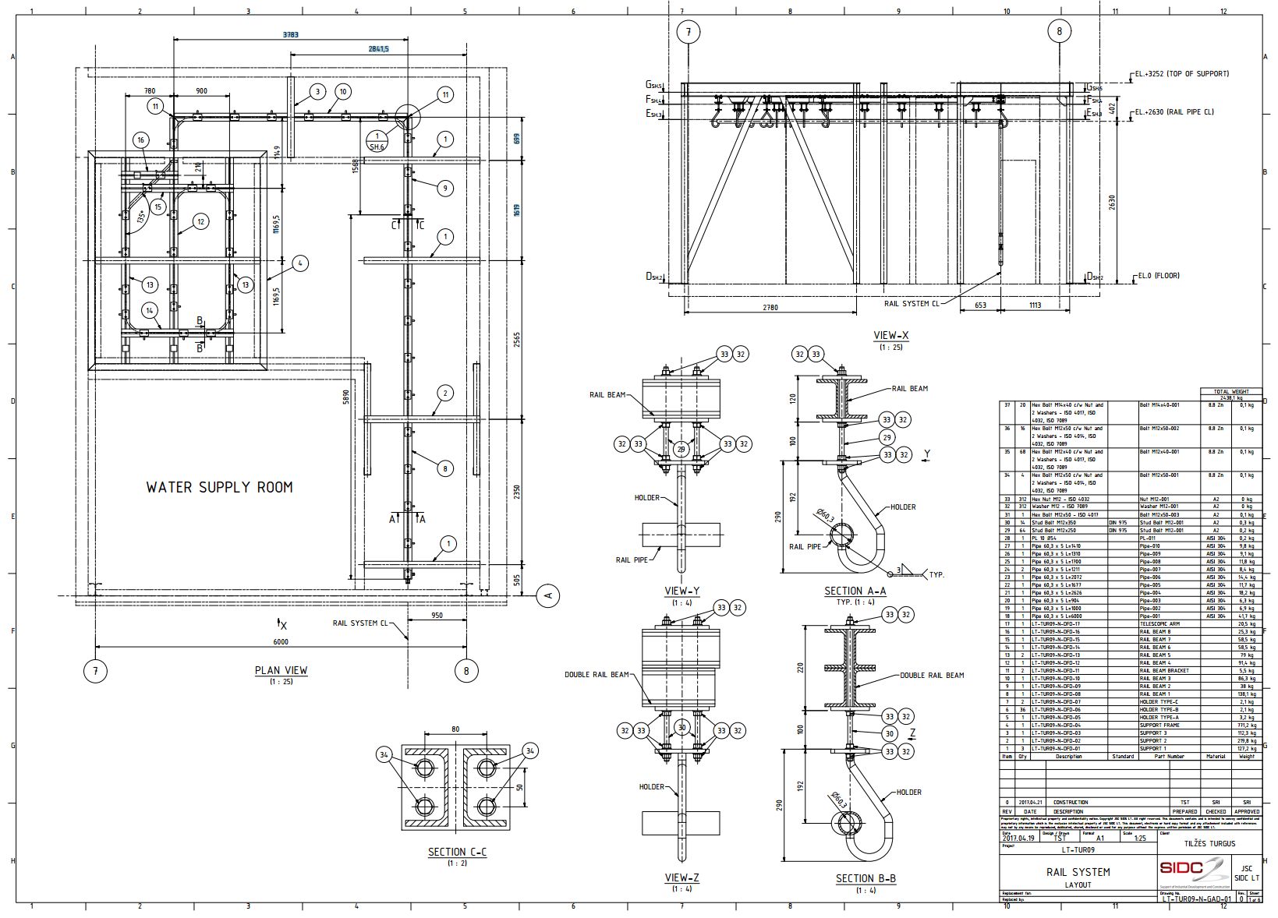
Layout and arrangement drawings
For easy installations or integrations, we always provide layout and arrangement drawings.

Slide 11
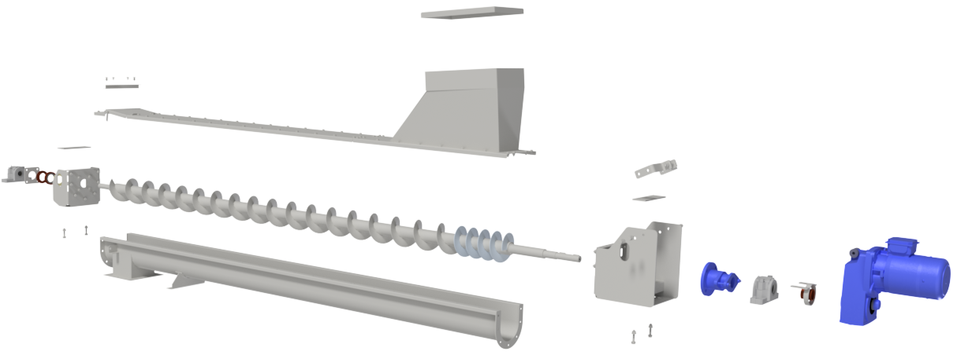
Assembly instructions and presentations
For the quick assembly of products we prepare clear assembly instructions and presentations.

Slide 12
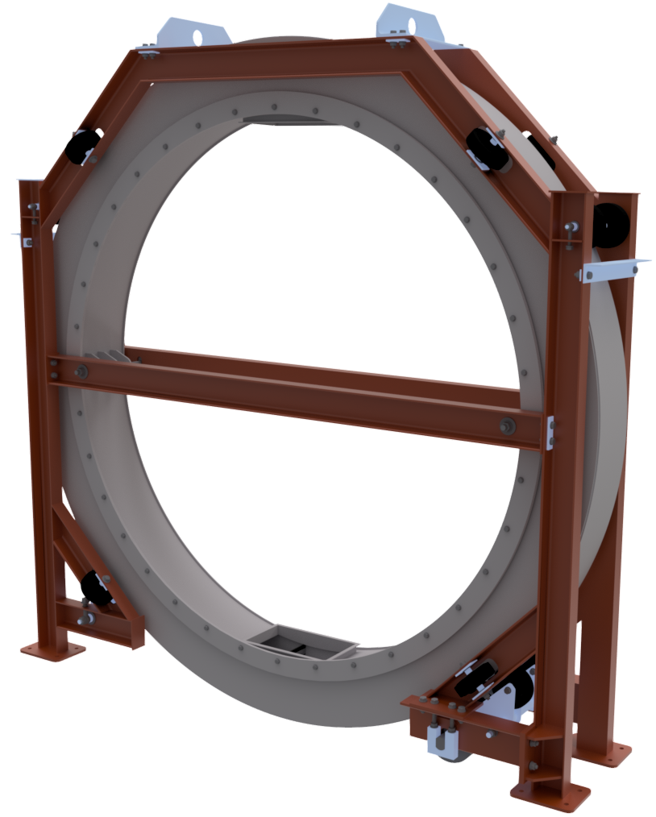
Prototype modelling and visualisations
When product is not completed or is in the engineering stage, then a prototype model can be created and used in the very early stages for marketing purposes. In addition, the visualisation model can be exported to any other 3D file format. A complete visualisation picture package is provided as well.

Slide 13
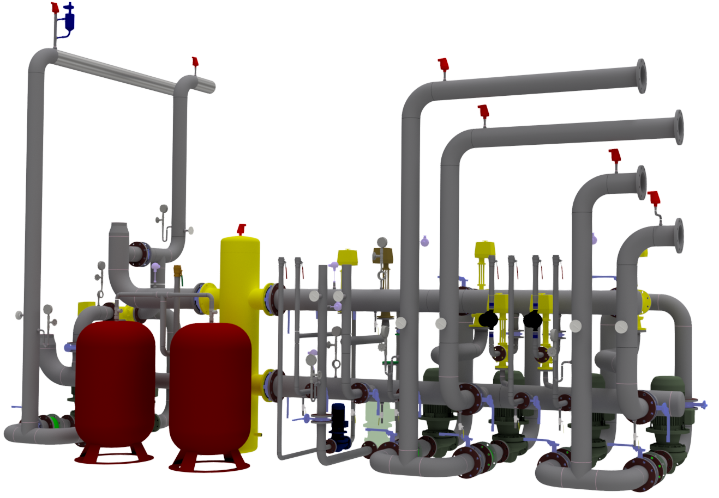
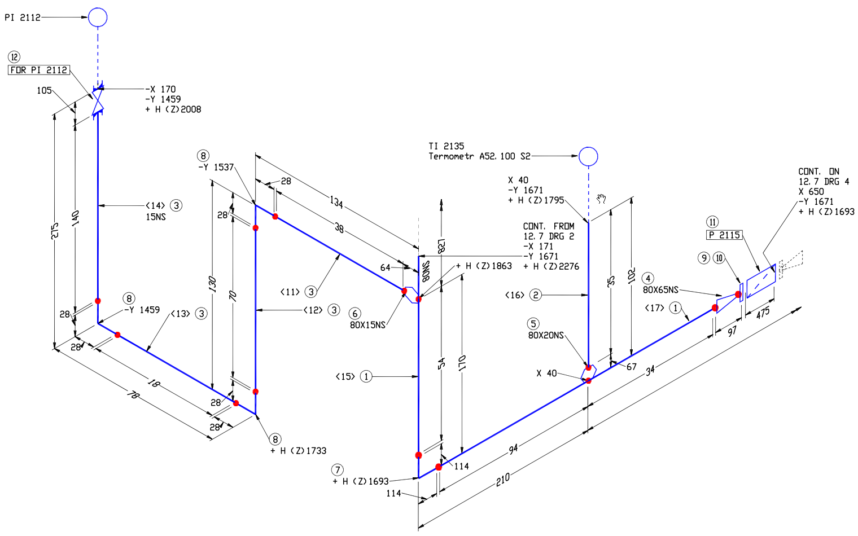
Piping designs and piping isometric drawings
We design pipelines with the machinery and equipment included. In order to fabricate and install pipelines we provide isometric drawings.

Slide 14
Engineering consultations
We enjoy solving any kind of engineering task.
Our engineering team will support you in solving your task.

Slide 15
SIDC LT, JSC
Company code: 302521994
Vat code: LT100006517214
Address: Taikos Ave. 52C,
91184 Klaipeda, Lithuania
Tel.: +370 652 51754
Email: info@sidc.eu

